Slide 1
What is Deep Learning? Why Should I Care?
Vivek Srikumar
School of Computing

Slide 2
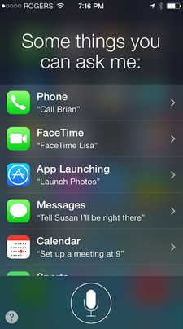


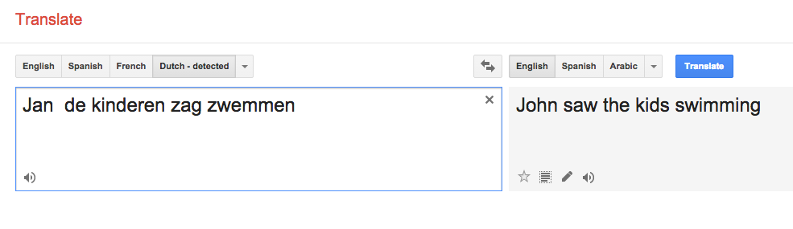
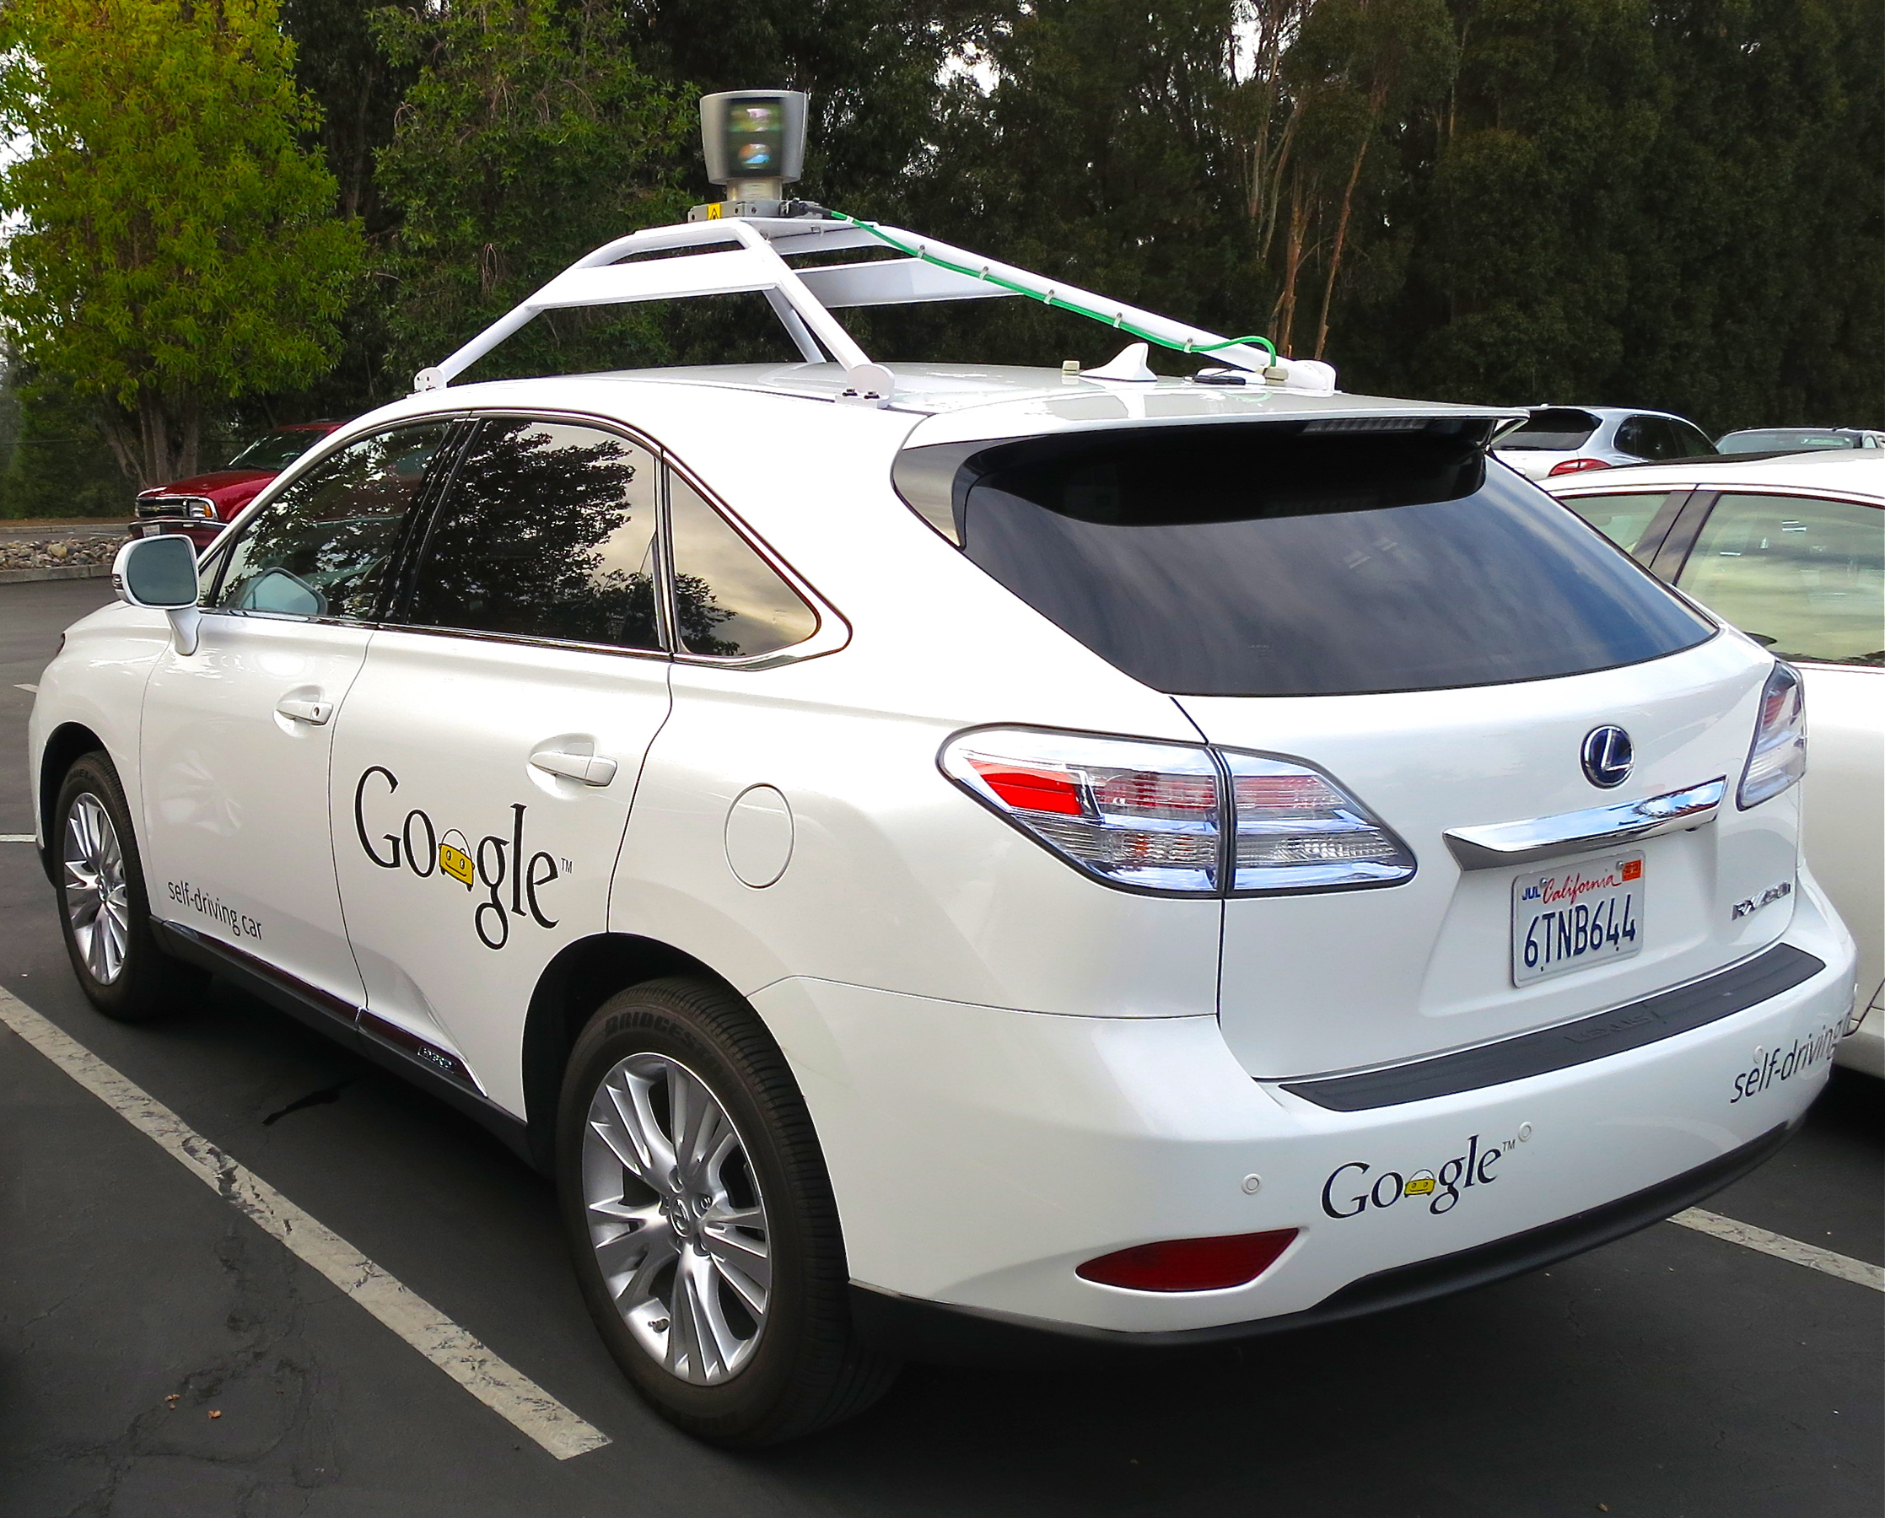
Deep learning is everywhere!
And you are probably already using it

Slide 3
This talk
What are neural networks?
How do we train them?
So, what’s new? Or: What do deep neural networks give us?
A case study: Predicting sequences
Closing thoughts

Slide 4
This talk
What are neural networks?
How do we train them?
So, what’s new? Or: What do deep neural networks give us?
A case study: Predicting sequences
Closing thoughts

Slide 5
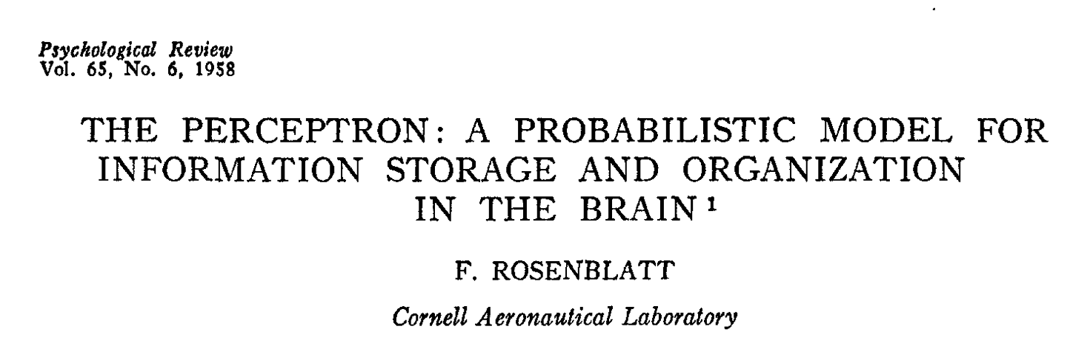
The Perceptron

Slide 6
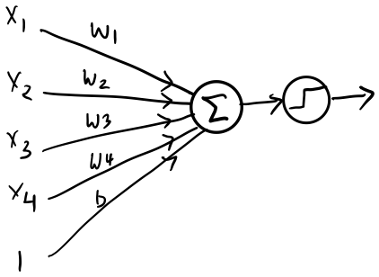
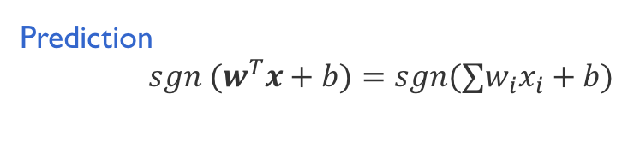

Perceptron = a single layer neural network
Prediction
$sgn {(w}^{T}x+b)=sgn(∑w_{i}x_{i}+b)$
Learning
various algorithms
perceptron, SVM, logistic regression,…
in general, minimize loss
dot
product
threshold
If dot product > 0,
predict true
Otherwise,
predict false
$$∑w_{i}x_{i}+b$$
features
But where do these input features come from?
What if the features were outputs of another classifier?

Slide 7
Features from classifiers

Slide 8
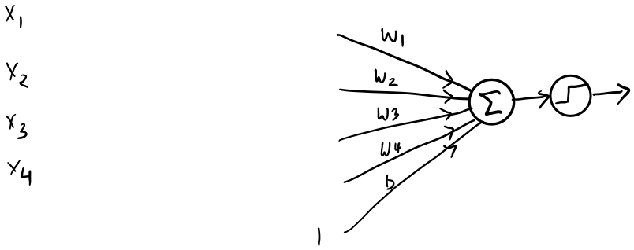
Features from classifiers

Slide 9
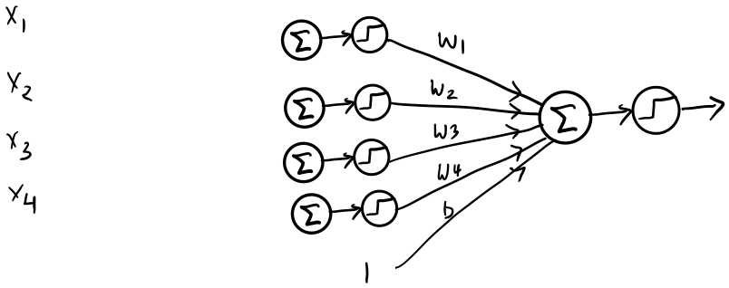
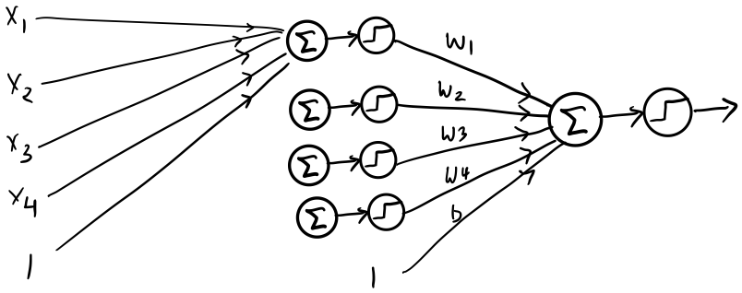
Features from classifiers
Each of these connections have their own weights as well

Slide 10
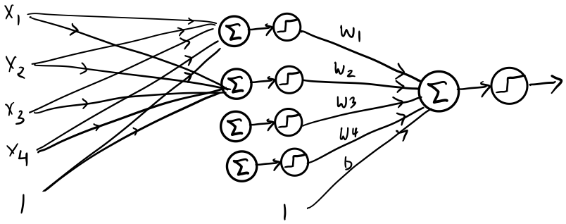
Features from classifiers

Slide 11
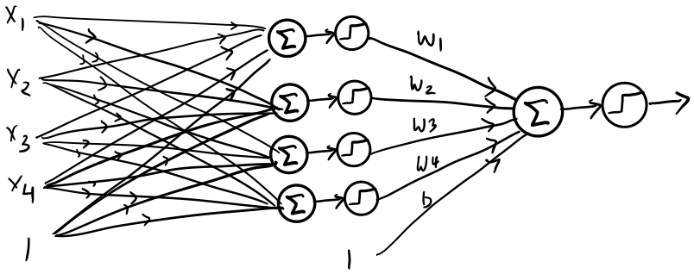
Features from classifiers
This is a two layer feed forward neural network

Slide 12
Features from classifiers
This is a two layer feed forward neural network
The output layer
The input layer
The hidden layer
Think of the hidden layer as learning a good representation of the inputs

Slide 13
Features from classifiers
This is a two layer feed forward neural network
The dot product followed by the threshold constitutes a neuron
Five neurons in this picture (four in hidden layer and one output)

Slide 14
But where do the inputs come from?
The input layer
What if the inputs were the outputs of a classifier?
We can make a three layer network…. And so on.

Slide 15
Let us try to formalize this

Slide 16
Neural networks
A robust approach for approximating real-valued, discrete-valued or vector valued functions
Among the most effective general purpose supervised learning methods currently known
Especially for complex and hard to interpret data such as real-world sensory data
The Backpropagation algorithm for neural networks has been shown successful in many practical problems
handwritten character recognition, speech recognition, object recognition, some NLP problems

Slide 17
Biological neurons
Neurons: core components of brain and the nervous system consisting of
Dendrites that collect information from other neurons
An axon that generates outgoing spikes
The first drawing of a brain cells by Santiago Ramón y Cajal in 1899

Slide 18
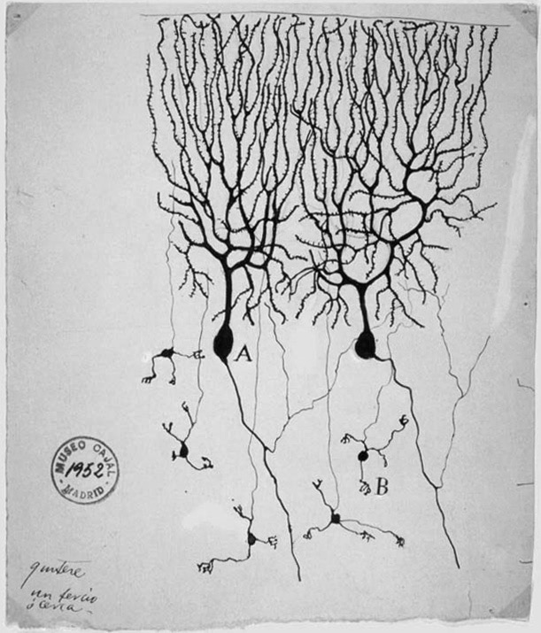
Biological neurons
Neurons: core components of brain and the nervous system consisting of
Dendrites that collect information from other neurons
An axon that generates outgoing spikes
Modern artificial neurons are “inspired” by biological neurons
But there are many, many fundamental differences
Don’t take the similarity seriously
(as also claims in the news about the “emergence” of intelligent behavior)
The first drawing of a brain cells by Santiago Ramón y Cajal in 1899

Slide 19

Artificial neurons
Functions that very loosely mimic a biological neuron
A neuron accepts a collection of inputs (a vector x) and produces an output by:
Applying a dot product with weights w and adding a bias b
Applying a (possibly non-linear) transformation called an activation
$$output=activation(w^{T}x+b)$$
Dot product
Threshold activation
Other activations are possible

Slide 20


A neural network
Output
A function that converts inputs to outputs. Defined as a directed acyclic graph
Nodes organized in layers, correspond to neurons
Edges carry output of one neuron to another, associated with weights
To define a neural network, we need to specify:
The structure of the graph
How many nodes, the connectivity
The activation function on each node
The edge weights
$$w_{ij}^{2}$$
Hidden
$$w_{ij}^{1}$$
Input
Called the architecture of the network
Typically predefined, part of the design of the classifier
Learned from data

Slide 21
What functions do neural networks express?

Slide 22
A single neuron with threshold activation
+
+
+
+
+
+
+
+
-
-
-
-
-
-
-
-
-
-
-
-
-
-
-
-
-
-

Slide 23
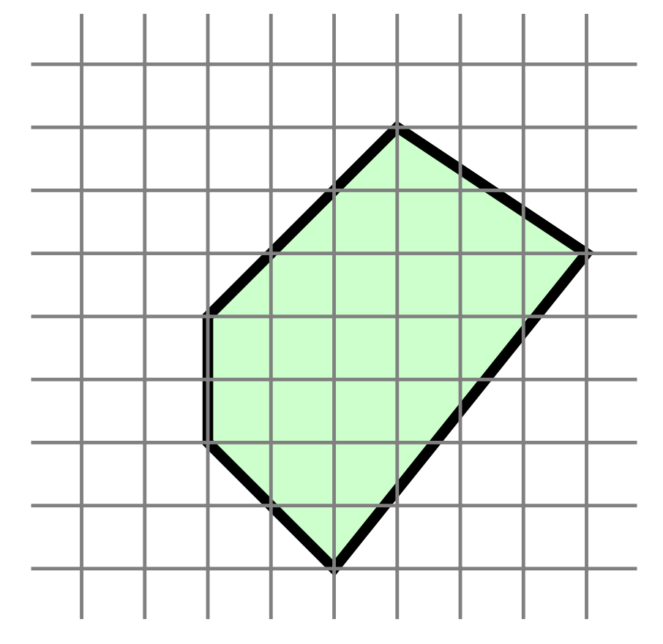
Two layers, with threshold activations
In general, convex polygons
Figure from Shai Shalev-Shwartz and Shai Ben-David, 2014

Slide 24
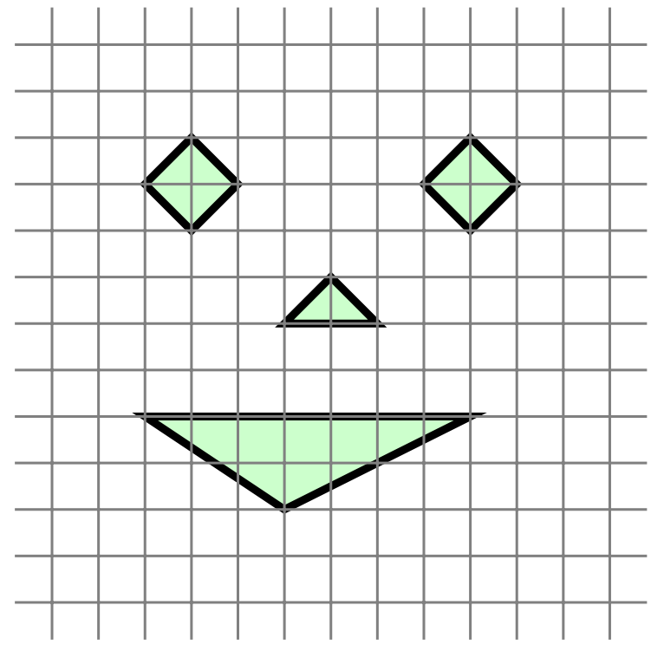
Three layers with threshold activations
In general, unions of convex polygons
Figure from Shai Shalev-Shwartz and Shai Ben-David, 2014

Slide 25
Neural networks are universal function approximators
Any continuous function can be approximated to arbitrary accuracy using one hidden layer of sigmoid units [Cybenko 1989]
Approximation error is insensitive to the choice of activation functions [DasGupta et al 1993]
Two layer threshold networks can express any Boolean function
Open question: The theory of why depth seems to help

Slide 26
Neural networks are prediction machines
Prediction
They encode highly expressive functions
Allow for modular design of classifiers
Think of the neural network as a black box
Focus on what it does, not the how
Neural network
Why? Because neural networks are not arbitrary input-output transducers.
They are differentiable functions of all the parameters
Given a neural network, we can compute its gradients.
This means that we can use learning to handle the how
Input

Slide 27
This talk
What are neural networks?
How do we train them?
So, what’s new? Or: What do deep neural networks give us?
A case study: Predicting sequences
Closing thoughts

Slide 28
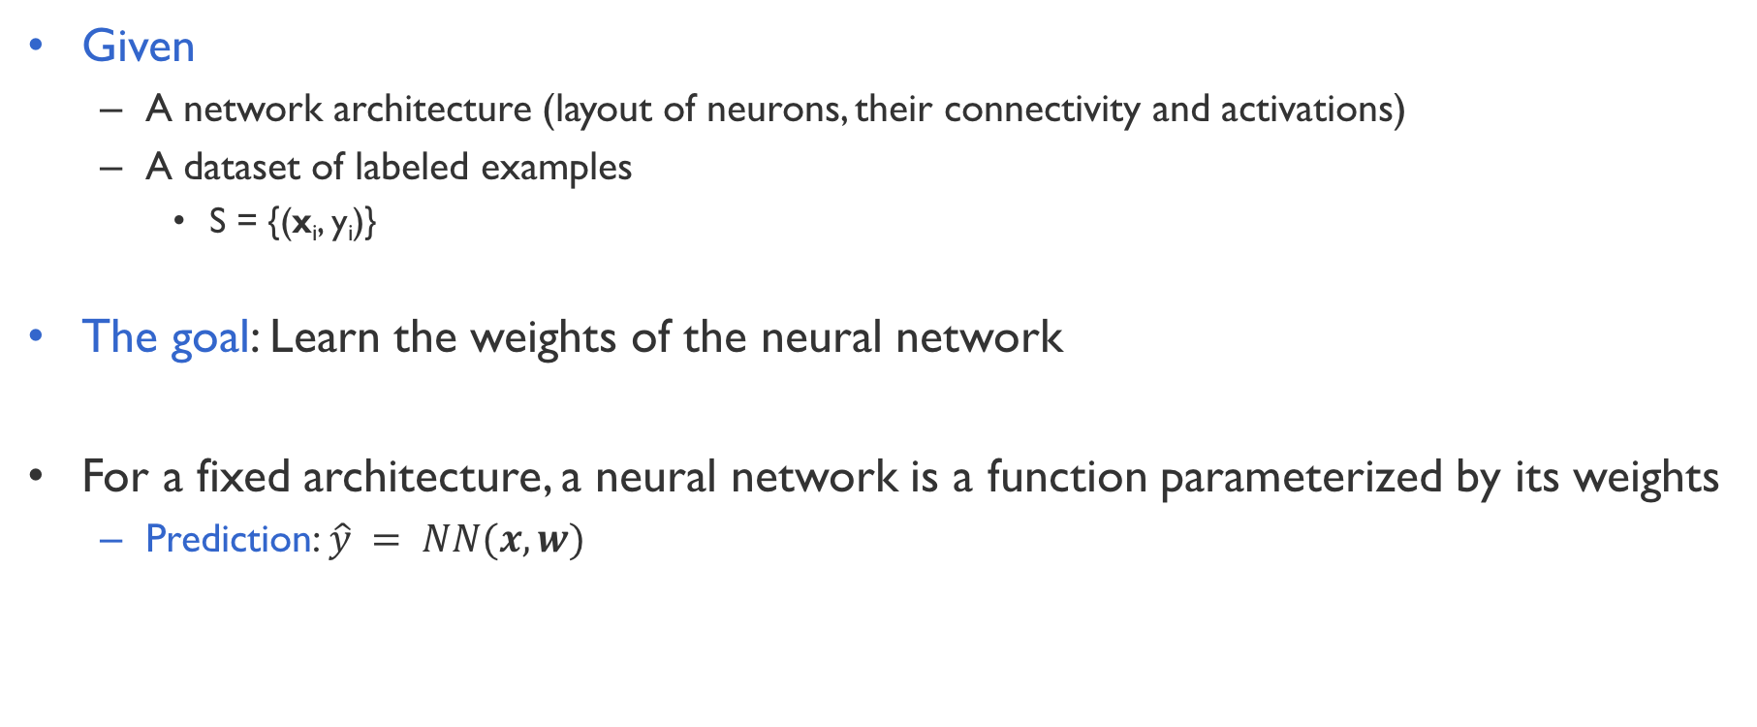
Training a neural network
Given
A network architecture (layout of neurons, their connectivity and activations)
A dataset of labeled examples
S = {(x_{i}, y_{i})}
The goal: Learn the weights of the neural network
For a fixed architecture, a neural network is a function parameterized by its weights
Prediction: $\hat{y} = NN(x, w)$

Slide 29

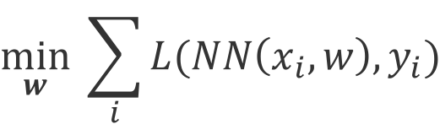
Learning as loss minimization
We have a neural network NN that is completely defined by its weights
Learn the weights by minimizing a penalty for misclassification called the loss $L$
$$\min_{w} \sum_{i}{L(NN\left(x_{i}, w\right), y_{i})}$$
How do we solve the optimization problem?

Slide 30
Learning via optimization
If the neural network is a differentiable function, we can find the gradient
This is decided by the architecture, activation functions and the loss function
Multi-variate calculus 101! ☺
But how do we find the gradient of a more complex function?
Eg: A recent paper used a ~150 layer neural network for image classification!
Not really multi-variate calculus 101! ☹
We need an efficient algorithm: Backpropagation

Slide 31
Mechanizing learning
Backpropagation gives you the gradient that will be used for gradient descent
SGD gives us a generic learning algorithm
Backpropagation is a generic method for computing partial derivatives
A recursive algorithm that proceeds from the top of the network to the bottom
Modern neural network libraries implement automatic differentiation using backpropagation
Allows easy exploration of network architectures
Don’t have to keep deriving the gradients by hand each time

Slide 32
This talk
What are neural networks?
How do we train them?
So, what’s new? Or: What do deep neural networks give us?
A case study: Predicting sequences
Closing thoughts

Slide 33
Neural networks are old news
…been around for decades
Are deep neural networks just about more layers in the network?!

Slide 34
A brief history of neural networks
1943: McCullough and Pitts showed how linear threshold units can compute logical functions
1949: Hebb suggested a learning rule that has some physiological plausibility
1950s: Rosenblatt, the Peceptron algorithm for a single threshold neuron
1969: Minsky and Papert studied the neuron from a geometrical perspective
1980s: Convolutional neural networks (Fukushima, LeCun), the backpropagation algorithm (various)
2003-today: More compute, more data, deeper networks, differentiable compute for end-to-end training
See also: http://people.idsia.ch/~juergen/deep-learning-overview.html

Slide 35
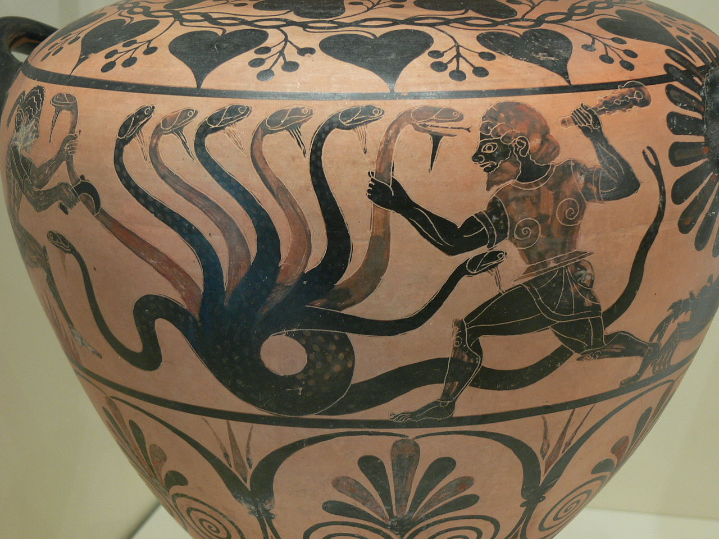
“Deep learning” is a combination of many ideas
Highly expressive functions
Coupled with creative architecture design
Better understanding of capacity control of classifiers
Learning only expressive functions is not enough
Need to control expressiveness to avoid overfitting
End-to-end training of differentiable functions
Possible because of advances in optimization
Better understanding of how to design representations
Better infrastructure support for running large experiments
Hardware: GPUs, software: TensorFlow, Torch, etc
Ability to get large datasets
Caeretan black-figure hydria (c. 346 BC)

Slide 36
Deep learning: Some important ideas stand out
Neural networks for scoring outputs
Non-linear scoring functions
Much wider design space
Distributed representations
Learned vector valued representations can coalesce superficially distinct objects
Eg: “cat” and “feline” share overlap in meaning, but
Differentiable compute

Slide 37
Why Distributed Representations
Think about feature representations
Cat
Dog
Tiger
Table
These vectors do not capture inherent similarities
Distances or dot products are all equal

Slide 38
Why Distributed Representations
Think about feature representations
Cat
Dog
Tiger
Table
Dense vector (often lower dimensional) representations can capture similarities better

Slide 39
End-to-end differentiable compute
Machine learning is the future
Gives a system the ability to perform a task in a situation which has never been encountered before
New way to think about programming
Learning allows programs to interact more robustly with messy data
Differentiable compute enables this vision
Mostly a change in how we see machine learning
All we need is to design the program structure
Because it is differentiable, we can use backpropagation to train it with data

Slide 40
Several specialized architectures tailored for various applications
If your inputs are images or videos:
Use convolutional neural networks to learn good features
Use another neural network on top of these features to do what you want
If your input is a sequence (like text):
Use a recurrent neural network to learn good features by encoding the sequence
Use another neural network on top of these features to do what you want
If your output is a single prediction (a number, or a label):
Use a simple multilayer neural network for prediction
If your output is a sequence (like text):
Use a recurrent neural network to produce the sequence

Slide 41
This talk
What are neural networks?
How do we train them?
So, what’s new? Or: What do deep neural networks give us?
A case study: Predicting sequences
Closing thoughts

Slide 42
Predicting sequences
An example of how we can use neural networks to build complex predictors
Some good online resources:
https://karpathy.github.io/2015/05/21/rnn-effectiveness/
https://colah.github.io/posts/2015-08-Understanding-LSTMs/

Slide 43
Neural networks are prediction machines
Prediction
We can assign labels to inputs
Neural network
Input
cat
burrito
But what if the label to an input depends on a previous state of the network?
Vanilla neural networks
Do not have persistent memory
Can not deal with varying sized inputs

Slide 44
Sequential prediction: Examples
Language models: “It was a dark and stormy _______”
Constructing sentences automatically requires us to remember what we constructed before
Speech recognition
Convert a sequence of audio signals to words
The word at time t may depend on what word was predicted at time (t-1)
Event extraction from movies
Watch a movie and predict what events are happening
The events at a particular scene probably depends on both the video signal and the events that were predicted in the previous scene
….. Many more examples

Slide 45
Recurrent Neural Networks: Networks with “loops”
Sequential output
The same template is repeated over time
Sequential input
Recurrent connections

Slide 46
Various configurations possible
Vanilla networks
Sequence output (eg: image captioning)
Sequence input (eg: sentiment analysis)
Seq2seq (eg: translation)

Slide 47
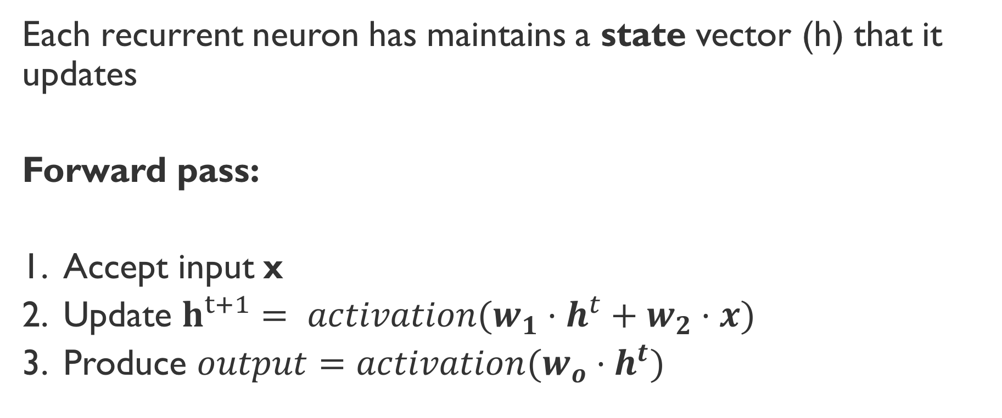
Insides of an RNN
Each recurrent neuron has maintains a state vector (h) that it updates
Forward pass:
Accept input x
Update $h^{t+1}= activation(w_{1}⋅h^{t}+w_{2}⋅x)$
Produce $output=activation(w_{o}⋅h^{t})$

Slide 48
An example: Character level language model

Slide 49
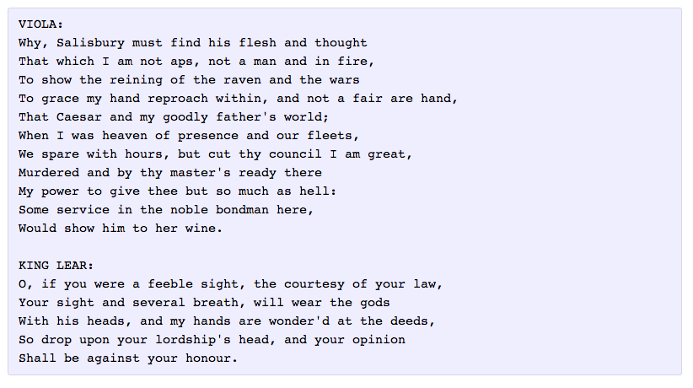
Examples: Generating Shakespeare
A three layer RNN, 512 hidden nodes in each layer
Millions of parameters
https://karpathy.github.io/2015/05/21/rnn-effectiveness/

Slide 50

Examples: Generating Audio
https://highnoongmt.wordpress.com/2015/05/22/lisls-stis-recurrent-neural-networks-for-folk-music-generation/

Slide 51
Predicting sequences
LSTMs are a fundamental unit of recurrent neural networks
Essential component of sequence-to-sequence models
Massive in terms of the number of parameters
The Google neural language model has billions of parameters
Several variants exist, but all have a similar flavor

Slide 52
This talk
What are neural networks?
How do we train them?
So, what’s new? Or: What do deep neural networks give us?
A case study: Predicting sequences
Closing thoughts

Slide 53
Deep neural networks: Is everything solved?
Neural networks combine expressive scoring functions with distributed input representations
Several open questions still remain. Some examples:
Why do they seem to work so well?!!
How do we incorporate output dependencies between vector valued representations?
Structures offer a clean approach for modeling compositionality. How do we compose distributed representations that are scored with neural networks?
Incorporating inference and domain knowledge within neural networks. Perhaps to guide training or for improved predictions?

Slide 54
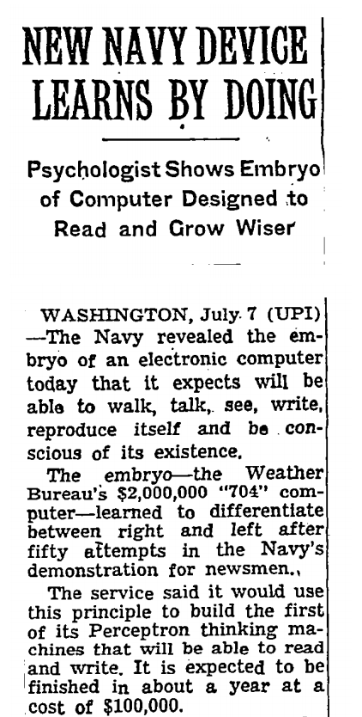
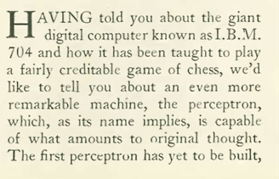
The hype
The New Yorker, December 6, 1958 P. 44
The New York Times, July 8 1958
The IBM 704 computer

Slide 55
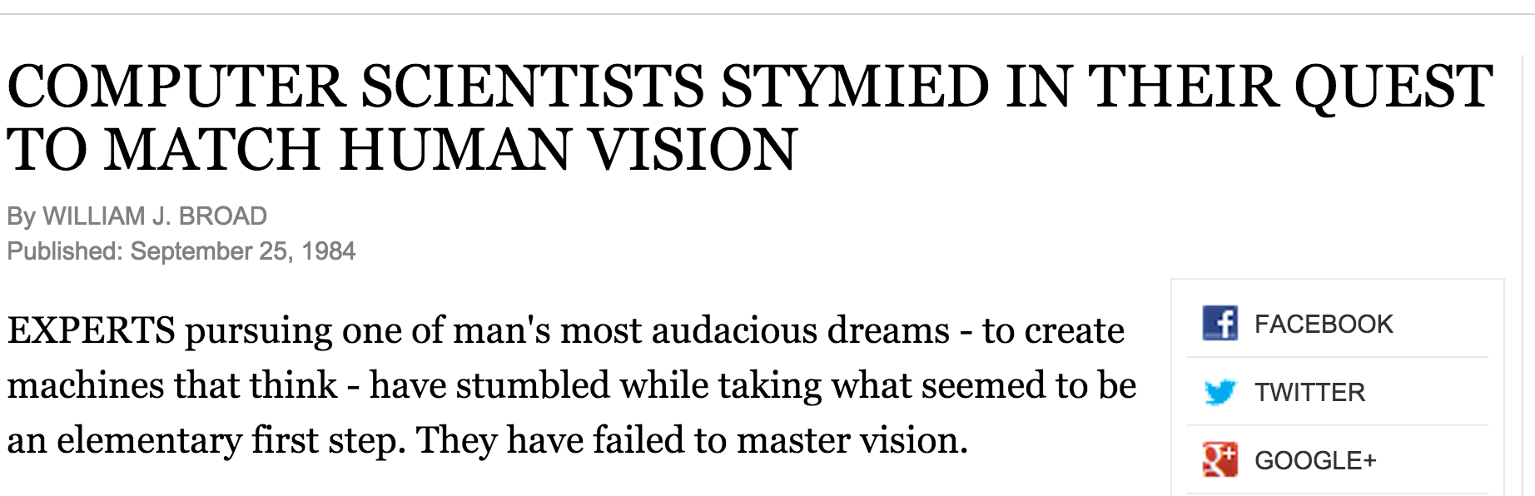
NYT, September 25, 1984

Slide 56
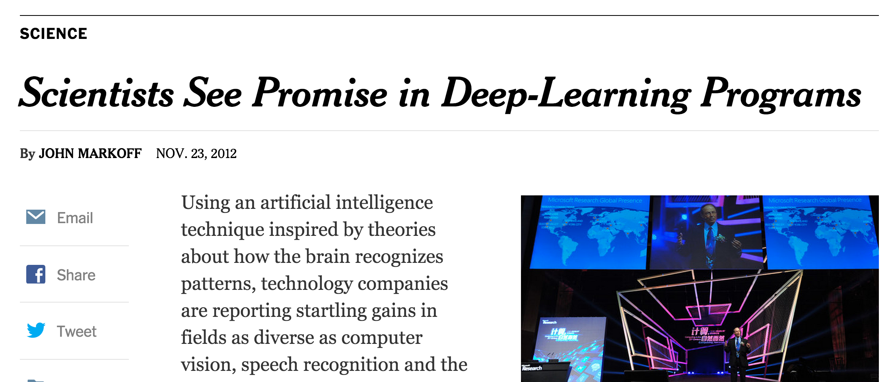

Slide 57
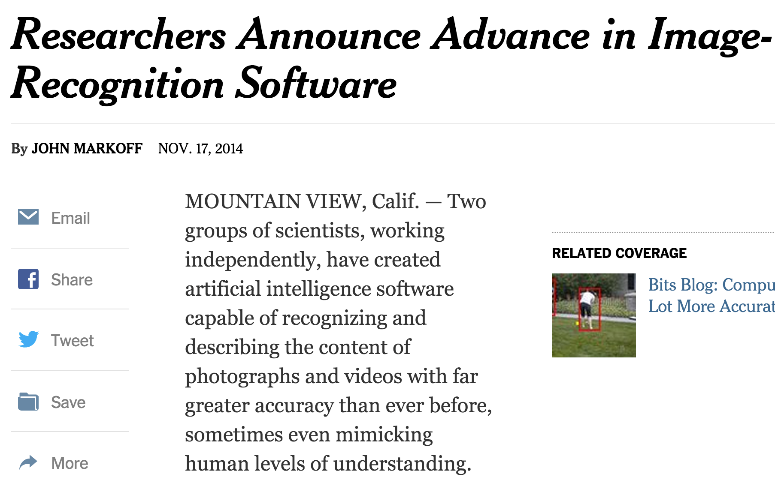

Slide 58

“…AI "died" about four times in five decades because of hype: people made wild claims (often to impress potential investors or funding agencies) and could not deliver. Backlash ensued. It happened twice with neural nets already: once in the late 60's and again in the mid-90's.
Don't let it happen again. Beware of hype…”

Slide 59
Something interesting is going on

Slide 60
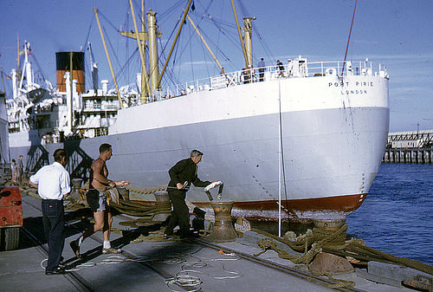
several people are on a dock in the water .

Slide 61
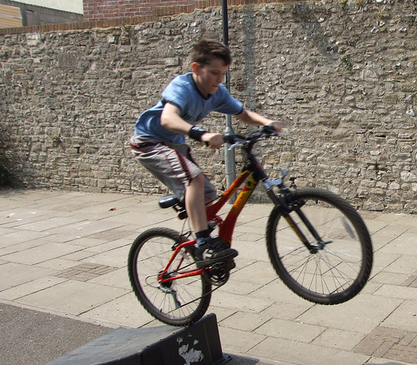
a man riding a bike .

Slide 62
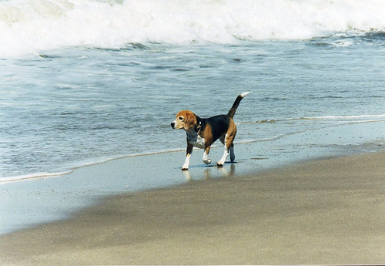
a dog running on a wet suit on the beach .

Slide 63
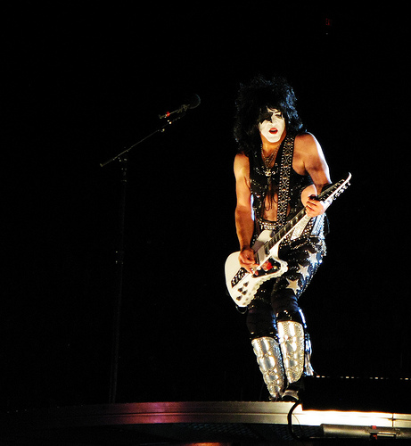
a woman is performing a guitar and singing into a microphone .

Slide 64
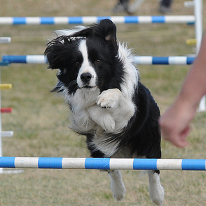
"black and white dog jumps over bar."

Slide 65

"a young boy is holding a baseball bat."

