Slide 1
What Logic can Teach Neural Networks:
Case Studies in Language
Vivek Srikumar
Joint work with Tao Li, Vivek Gupta and Maitrey Mehta.

Slide 2
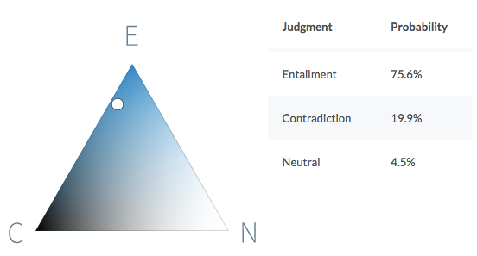
Neural networks can understand text!
Premise
Before moving its headquarters to Chicago, aerospace manufacturer Boeing was the largest company based in Seattle.
Hypothesis
Boeing is a Chicago-based aerospace manufacturer.
It is quite likely that the premise entails the hypothesis.
https://demo.allennlp.org/textual-entailment/

Slide 3
Can neural networks understand text?
P John is on a train to Berlin.
H John is traveling to Berlin.
Z John is having lunch in Berlin.
If a system predicts that
P entails H.
H contradicts Z.
But, there is no correlation between the P and Z.
Violates this invariant
If P entails H and H contradicts Z,
then P contradicts Z
A BERT-based model that gets 90% on SNLI violates this invariant on 46% of a large collection of (P, H, Z)

Slide 4
Can neural networks understand text?
P John is on a train to Berlin.
H John is traveling to Berlin.
Z John is having lunch in Berlin.
If P entails H and H contradicts Z,
then P contradicts Z
Can today’s neural networks use such “advice”?

Slide 5
A reading comprehension example
….Gaius Julius Caesar, Roman general, statesman and notable author of Latin prose, ….
Question: Which Roman general is known for writing prose?
Suppose we know that
If words are related, then model should align them.
Can today’s neural networks use such advice?

Slide 6
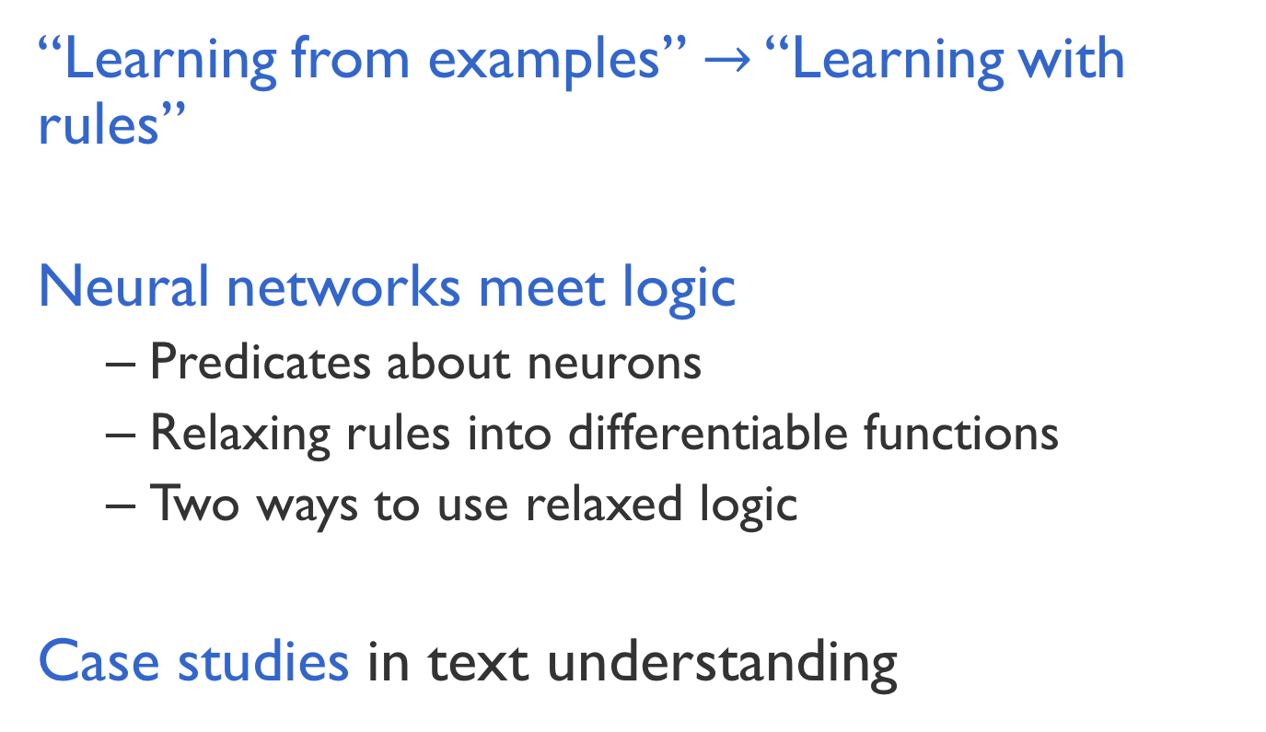
This talk
“Learning from examples” $→$ “Learning with rules”
Neural networks meet logic
  Predicates about neurons
  Relaxing rules into differentiable functions
  Two ways to use relaxed logic
Case studies in text understanding

Slide 7

Learning from examples $→$ Learning with rules

Slide 8
Neural networks sans large datasets?
Neural networks are great, but are data hungry
What if we do not have the luxury of massive datasets,…
…but we do have domain knowledge about the problem in the form of rules.

Slide 9
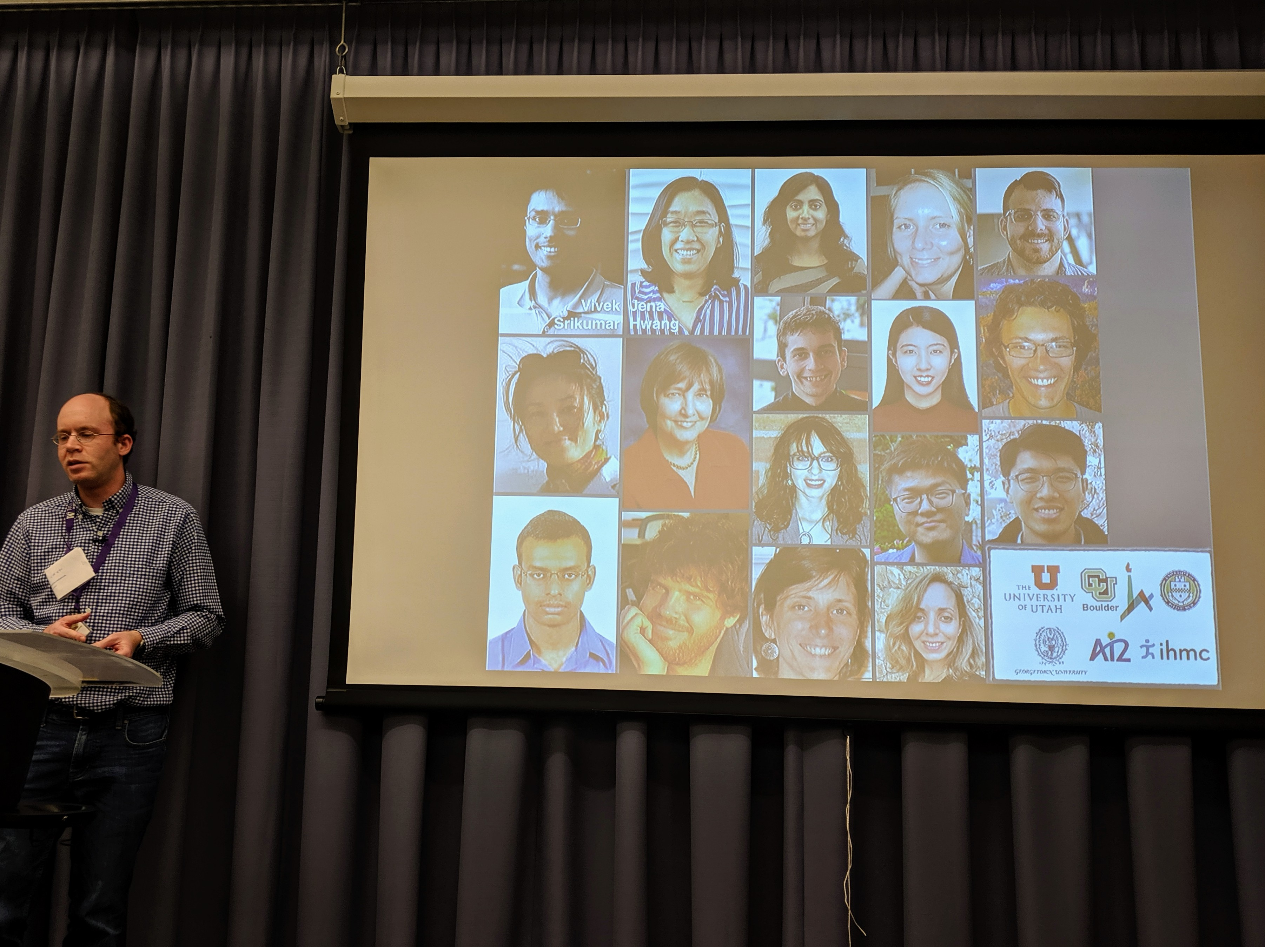
Good datasets are not easy to make
Observation 1:
Takes time, money

Slide 10
Easy to write rules about models
Observation 2:
(Often)
  E.g. “If no content word in the hypothesis is aligned with the premise, the label can not be entail or contradict”
  Statements in logic
    Invariants or inference rules
  Often universally quantified statements
    For every input, the above property should hold

Slide 11
Neural networks meet logic

Slide 12
Neural Networks vs. Logic
Neural Networks
Differentiable learning, easy to use
Hard to supervise except via labeled examples
First-order logic
Not differentiable, hard to use with today’s best infrastructure
Expressive and easy to state for domain experts
What we want: Best of both worlds!

Slide 13
Opportunities for logic to be involved
Model design
Loss function design & training
Constrain predictions to be valid
Augmenting neural networks with logic (ACL 2019)
Logic-based loss design (EMNLP 2019)
Structured prediction
Can be difficult to train due to discreteness
Computational expense for each prediction
This talk

Slide 14
Three challenges facing logic in neural network land
Bridging predicates in rules with neural networks?
    Answer: Named neurons
Making logic differentiable?
    Answer: Use a t-norm
Using differentiable logic?

Slide 15
Bridging neural networks and logic
All neural models expose an interface in the form of nodes that have externally defined meaning
Let’s use a textual entailment example to illustrate this

Slide 16
Bridging neural networks and logic
Premise
All neural models expose an interface in the form of nodes that have externally defined meaning
John is on a train to Berlin.
A neural network
Predict
Entail
Outputs are predicates.
So are deterministic properties of inputs
Entail(Premise, Hypothesis)
John is traveling to Berlin.
Hypothesis

Slide 17
Bridging neural networks and logic
Premise
All neural models expose an interface in the form of nodes that have externally defined meaning
John is on a train to Berlin.
Encode
Predict
Attend
Entail
Some internal nodes in the network have meaning by design
Align(train, traveling)
Encode
John is traveling to Berlin.
Hypothesis

Slide 18
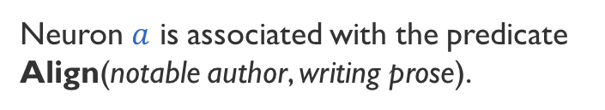

Named neurons
Nodes in a computation graph that have externally defined meaning
Named neurons give us the vocabulary for writing rules
Lower-case for neuron
notable author
Neuron $a$ is associated with the predicate Align(notable author, writing prose).
$$a$$
known for writing
Upper-case for predicate

Slide 19
Three challenges facing logic in neural network land
Bridging predicates in rules with neural networks?
    Answer: Named neurons
Making logic differentiable?
    Answer: Use a t-norm
Using differentiable logic?

Slide 20
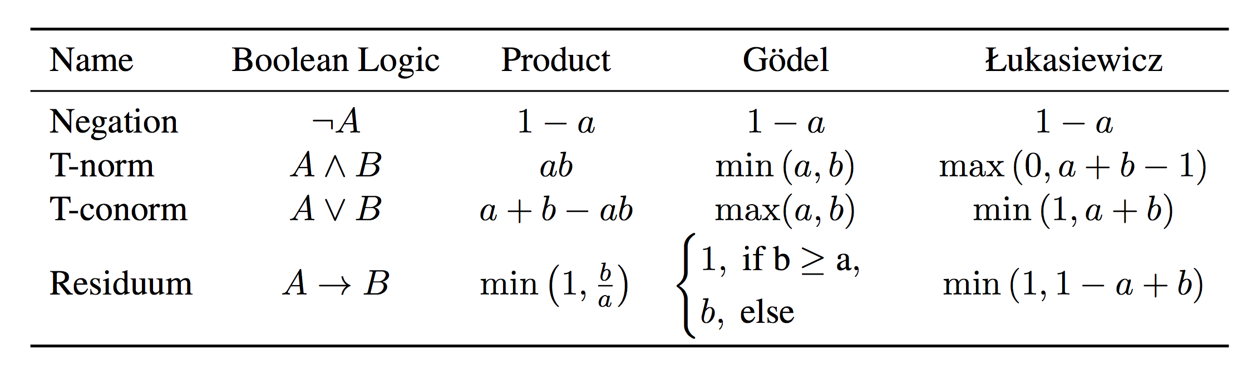
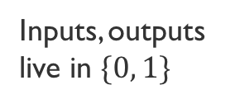
Relaxing Boolean operators
Triangular norms provide systematic relaxations of logic
Some are continuous and sub-differentiable
Inputs, outputs live in $\{0, 1\}$
Inputs, outputs live in $[0, 1]$
Basically rectified linear units
Klement, Erich Peter, Radko Mesiar, and Endre Pap. Triangular norms. Vol. 8. S2013.

Slide 21
Three challenges facing logic in neural network land
Bridging predicates in rules with neural networks?
    Answer: Named neurons
Making logic differentiable?
    Answer: Use a t-norm
Using differentiable logic?

Slide 22
What logic can do for neural networks?
Introduce inductive bias by…
…augmenting the network architecture
  Networks should prefer to satisfy the constraints
…by regularizing learning
  Penalize models that violate the constraints

Slide 23
What logic can do for neural networks?
Introduce inductive bias by…
…augmenting the network architecture
  Networks should prefer to satisfy the constraints
…by regularizing learning
  Penalize models that violate the constraints
Augmenting Neural Networks with First-order Logic.
Li and Srikumar, ACL 2019

Slide 24

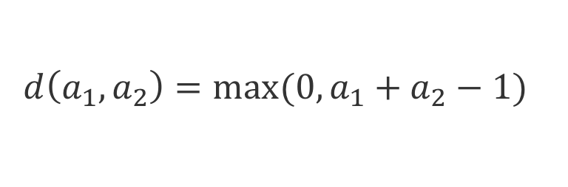

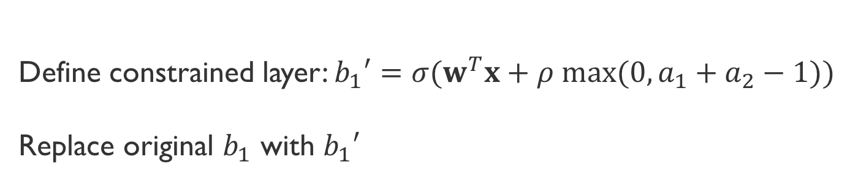





Augmenting models: An example
$$b_{1}=σ(w^{T}x)$$
$$b_{1}$$
$$b_{2}$$
Possibly many layers
$$A_{1}∧A_{2}→B_{1}$$
$$a_{1}$$
$$a_{2}$$
$$a_{3}$$
LHS in Łukasiewicz logic
$$d\left(a_{1},a_{2}\right)=max⁡(0, a_{1}+a_{2}−1)$$
Define constrained layer: $b_{1}′=σ(w^{T}x+ρ max(0, a_{1}+a_{2}−1))$
Replace original $b_{1}$ with $b_{1}′$
Notes:
This rule says that information from a_1 and a_2 to impact b_1 directly irrespective of what happens in the intervening layers
Of course, the neural network can learn this information if it is expressive enough. But why learn what we know?

Slide 25
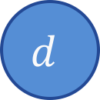

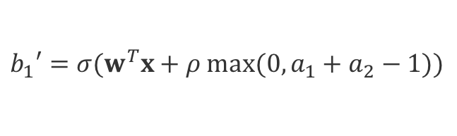
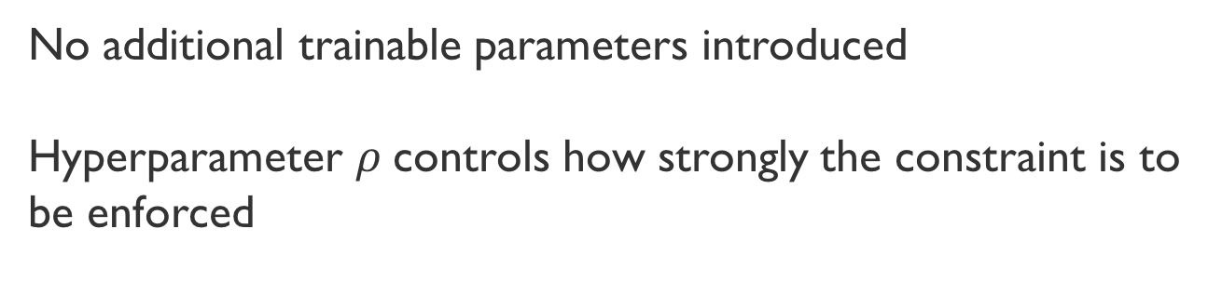

Augmenting models: An example
$$b_{1}′=σ(w^{T}x+ρ max(0, a_{1}+a_{2}−1))$$
$$b_{1}=σ(w^{T}x)$$
$$b_{1}′$$
$$b_{2}$$
$$d$$
Possibly many layers
$$A_{1}∧A_{2}→B_{1}$$
$$a_{1}$$
$$a_{2}$$
$$a_{3}$$
LHS in Łukasiewicz logic
$$d\left(a_{1},a_{2}\right)=max⁡(0, a_{1}+a_{2}−1)$$
No additional trainable parameters introduced
Hyperparameter $ρ$controls how strongly the constraint is to be enforced

Slide 26
What logic can do for neural networks?
Introduce inductive bias by…
…augmenting the network architecture
  Networks should prefer to satisfy the constraints
…by regularizing learning
  Penalize models that violate the constraints
A Logic-Driven Framework for Consistency of Neural Models, Li, Gupta, Mehta and Srikumar EMNLP 2019

Slide 27

Unifying examples & constraints
A labeled example is a predicate about the example
  e.g. $Entail\left(p, h\right)$ or, equivalently $⊤→Entail(p, h)$
Constraints are naturally in this form
  e.g. $Entail\left(P,H\right)∧Entail\left(H, Z\right)→Entail\left(P, Z\right)$
  Universally quantified
Examples and constraints, together, are a huge conjunction
$$\bigwedge_{x}{L\left(x\right)→R(x)}$$

Slide 28
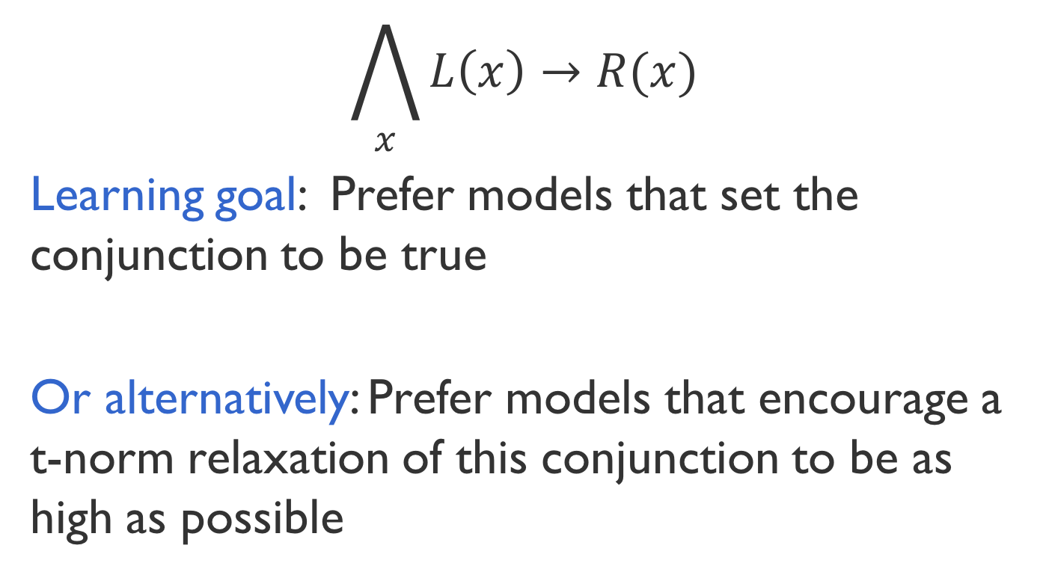
Encouraging consistency of models
$$\bigwedge_{x}{L\left(x\right)→R(x)}$$
Learning goal: Prefer models that set the conjunction to be true
Or alternatively: Prefer models that encourage a t-norm relaxation of this conjunction to be as high as possible
Inconsistency losses

Slide 29
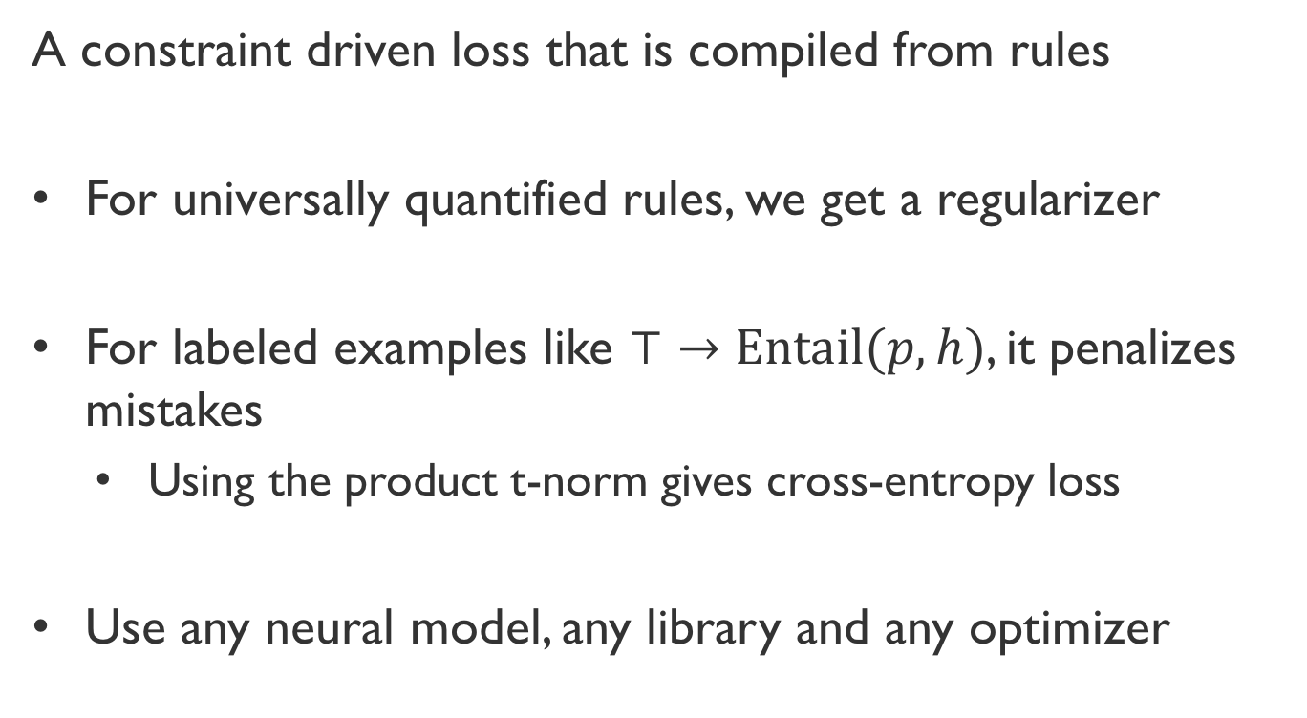
Inconsistency loss
A constraint driven loss that is compiled from rules
For universally quantified rules, we get a regularizer
  For labeled examples like $⊤→Entail(p, h)$, it penalizes mistakes
    Using the product t-norm gives cross-entropy loss
Use any neural model, any library and any optimizer

Slide 30
Do rules help neural networks?

Slide 31

Natural Language Inference
Case Study 1: Augmenting a network
SNLI dataset, decomposable Attention Model (Parikh et al 2016)
Two constraints:
  $p_{i}$: the $i^{th}$ word in the premise
  $h_{j}$: the $j^{th}$ word in the hypothesis
$$∀p_{i}, h_{j},Related\left(p_{i}, h_{j}\right)→Align\left(p_{i}, h_{j}\right)$$
$$∃h_{j}∀p_{i}, ContentWord\left(h_{j}\right)∧¬Align\left(p_{i}, h_{j}\right)→¬Entail(p, h)$$
(If two words are related, they should be aligned)
(If no content word in the hypothesis is aligned, then the label can not be Entail)

Slide 32
Results: Natural Language Inference
Case Study 1: Augmenting a network
1. Constraints help
3. With 0.5M data, constraints don’t help, or even slightly hurt
2. Larger improvements if training data is limited (~3%)
Have very large dataset? Just believe the data.

Slide 33

Consistency of NLI
Case study 2: Regularizing learning
BERT based models over SNLI & MultiNLI datasets
Two kinds of regularizers from constraints
Symmetry:
  $$∀P, H, Contradict\left(P,H\right)↔Contradict(H, P)$$
Four transitivity constraints of the form
  $$Entail\left(P,H\right)∧Entail\left(H, Z\right)→Entail\left(P, Z\right)$$

Slide 34
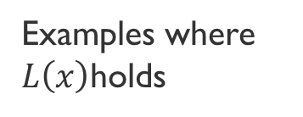
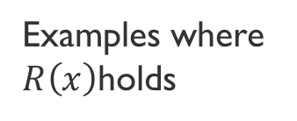
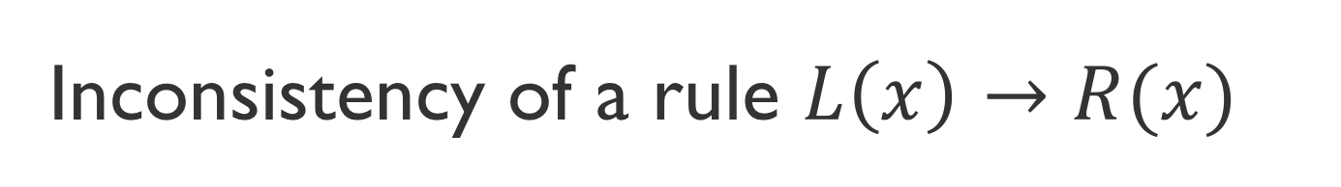
Inconsistency of a rule $L\left(x\right)→R(x)$
Case study 2: Regularizing learning
All examples
Inconsistency
  Inconsistency = fraction of examples where the antecedent is true, but the consequent is not
Examples where $L\left(x\right)$holds
Examples where $R\left(x\right)$holds

Slide 35
Results: Consistency of NLI
Case study 2: Regularizing learning
1. Merely adding more data does not make models consistent
2. Regularizers help with consistency

Slide 36
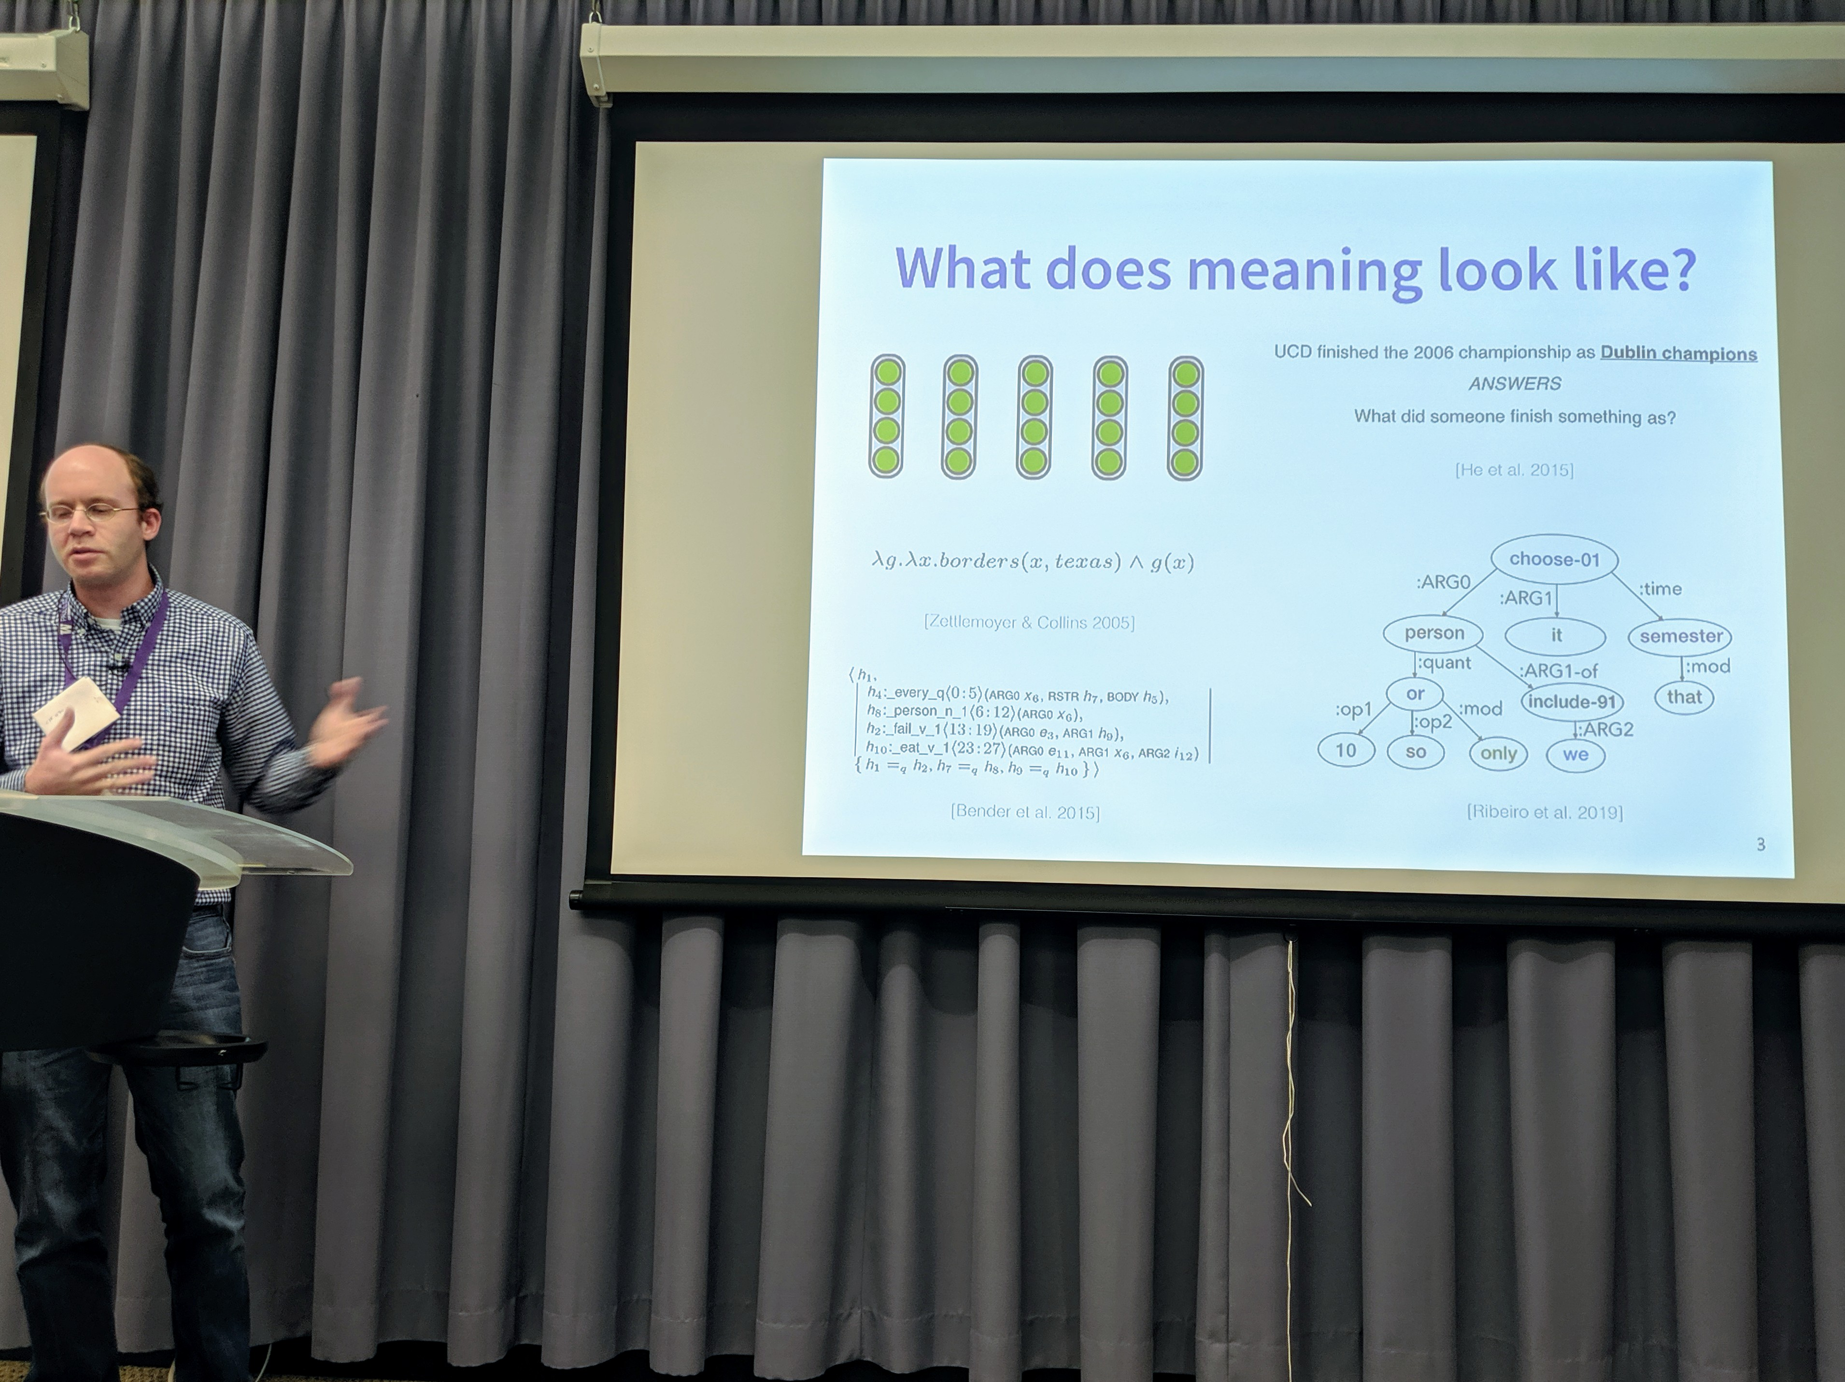
Final words
“What makes you so sure that mathematical logic corresponds to the way we think?”
— Stanislaw Ulam (maybe)
Logic can be a connection between these representations of meaning and vector representations

Slide 37
Final, final words
Logic is a convenient language to convey information to models
Logic and neural networks can play nice with each other if we relax logic systematically
  Either augment the model itself,
  Or, modify the loss function for training the model
Think about consistency of models
Questions

Slide 38
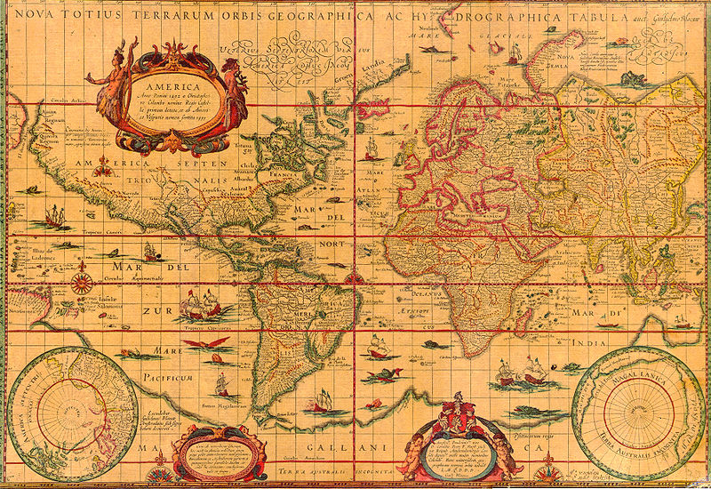
Extra slides
Here be dragons

Slide 39
Three Case Studies
Case study 1: Augmenting a reading comprehension model
Case study 2: Augmenting a natural language inference model
Case study 3: Making natural language inference more consistent

Slide 40
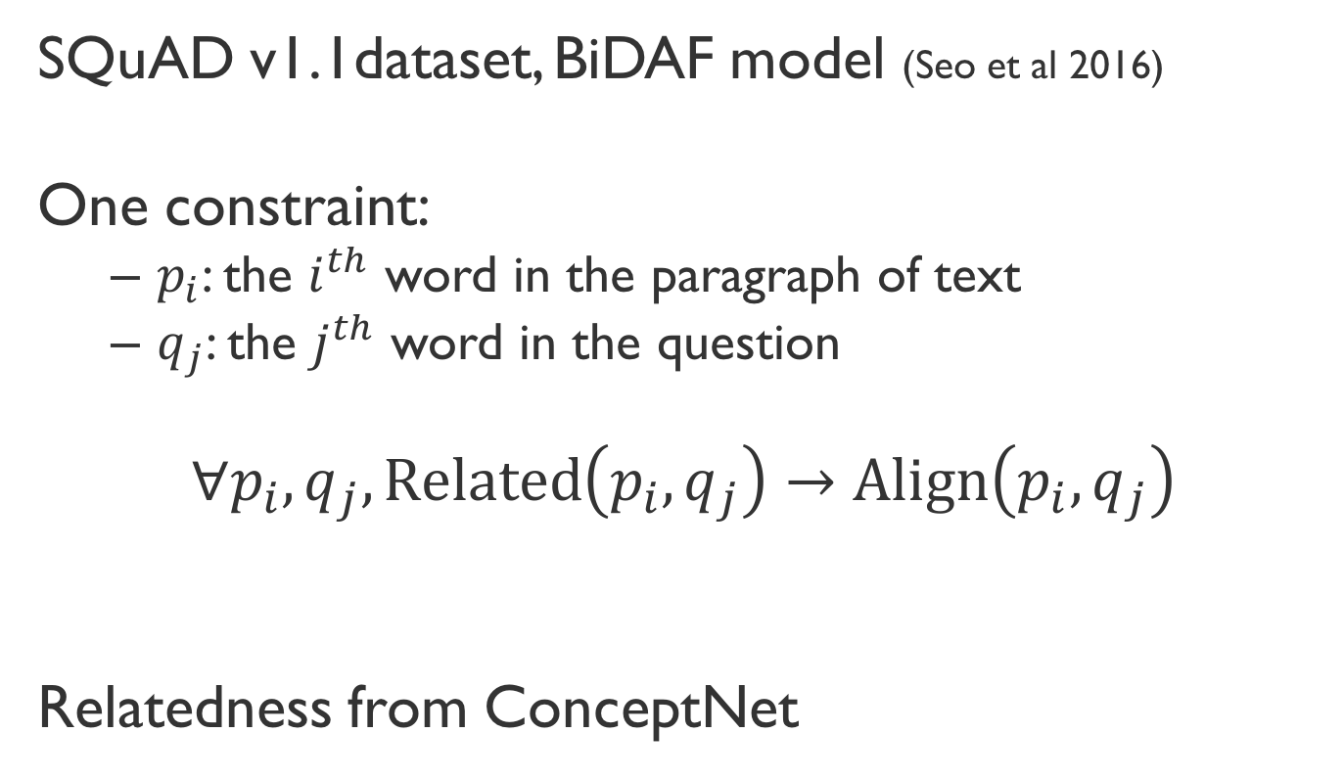
Reading Comprehension
Case Study 1:
SQuAD v1.1dataset, BiDAF model (Seo et al 2016)
One constraint:
  $p_{i}$: the $i^{th}$ word in the paragraph of text
  $q_{j}$: the $j^{th}$ word in the question
$$∀p_{i}, q_{j},Related\left(p_{i}, q_{j}\right)→Align\left(p_{i}, q_{j}\right)$$
Relatedness from ConceptNet
(If two words are related, they should be aligned)

Slide 41
Results: Reading Comprehension
Case Study 1:
1. Constraints help with no extra trainable parameters!
2. Larger improvements if training data is limited (~4%)

Slide 42
What if…
SQuAD, SNLI have hundreds of thousands of examples
Preposition supersenses dataset is much, much smaller
… we don’t have massive datasets?
… we have an expert who can state general principles about the problem at hand?
… we want neural networks to be interpretable?
… we want neural networks to be self consistent?

Slide 43
Lessons from experiments
If we have a lot of data, believe the data
But test set evaluation by itself insufficient
  Models may be bad in other ways

Slide 44
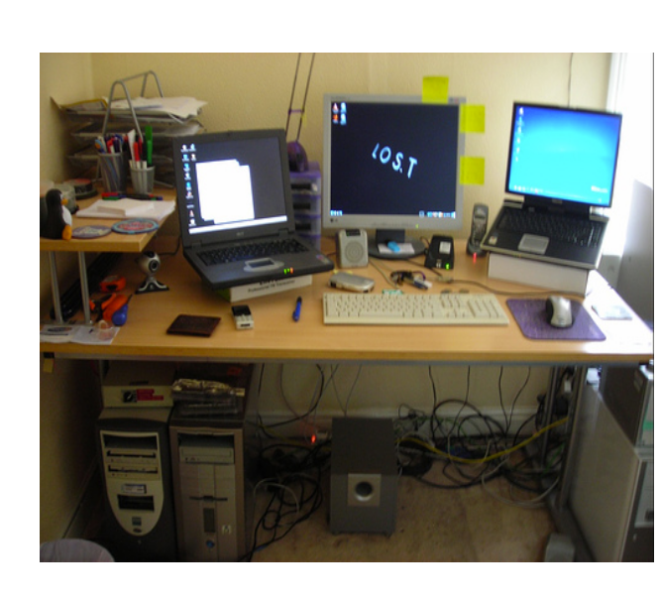
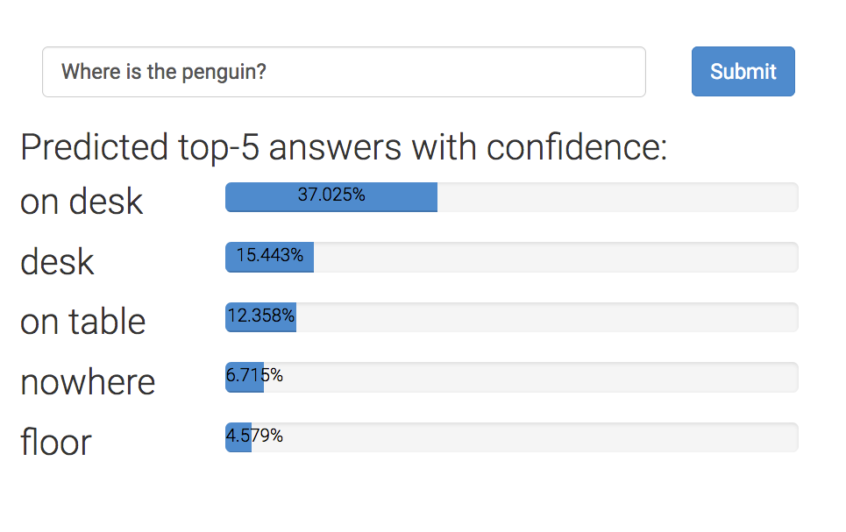

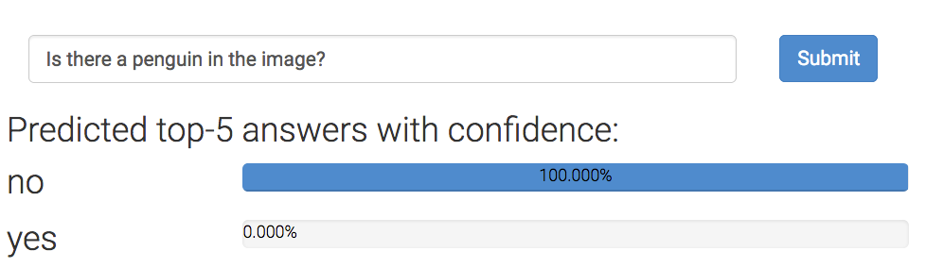
Neural networks can ‘read’ images!
Where is the penguin?
But can they really ‘read’ images?
Is there a penguin in the image?
From https://visualqa.org, uses Pythia v0. 1: the winning entry to the VQA challenge 2018 [Jiang, Y et al 2018.]

Slide 45
Can neural networks ‘read’ images?
Where is the penguin?
Only one of these answers can be correct.
An invariant
Is there a penguin in the image?
Can today’s neural networks use such relational advice?

Slide 46
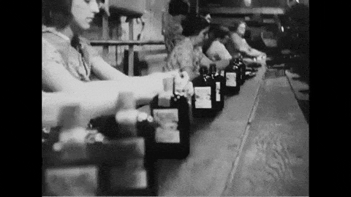
Modeling datasets: The assembly line
Step 1: Collect a large dataset
  Larger the better
  If possible avoid this step.
  (Use someone else’s dataset)
Step 2: Design a neural network
  Larger the better
  If possible avoid this step.
  (Use someone else’s pre-trained network & fine tune)
Step 3: Submit results to a public leaderboard
  Top of the leaderboard = State-of-the-art = Victory
Step 4: Rinse, lather, repeat

Slide 47
Learning from examples
Clearly a success story
Label examples (more = better)
Design a neural architecture (larger = better?)
Minimize loss
Declare victory (?)

Slide 48
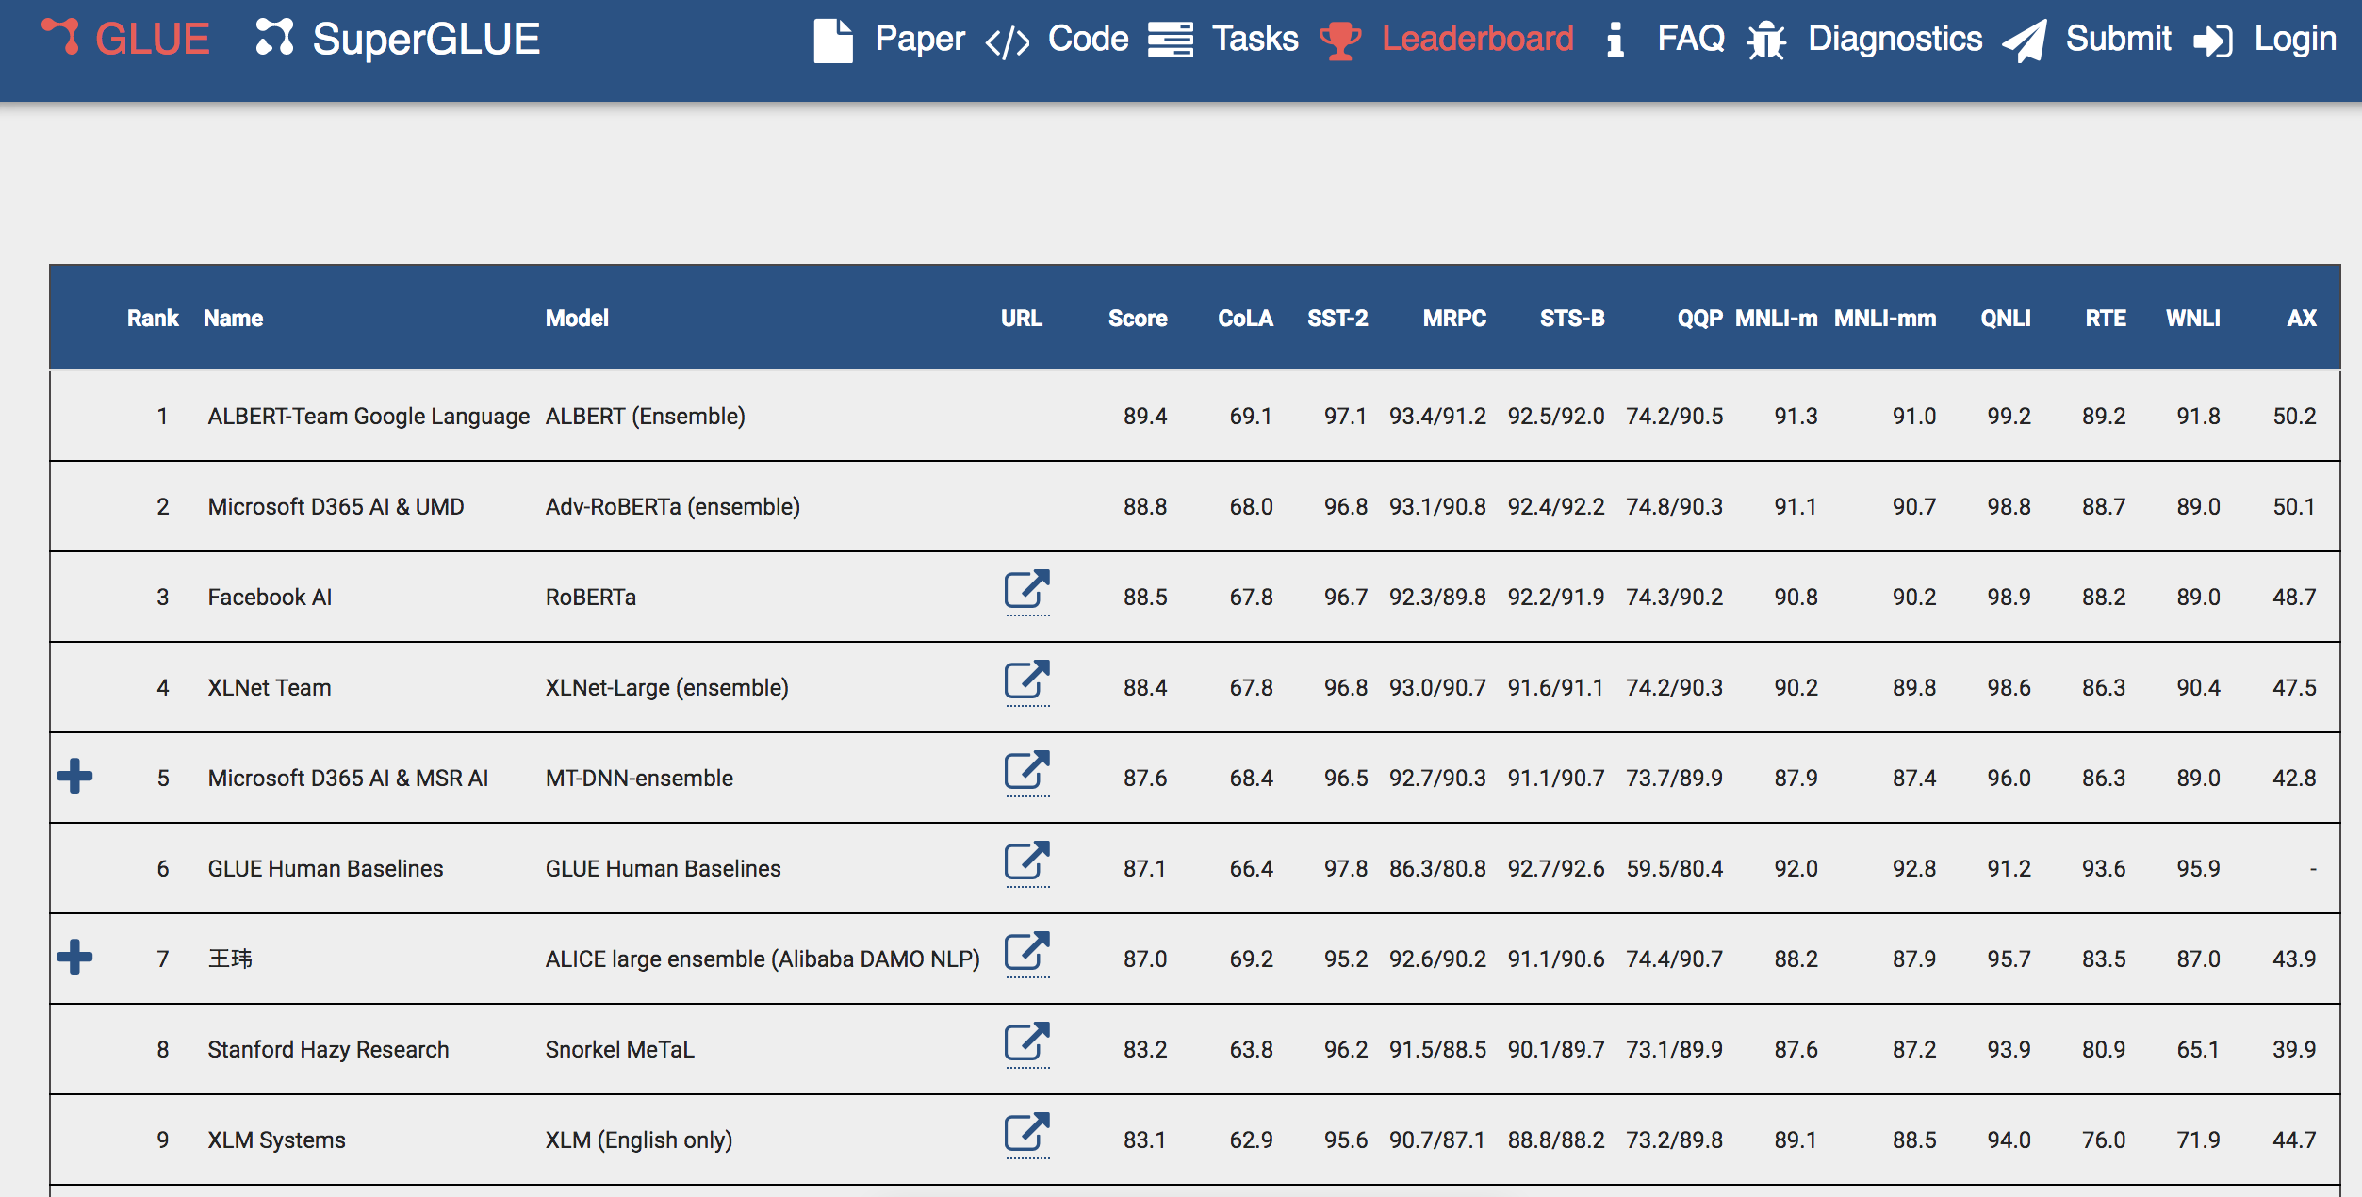
Text understanding = Leaderboards?
Massive neural networks trained on massive datasets
Glue leaderboard last month

Slide 49
Textual entailment: A running example
Premise
Premise
John is on a train to Berlin.
Hypothesis
John is traveling to Berlin.
Encode
Predict
Attend
Entail
Encode
John is traveling to Berlin.
Hypothesis

