Slide 1
Training Neural Networks
With a Little Help from Knowledge
Vivek Srikumar
Joint work with Tao Li, Vivek Gupta and Maitrey Mehta.

Slide 2
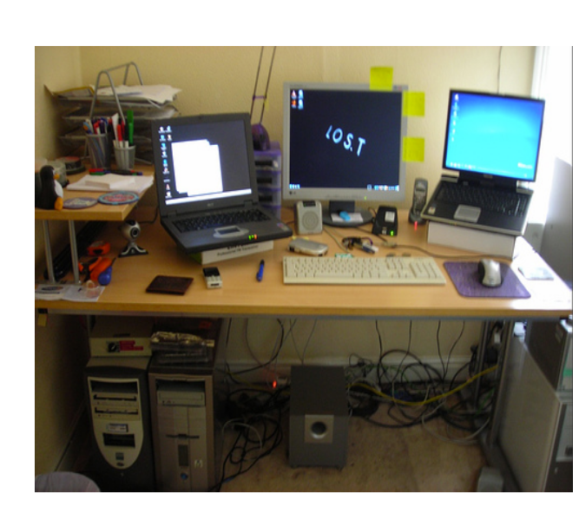
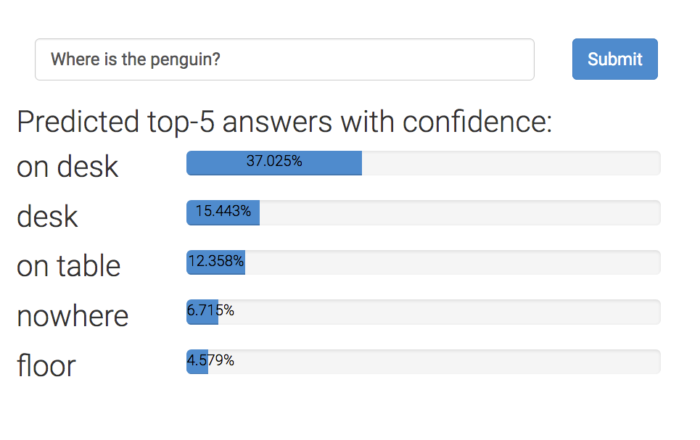


Neural networks can ‘read’ images!
Where is the penguin?
But can they really ‘read’ images?
Is there a penguin in the image?
From https://visualqa.org, uses Pythia v0. 1: the winning entry to the VQA challenge 2018 [Jiang, Y et al 2018.]

Slide 3
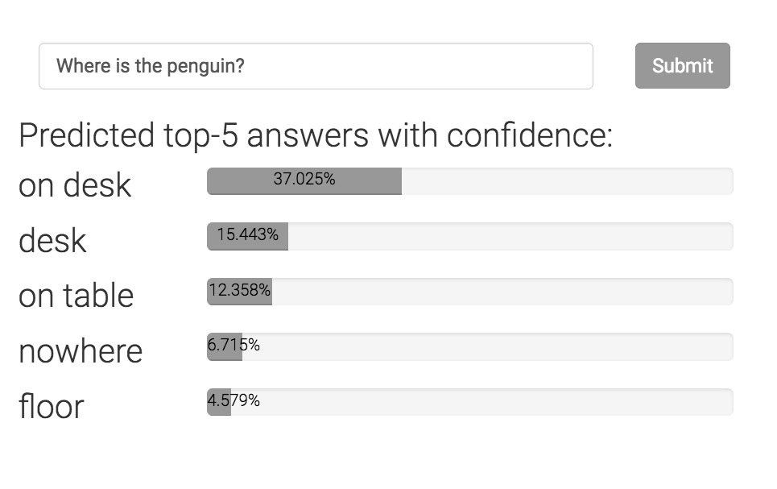

Can neural networks ‘read’ images?
Where is the penguin?
An invariant
Only one of these answers can be correct.
Is there a penguin in the image?
Can today’s neural networks use such “advice” in the form of invariant knowledge?

Slide 4
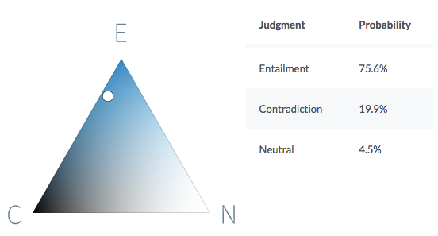
Neural networks can understand text!
Premise
Before it moved to Chicago, aerospace manufacturer Boeing was the largest company in Seattle.
Hypothesis
Boeing is a Chicago-based aerospace manufacturer.
It is quite likely that the premise entails the hypothesis.
https://demo.allennlp.org/textual-entailment/

Slide 5
Can neural networks understand text?
P John is on a train to Berlin.
H John is traveling to Berlin.
Z John is having lunch in Berlin.
A system cannot simultaneously hold the following beliefs:
P entails H
H contradicts Z
there is no correlation between the P and Z
Violates this invariant
If P entails H and H contradicts Z,
then P contradicts Z
Can today’s neural networks use such “advice” in the form of invariant knowledge?
A BERT-based model that gets 90% on SNLI violates this invariant on 46% of a large collection of sentence triples.

Slide 6
This talk
From “Learning from examples” to “Learning from knowledge”
Knowledge meets Neural Networks
  Neurons as predicates
  Relaxing rules into differentiable functions
  Using relaxed logic
Case studies in text understanding

Slide 7
Learning from examples
knowledge

Slide 8
Neural networks sans large datasets?
Neural networks are great, but are data hungry
What if we do not have the luxury of massive datasets,…
…but we do have domain knowledge about the problem in the form of rules.

Slide 9
Rules can augment annotated data
Good datasets are not easy to make
  Takes time, costs money
Often easy to write rules about model behavior
  Sometimes, even their internal beliefs
  Statements in logic expressing invariants or inference rules
  “If two sentences have no aligned words, they can not entail or contradict each other.”

Slide 10
Knowledge in neural network land

Slide 11
Neural network land vs. Logic land
Neural Networks
Differentiable learning, easy to use
Hard to supervise except via labeled examples
First-order logic
Not differentiable, hard to use with today’s best infrastructure
Expressive and easy to state for domain experts
What we want: Best of both!

Slide 12
Where can knowledge be involved?
Model design
Loss function design & training
Enforce congruent predictions
Augmenting neural networks with logic (ACL 2019)
Logic-based loss design (EMNLP 2019)
Structured prediction
Can be difficult to train due to discreteness
Computational expense for each prediction
This talk

Slide 13
Three challenges facing logic in neural network land
Bridging predicates in rules with neural networks
Making logic differentiable
    Answer: Use a t-norm
Using differentiable logic

Slide 14
Predicates in neural networks
All neural models expose interfaces in the form of nodes that have externally defined meaning
Let’s use a textual entailment example to illustrate this

Slide 15
Predicates in neural networks
Premise
All neural models expose interfaces in the form of nodes that have externally defined meaning
John is on a train to Berlin.
A neural network
Predict
Entail
Outputs are predicates.
So are deterministic properties of inputs
Entail(Premise, Hypothesis)
John is traveling to Berlin.
Hypothesis

Slide 16
Predicates in neural networks
Premise
All neural models expose interfaces in the form of nodes that have externally defined meaning
John is on a train to Berlin.
Encode
Predict
Attend
Entail
Some internal nodes in the network have meaning by design
Align(train, traveling)
Encode
John is traveling to Berlin.
Hypothesis

Slide 17
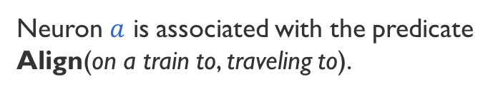

Named neurons
Nodes in a computation graph that have externally defined meaning
Named neurons give us the vocabulary for writing rules
Lower-case for neuron
on a train to
Neuron $a$ is associated with the predicate Align(on a train to, traveling to).
$$a$$
traveling to
Upper-case for predicate

Slide 18
Three challenges facing logic in neural network land
Bridging predicates in rules with neural networks?
    Answer: Named neurons
Making logic differentiable?
    Answer: Use a t-norm
Using differentiable logic?

Slide 19
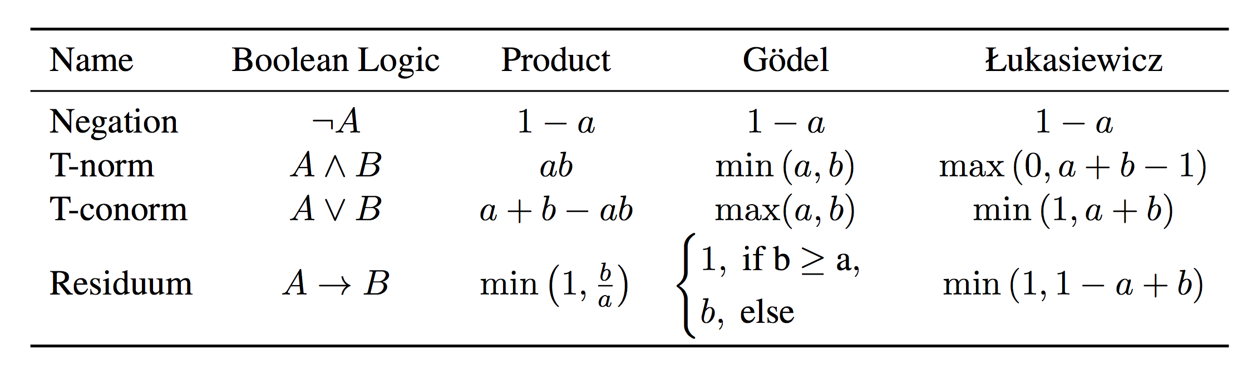
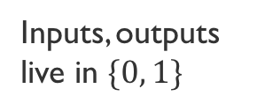
Relaxing Boolean operators
Triangular norms provide systematic relaxations of logic
Some are continuous and sub-differentiable
Inputs, outputs live in $\{0, 1\}$
Inputs, outputs live in $[0, 1]$
Basically rectified linear units
Klement, Erich Peter, Radko Mesiar, and Endre Pap. Triangular norms. Vol. 8. S2013.

Slide 20
Three challenges facing logic in neural network land
Bridging predicates in rules with neural networks?
    Answer: Named neurons
Making logic differentiable?
    Answer: Use a t-norm
Using differentiable logic?

Slide 21
What logic can do for neural networks?
Introduce inductive bias by…
…changing network architecture
  to networks that prefer satisfying the constraints
…by regularizing learning
  to penalize models that violate the constraints

Slide 22
What logic can do for neural networks?
Introduce inductive bias by…
…changing network architecture
  to networks that prefer satisfying the constraints
…by regularizing learning
  to penalize models that violate the constraints
Augmenting Neural Networks with First-order Logic.
Li and Srikumar, ACL 2019

Slide 23

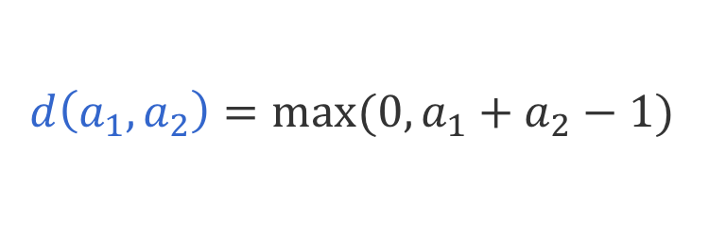

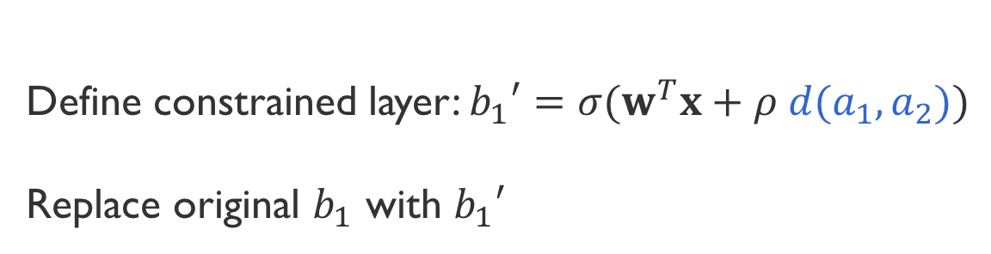





Augmenting models: An example
$$b_{1}=σ(w^{T}x)$$
$$b_{1}$$
$$b_{2}$$
Possibly many layers
$$A_{1}∧A_{2}→B_{1}$$
$$a_{1}$$
$$a_{2}$$
$$a_{3}$$
LHS in Łukasiewicz logic
$$d\left(a_{1},a_{2}\right)=max⁡(0, a_{1}+a_{2}−1)$$
Define constrained layer: $b_{1}′=σ(w^{T}x+ρ d(a_{1},a_{2}))$
Replace original $b_{1}$ with $b_{1}′$
Notes:
This rule says that information from a_1 and a_2 to impact b_1 directly irrespective of what happens in the intervening layers
Of course, the neural network can learn this information if it is expressive enough. But why learn what we know?

Slide 24
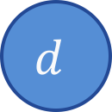

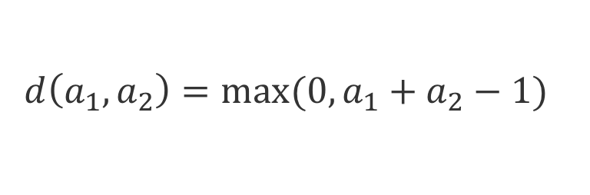
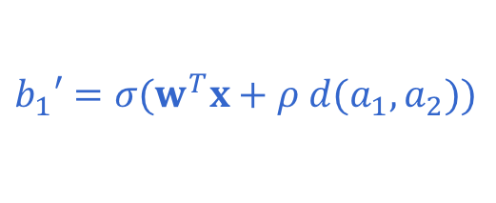
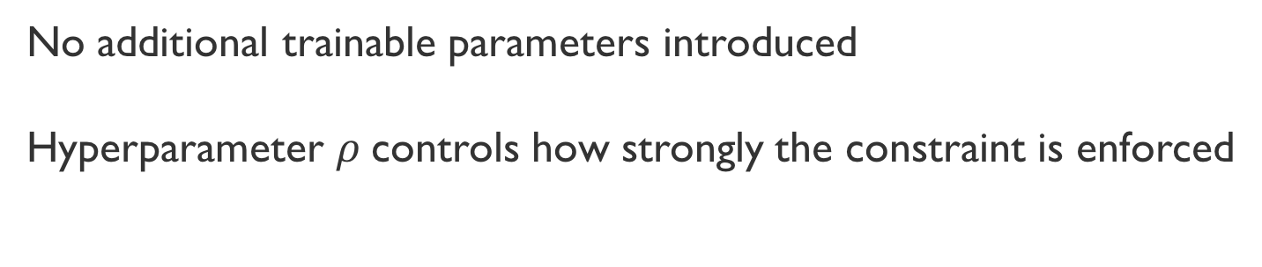
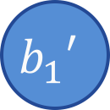
Augmenting models: An example
$$b_{1}′=σ(w^{T}x+ρ d(a_{1},a_{2}))$$
$$b_{1}=σ(w^{T}x)$$
$$b_{1}′$$
$$b_{2}$$
$$d$$
Possibly many layers
$$A_{1}∧A_{2}→B_{1}$$
$$a_{1}$$
$$a_{2}$$
$$a_{3}$$
LHS in Łukasiewicz logic
$$d\left(a_{1},a_{2}\right)=max⁡(0, a_{1}+a_{2}−1)$$
No additional trainable parameters introduced
Hyperparameter $ρ$controls how strongly the constraint is enforced

Slide 25
What logic can do for neural networks?
Introduce inductive bias by…
…changing network architecture
  to networks that prefer satisfying the constraints
…by regularizing learning
  to penalize models that violate the constraints
A Logic-Driven Framework for Consistency of Neural Models, Li, Gupta, Mehta and Srikumar EMNLP 2019

Slide 26
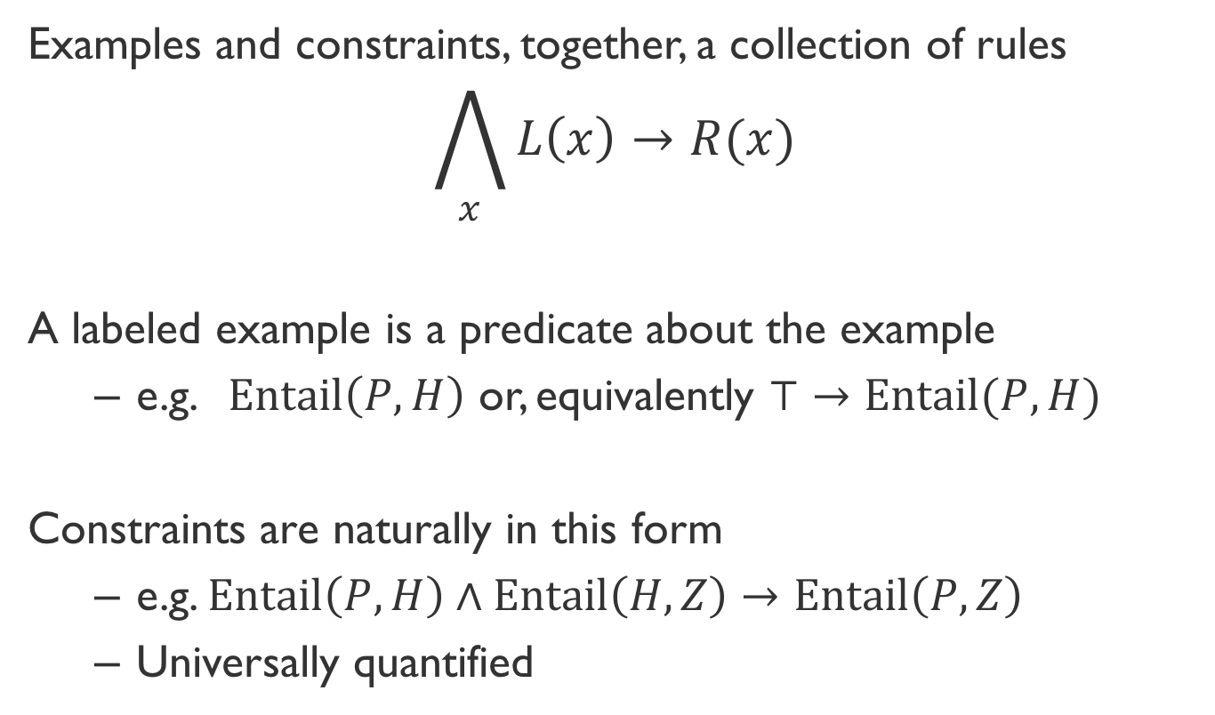
Unifying examples & constraints
Examples and constraints, together, a collection of rules
$$\bigwedge_{x}{L\left(x\right)→R(x)}$$
A labeled example is a predicate about the example
  e.g. $Entail\left(P, H\right)$ or, equivalently $⊤→Entail(P, H)$
Constraints are naturally in this form
  e.g. $Entail\left(P,H\right)∧Entail\left(H, Z\right)→Entail\left(P, Z\right)$
  Universally quantified

Slide 27
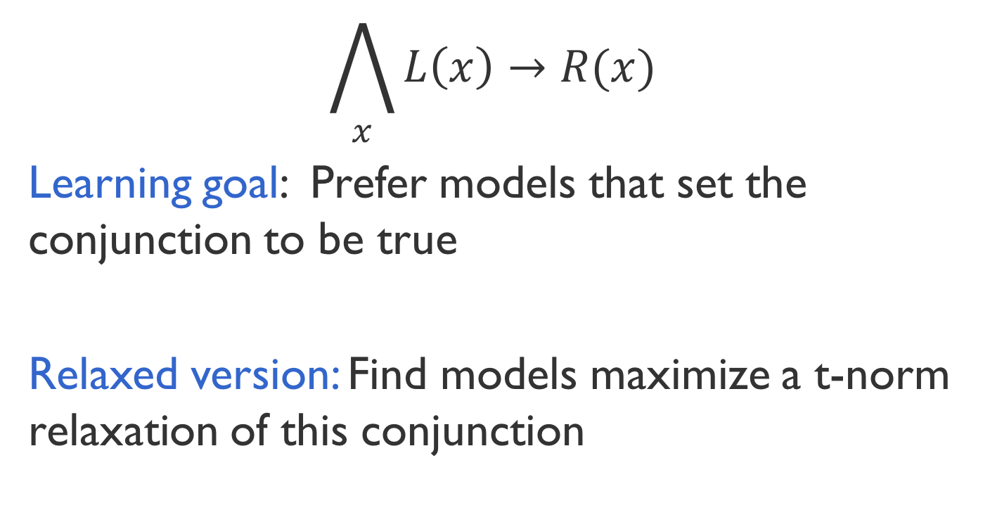
Encouraging consistency of models
$$\bigwedge_{x}{L\left(x\right)→R(x)}$$
Learning goal: Prefer models that set the conjunction to be true
Relaxed version: Find models maximize a t-norm relaxation of this conjunction
Inconsistency losses
Use any neural model, any library and any optimizer
Product t-norm + labeled examples gives cross entropy loss

Slide 28
Do rules help neural networks?

Slide 29
Natural Language Inference
Case Study 1: Augmenting a network
SNLI dataset, decomposable Attention Model (Parikh et al 2016)
Two constraints (formalized in first order logic):
If two words are related, they should be aligned
If no content word in the hypothesis is aligned, then the label can not be Entail

Slide 30
Results: Natural Language Inference
Case Study 1: Augmenting a network
1. Constraints help
3. With 0.5M data, constraints don’t help, or even slightly hurt
2. Larger improvements if training data is limited (~3%)
Have very large dataset? Just believe the data.

Slide 31
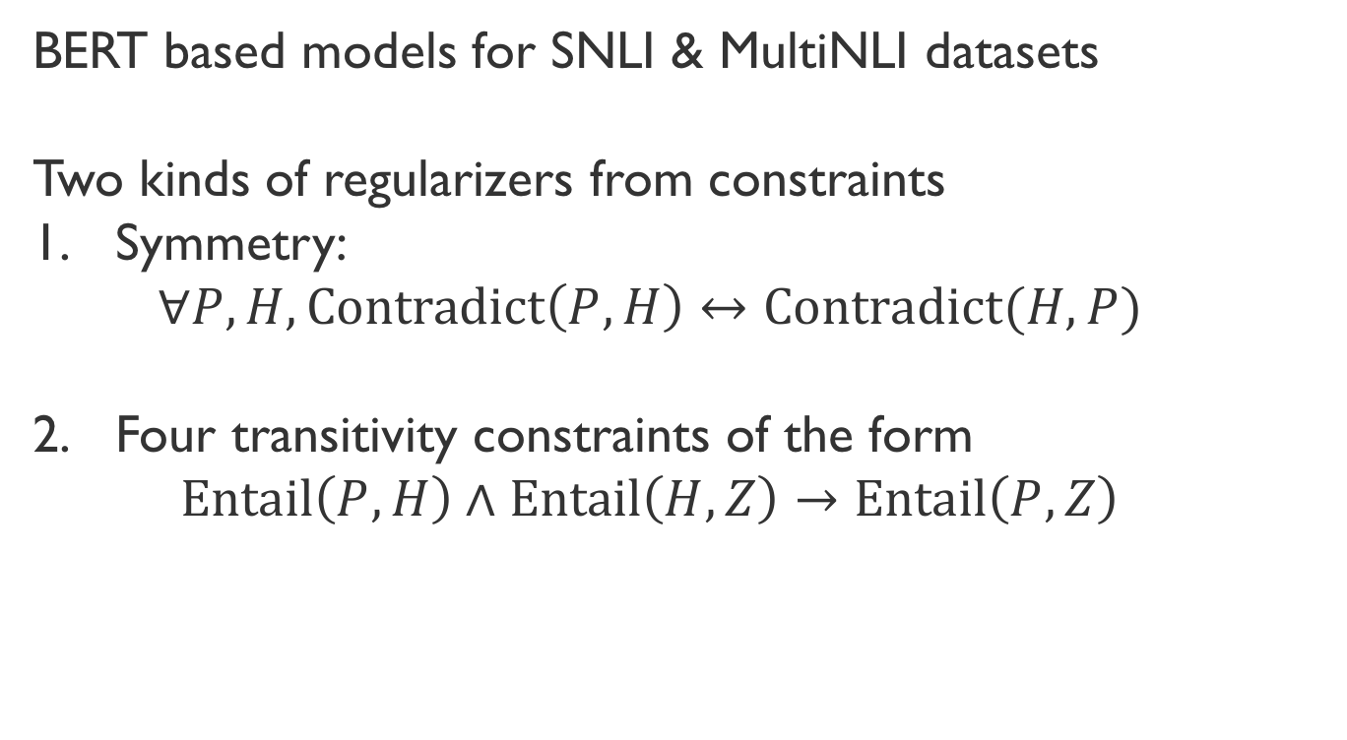
Consistency of NLI
Case study 2: Regularizing learning
BERT based models for SNLI & MultiNLI datasets
Two kinds of regularizers from constraints
Symmetry:
  $$∀P, H, Contradict\left(P,H\right)↔Contradict(H, P)$$
Four transitivity constraints of the form
  $$Entail\left(P,H\right)∧Entail\left(H, Z\right)→Entail\left(P, Z\right)$$

Slide 32
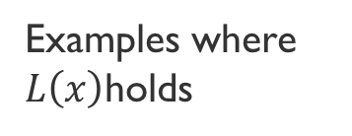
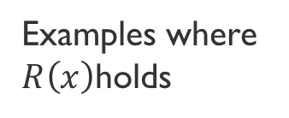
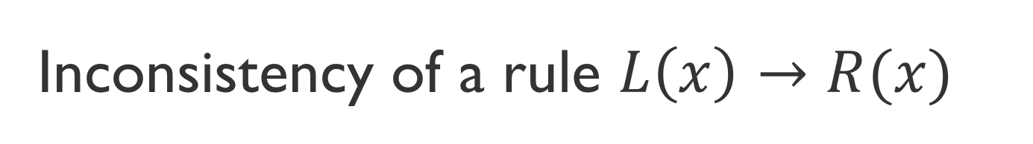
Inconsistency of a rule $L\left(x\right)→R(x)$
Case study 2: Regularizing learning
All examples
Inconsistency
  Inconsistency = fraction of examples where the antecedent is true, but the consequent is not
Examples where $L\left(x\right)$holds
Examples where $R\left(x\right)$holds

Slide 33
Results: Consistency of NLI
Case study 2: Regularizing learning
1. Merely adding more data does not make models consistent
2. Regularizers help with consistency

Slide 34
Final words
Neural networks with a little help from knowledge
Logic is a convenient representation to introduce knowledge into models
Logic and neural networks can play nice with each other if we relax logic systematically
  Either augment the model itself,
  Or, modify the loss function for training the model
Questions

