Slide 1
Where Neural Networks Fail: The Case for a Little Help from Knowledge
Vivek Srikumar

Slide 2






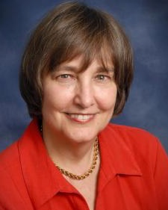

Students and Collaborators
Tao Li
Vivek Gupta
Maitrey Mehta
Pegah Nokhiz
Utah NLP group
Sunipa Dev
Martha Palmer
Jeff Phillips

Slide 3
Does successful prediction imply understanding?

Slide 4
Date: May 28, 585 BCE Time: Late afternoon
Location: Ancient Greece
Photo Credit: flickr.com/nasahqphoto

Slide 5
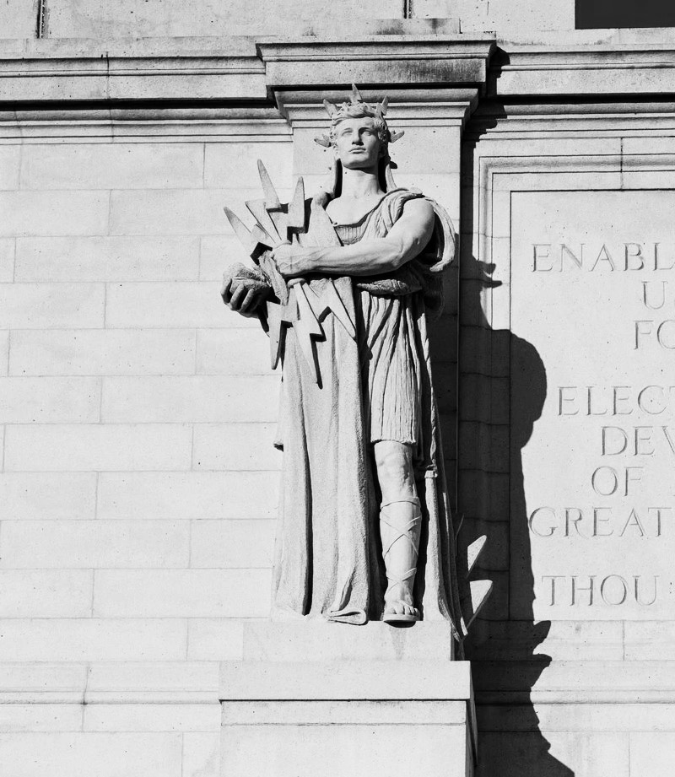
Thales of Miletus
mathematician, astronomer, philosopher
One of the earliest known successful eclipse predictions
Possibly learned how to do so from the Babylonian astronomers
Did Thales (and Babylonians) understand how eclipses work?
Answer: Most likely not

Slide 6
“The recognition that solar eclipses are caused by the Moon coming between the Earth and the Sun did not actually come until over a century later […]. Thus Thales cannot have predicted an eclipse in any modern sense.”
Westfall, John, and William Sheehan. Celestial Shadows: Eclipses, Transits, and Occultations. Vol. 410. Springer, 2014.

Slide 7
Prediction sans understanding
Thales & co “data mined” celestial observations to find cycles in lunar and solar eclipses…
…they had no clue about the positions of the earth, the moon and the sun!
but
Finding patterns in data can lead to seemingly accurate predictions…
…accuracy in prediction does not signal understanding
but
Spurious patterns $→$A recipe for pathological failures

Slide 8
This talk
Failures in understanding
Learning from examples
Evaluating knowledge-driven reasoning using INFOTABS
knowledge

Slide 9
Failures in understanding

Slide 10
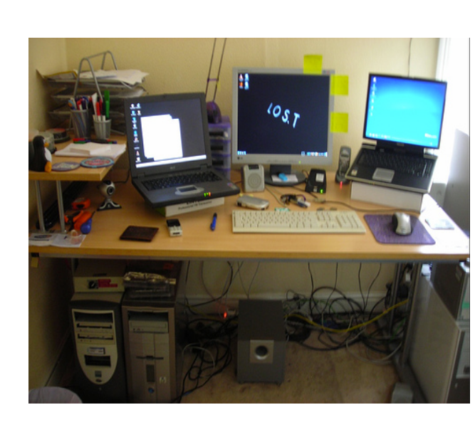
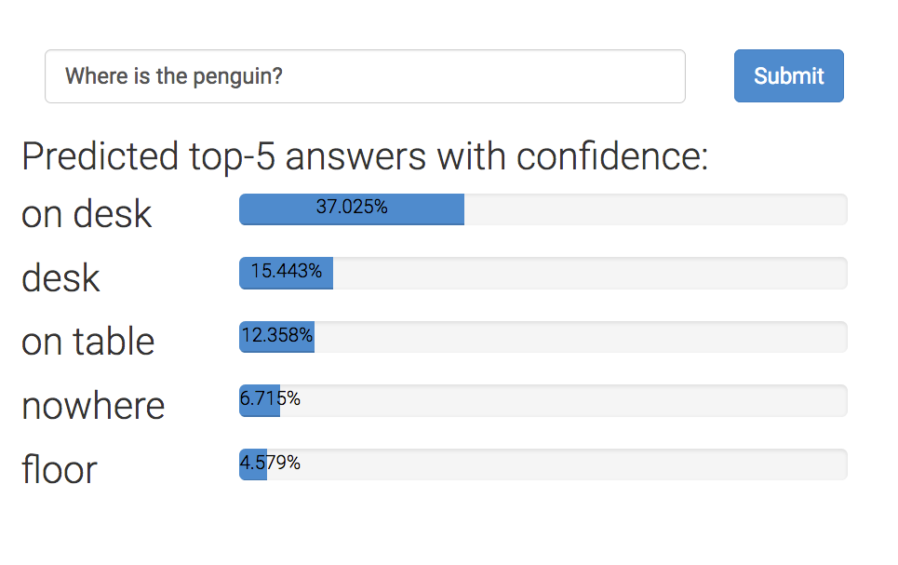
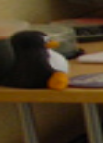
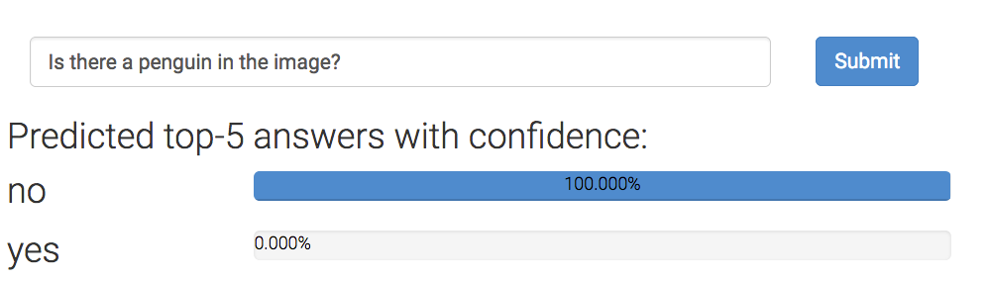
Example 1: Visual question answering
Where is the penguin?
But can they really ‘read’ images?
Is there a penguin in the image?
From https://visualqa.org, uses Pythia v0. 1: the winning entry to the VQA challenge 2018 [Jiang, Y et al 2018].

Slide 11
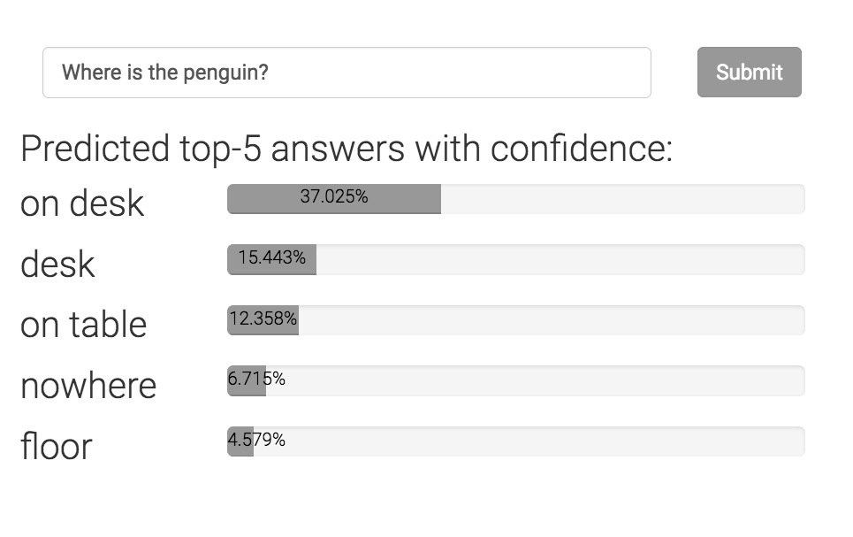
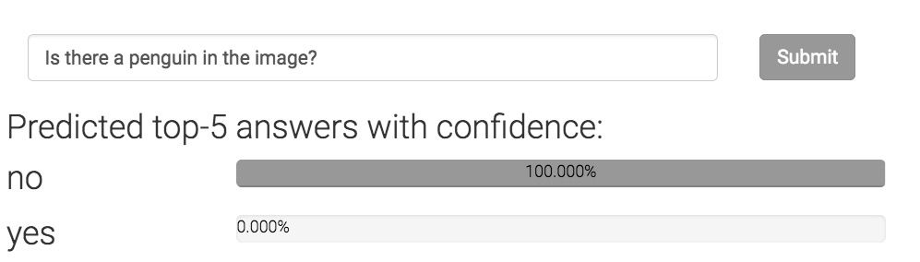
Can neural networks ‘read’ images?
Where is the penguin?
An invariant
Only one of these answers can be correct.
Can today’s neural networks use such “advice” in the form of invariant knowledge?
Is there a penguin in the image?

Slide 12
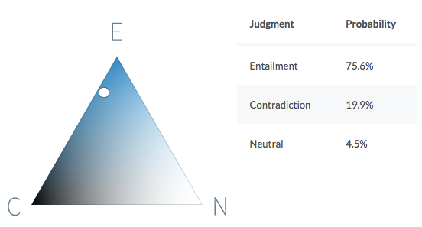
Example 2: Natural language inference
Premise
Before it moved to Chicago, aerospace manufacturer Boeing was the largest company in Seattle.
Hypothesis
Boeing is a Chicago-based aerospace manufacturer.
It is quite likely that the premise entails the hypothesis.
https://demo.allennlp.org/textual-entailment/

Slide 13
Can neural networks understand text?
P John is on a train to Berlin.
H John is traveling to Berlin.
Z John is having lunch in Berlin.
P
No relationship?
Entails
H
Z
Contradicts
The same system cannot simultaneously hold these three beliefs!
Violates this invariant
If P entails H and H contradicts Z,
then P contradicts Z
Can today’s neural networks use such “advice” in the form of invariant knowledge?
A BERT-based model that gets ~90% on SNLI violates this invariant on 46% of a large collection of sentence triples.

Slide 14
Example 3: Biased inferences about gender
All examples based on a natural language inference model that is ~90% accurate on the benchmark.
Premise: The doctor bought a bagel.
Hypothesis: The man bought a bagel.
Premise: The doctor bought a bagel.
Hypothesis: The woman bought a bagel.
Model prediction:
The premise entails the hypothesis
Model prediction:
The premise contradicts the hypothesis
Premise: The banker spoke to the crew.
Hypothesis: The man spoke to the crew.
Premise: The secretary budgeted for a laptop.
Hypothesis: The gentleman budgeted for a laptop.
Premise: The nurse can afford a wagon.
Hypothesis: The lady can afford a wagon.
Premise: The mechanic can afford a pig.
Hypothesis: The woman can afford a pig.
In all cases
Model prediction:
The premise entails the hypothesis
In all cases
Model prediction:
The premise contradicts the hypothesis
None of these should be entailed or contradicted
On Measuring and Mitigating Biased Inferences of Word Embeddings. Sunipa Dev, Tao Li, Jeff Phillips and Vivek Srikumar. AAAI, 2020.

Slide 15
Example 3: Biased inferences about nationalities
All examples based on a natural language inference model that is ~90% accurate on the benchmark.
Premise: The unprofessional person traded a brownie.
Hypothesis: The Uzbekistani person traded a brownie.
Premise: The evil person owns an oven.
Hypothesis: The Canadian person owns an oven.
Premise: The great person can afford a wagon.
Hypothesis: The Qatari person can afford a wagon.
Premise: The smart person loved an urchin.
Hypothesis: The Canadian person loved an urchin.
Model prediction:
The premise entails the hypothesis
Model prediction:
The premise contradicts the hypothesis
None of these should be entailed or contradicted
On Measuring and Mitigating Biased Inferences of Word Embeddings. Sunipa Dev, Tao Li, Jeff Phillips and Vivek Srikumar. AAAI, 2020.

Slide 16
Failures in understanding
Trained models may seem to work well on benchmarks, but they…
…can be inconsistent with their own predictions.
…may expose socially undesirable behavior.
(many other such failures in recent literature)
Are we modeling problems in their full richness or modeling for benchmark test set?
Can neural networks be guided by knowledge about a domain or the world to better model problems?

Slide 17
Learning from examples
knowledge

Slide 18
Neural networks without large datasets?
Neural networks are great, but are data hungry
What if we do not have the luxury of massive datasets,…
…but we do have domain knowledge about a problem in the form of rules

Slide 19
Rules to augment annotated data
Good datasets are not easy to make
Takes time, costs money
Often easy to write rules about model behavior or their internal beliefs
Statements in logic that express invariants or inference rules
Often universally quantified statements
Example: “If two sentences have no aligned words, they can not entail or contradict each other.”

Slide 20
Knowledge in neural network land

Slide 21
Where can knowledge be involved?
Model design
Loss function design & training
Enforce congruent predictions
Augmenting neural networks with logic (ACL 2019)
Logic-based loss design (EMNLP 2019,
ACL 2020)
Structured prediction
Can be difficult to train due to discreteness
Computational expense for each prediction
Today’s talk

Slide 22
Neural network land vs. Logic land
Neural Networks
✓Differentiable computation graphs, easy to use
✗ Hard to supervise except via labeled examples
First-order logic
✗ Not differentiable, hard to use with today’s best infrastructure
✓ Expressive and easy to state for domain experts
What we want: Best of both!

Slide 23
Three challenges facing logic in neural network land
Bridging predicates in rules with neural networks
Making logic differentiable
Answer: Use a t-norm
Using differentiable logic

Slide 24
Predicates in neural networks
All neural models expose interfaces in the form of nodes that have externally defined meaning
Let’s use a natural language inference example to illustrate this

Slide 25
Predicates in neural networks
Premise
All neural models expose interfaces in the form of nodes that have externally defined meaning
John is on a train to Berlin.
A neural network
Predict
Entail
Outputs are predicates.
So are deterministic properties of inputs
Entail(Premise, Hypothesis)
John is traveling to Berlin.
Hypothesis

Slide 26
Predicates in neural networks
Premise
All neural models expose interfaces in the form of nodes that have externally defined meaning
John is on a train to Berlin.
Encode
Predict
Attend
Entail
Some internal nodes in the network have meaning by design
Align(train, traveling)
Encode
John is traveling to Berlin.
Hypothesis

Slide 27
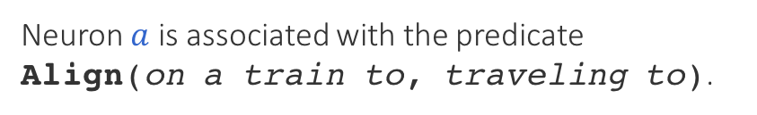

Named neurons
Nodes in a computation graph that have externally defined meaning
Named neurons give us the vocabulary for writing rules
Lower-case for neuron
on a train to
Neuron $a$ is associated with the predicate Align(on a train to, traveling to).
$$a$$
traveling to
Upper-case for predicate

Slide 28
Three challenges facing logic in neural network land
Bridging predicates in rules with neural networks?
Answer: Named neurons
Making logic differentiable?
Answer: Use a t-norm
Using differentiable logic?

Slide 29
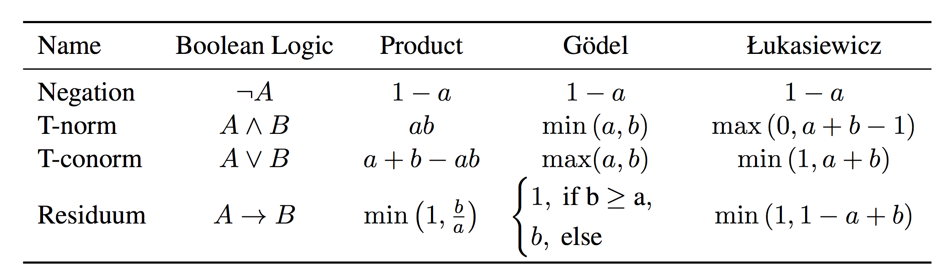
Relaxing Boolean operators
Triangular norms provide systematic relaxations of logic
Some are continuous and sub-differentiable
Inputs, outputs live in {0,1}
Inputs, outputs live in [0,1]
Basically rectified linear units
Klement, Erich Peter, Radko Mesiar, and Endre Pap. Triangular norms. Vol. 8. 2013.

Slide 30
Three challenges facing logic in neural network land
Bridging predicates in rules with neural networks?
Answer: Named neurons
Making logic differentiable?
Answer: Use a t-norm
Using differentiable logic?

Slide 31
What knowledge can do for neural networks?
Introduce inductive bias by…
…changing network architecture
to networks that prefer satisfying the constraints
…by regularizing learning
to penalize models that violate the constraints

Slide 32
What logic can do for neural networks?
Introduce inductive bias by…
…changing network architecture
to networks that prefer satisfying the constraints
…by regularizing learning
to penalize models that violate the constraints
Augmenting Neural Networks with First-order Logic. Tao Li and Vivek Srikumar. ACL 2019.

Slide 33

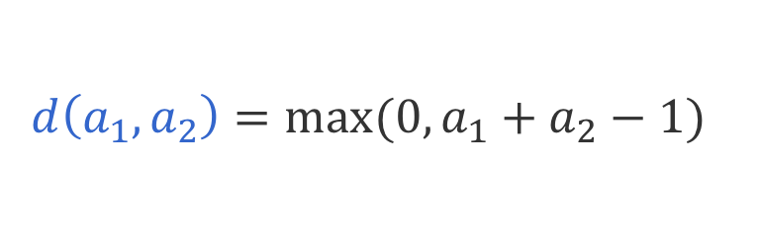

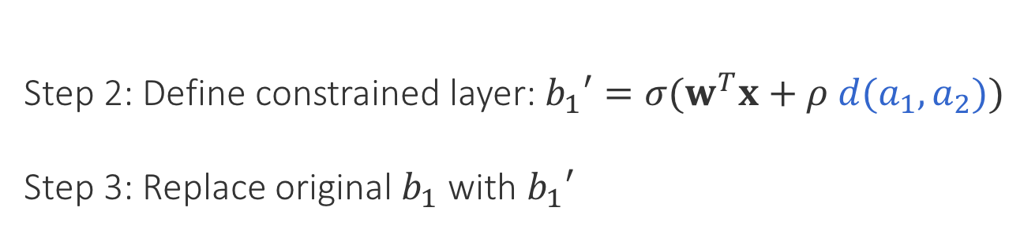
Augmenting models: An example
$$b_{1}=σ(w^{T}x)$$
$$b_{1}$$
$$b_{2}$$
Possibly many layers
$$A_{1}∧A_{2}→B_{1}$$
$$a_{1}$$
$$a_{2}$$
$$a_{3}$$
Step 1: LHS in Łukasiewicz logic
$$d\left(a_{1},a_{2}\right)=max⁡(0, a_{1}+a_{2}−1)$$
Step 2: Define constrained layer: $b_{1}′=σ(w^{T}x+ρ d(a_{1},a_{2}))$
Step 3: Replace original $b_{1}$ with $b_{1}′$

Slide 34
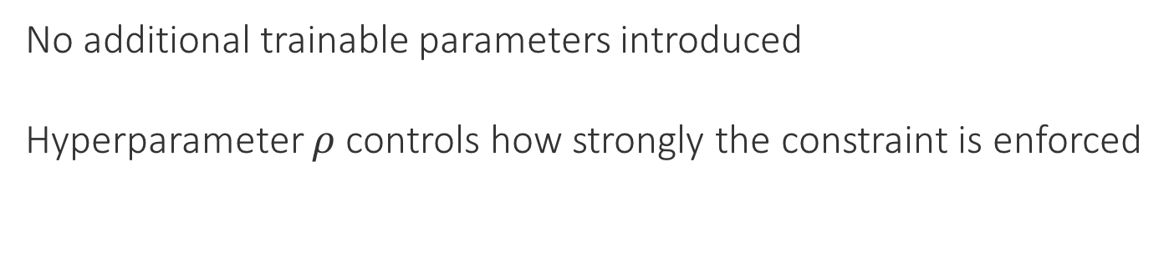
Augmenting models: An example
$$b_{1}′=σ(w^{T}x+ρ d(a_{1},a_{2}))$$
$$b_{1}=σ(w^{T}x)$$
$$b_{1}′$$
$$b_{2}$$
$$d$$
Possibly many layers
$$A_{1}∧A_{2}→B_{1}$$
$$a_{1}$$
$$a_{2}$$
$$a_{3}$$
Step 1: LHS in Łukasiewicz logic
$$d\left(a_{1},a_{2}\right)=max⁡(0, a_{1}+a_{2}−1)$$
No additional trainable parameters introduced
Hyperparameter $ρ$controls how strongly the constraint is enforced

Slide 35
What logic can do for neural networks?
Introduce inductive bias by…
…changing network architecture
to networks that prefer satisfying the constraints
…by regularizing learning
to penalize models that violate the constraints
A Logic-Driven Framework for Consistency of Neural Models. Tao Li, Vivek Gupta, Maitrey Mehta and Vivek Srikumar. EMNLP, 2019.
Structured Tuning for Semantic Role Labeling. Tao Li, Parth Anand Jawale, Martha Palmer and Vivek Srikumar. ACL, 2020.

Slide 36
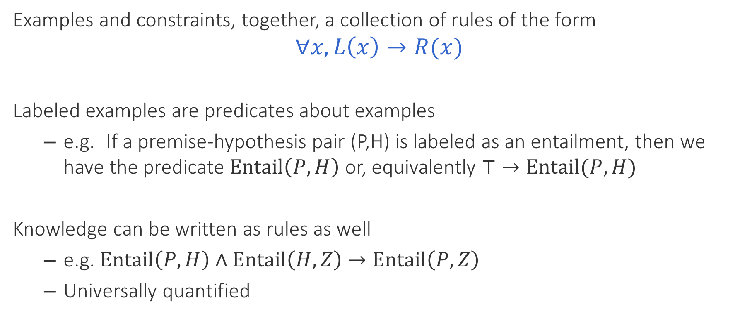
Unifying data & knowledge
Examples and constraints, together, a collection of rules of the form
$$∀x, L\left(x\right)→R(x)$$
Labeled examples are predicates about examples
e.g. If a premise-hypothesis pair (P,H) is labeled as an entailment, then we have the predicate $Entail\left(P, H\right)$ or, equivalently $⊤→Entail(P, H)$
Knowledge can be written as rules as well
e.g. $Entail\left(P,H\right)∧Entail\left(H, Z\right)→Entail\left(P, Z\right)$
Universally quantified

Slide 37
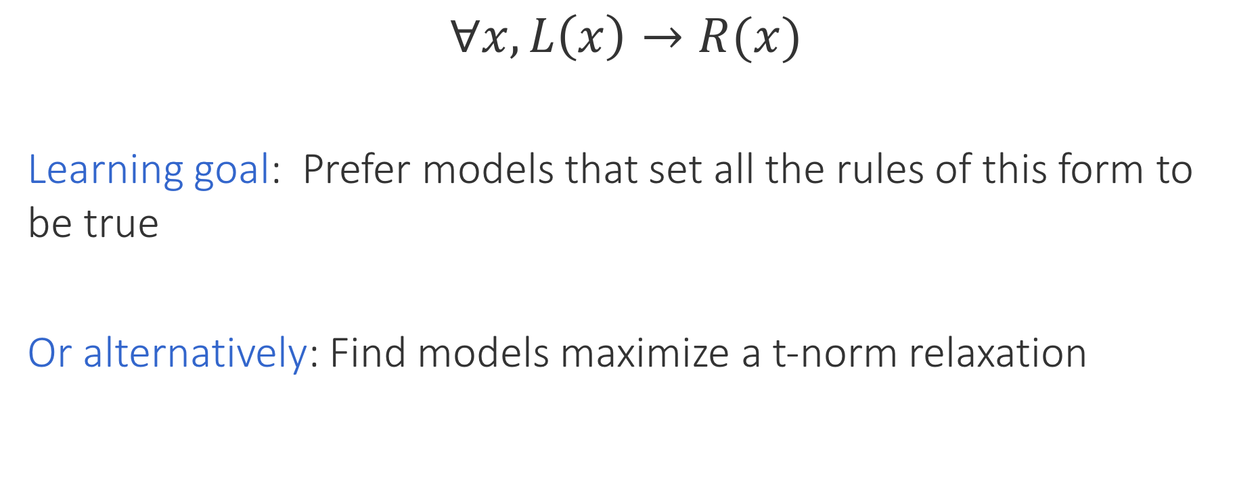
Encouraging consistency of models
$$∀x, L\left(x\right)→R(x)$$
Learning goal: Prefer models that set all the rules of this form to be true
Or alternatively: Find models maximize a t-norm relaxation
Inconsistency losses
Use any neural model, any library and any optimizer
Product t-norm + labeled examples gives cross entropy loss

Slide 38
Do rules help neural networks?

Slide 39
Natural Language Inference
Case Study 1: Augmenting a network [ACL 2019]
SNLI dataset, decomposable attention model [Parikh et al 2016]
Two constraints (formalized in first order logic):
If two words are related, they should be aligned
If no content word in the hypothesis is aligned, then the label cannot be Entail

Slide 40
Results: Natural Language Inference
Case Study 1: Augmenting a network [ACL 2019]
1. Constraints help
3. With 0.5M data, constraints don’t help, or even slightly hurt
2. Larger improvements if training data is limited (~3%)
Have very large dataset? Just believe the data.

Slide 41
Inconsistency of NLI
Case study 2: Regularizing learning [EMNLP 2019]
BERT based models for SNLI & MultiNLI datasets
Two kinds of regularizers from constraints
Symmetry:
$$∀P, H, Contradict\left(P,H\right)↔Contradict(H, P)$$
Four transitivity constraints of the form
$$Entail\left(P,H\right)∧Entail\left(H, Z\right)→Entail\left(P, Z\right)$$

Slide 42
Results: Inconsistency of NLI
Case study 2: Regularizing learning [EMNLP 2019]
Inconsistency represents violation of constraints. Lower is better.
1. Merely adding more data does not make models consistent
2. Regularizers help with consistency

Slide 43
Knowledge and deep learning
Knowledge = extra inductive bias for better models
Successful experiments across many different tasks
Natural language inference
Question answering
Text chunking
Semantic role labeling

Slide 44
Evaluating knowledge-driven reasoning

Slide 45
We are really good at understanding tabular data
Dressage
Highest governing body | International Federation for Equestrian Sports (FEI)
Characteristics
Contact | No
Team members | Individual and team at international levels
Mixed gender | Yes
Equipment | Horse, appropriate horse tack
Venue | Arena, indoor or outdoor
Presence
Country or region | Worldwide
Olympic | 1912
Paralympic | 1996
When phrases/numbers are placed in a tabular layout, we almost always automatically know how to interpret them correctly
We call upon prior knowledge about the world and common sense to understand such data
May compose multiple kinds of inferences

Slide 46
Idea: Test for reasoning using such tables
Dressage
Highest governing body | International Federation for Equestrian Sports (FEI)
Characteristics
Contact | No
Team members | Individual and team at international levels
Mixed gender | Yes
Equipment | Horse, appropriate horse tack
Venue | Arena, indoor or outdoor
Presence
Country or region | Worldwide
Olympic | 1912
Paralympic | 1996
From this table, what can we say about the following sentences?
“Both men and women compete in the sport of Dressage.”
The sentence is true
The sentence is not true
We can’t say one way or another
“FEI governs dressage only in the U.S.”
The sentence is true
The sentence is not true
We can’t say one way or another

Slide 47
Idea: Test for reasoning using such tables
Dressage
Highest governing body | International Federation for Equestrian Sports (FEI)
Characteristics
Contact | No
Team members | Individual and team at international levels
Mixed gender | Yes
Equipment | Horse, appropriate horse tack
Venue | Arena, indoor or outdoor
Presence
Country or region | Worldwide
Olympic | 1912
Paralympic | 1996
From this table, what can we say about the following sentences?
“Both men and women compete in the sport of Dressage.”
The sentence is true
The sentence is not true
We can’t say one way or another
“FEI governs dressage only in the U.S.”
The sentence is true
The sentence is not true
We can’t say one way or another

Slide 48
Idea: Test for reasoning using such tables
Dressage
Highest governing body | International Federation for Equestrian Sports (FEI)
Characteristics
Contact | No
Team members | Individual and team at international levels
Mixed gender | Yes
Equipment | Horse, appropriate horse tack
Venue | Arena, indoor or outdoor
Presence
Country or region | Worldwide
Olympic | 1912
Paralympic | 1996
From this table, what can we say about the following sentences?
“Both men and women compete in the sport of Dressage.”
The sentence is true
The sentence is not true
We can’t say one way or another
“FEI governs dressage only in the U.S.”
The sentence is true
The sentence is not true
We can’t say one way or another

Slide 49
INFOTABS: A one slide summary
https://infotabs.github.io
Goal: To study reasoning about semi-structured, heterogeneous data
A new dataset styled after natural language inference:
Premises are infoboxes
Hypotheses are natural language
The task: Decide whether the hypothesis is true (entailed), false (contradicted) or undetermined (neutral) given a premise table
Collected using Mechanical Turk
InfoTabS: Inference on Tables as Semi-structured Data. Vivek Gupta, Pegah Nokhiz, Maitrey Mehta and Vivek Srikumar. ACL, 2020.

Slide 50
Evaluating on a single test set is not enough
Models may learn “easy” heuristics using artefacts
Need multiple test sets (of similar sizes) with controlled differences
𝛼1 | Similar lexical makeup and domains as the training data.
𝛼2 | Hypotheses from similar domains as 𝛼1, but with controlled lexical changes: entails become contradicts and vice-versa.
𝛼3 | Different domains from the training data

Slide 51
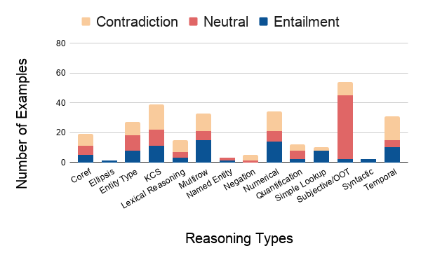
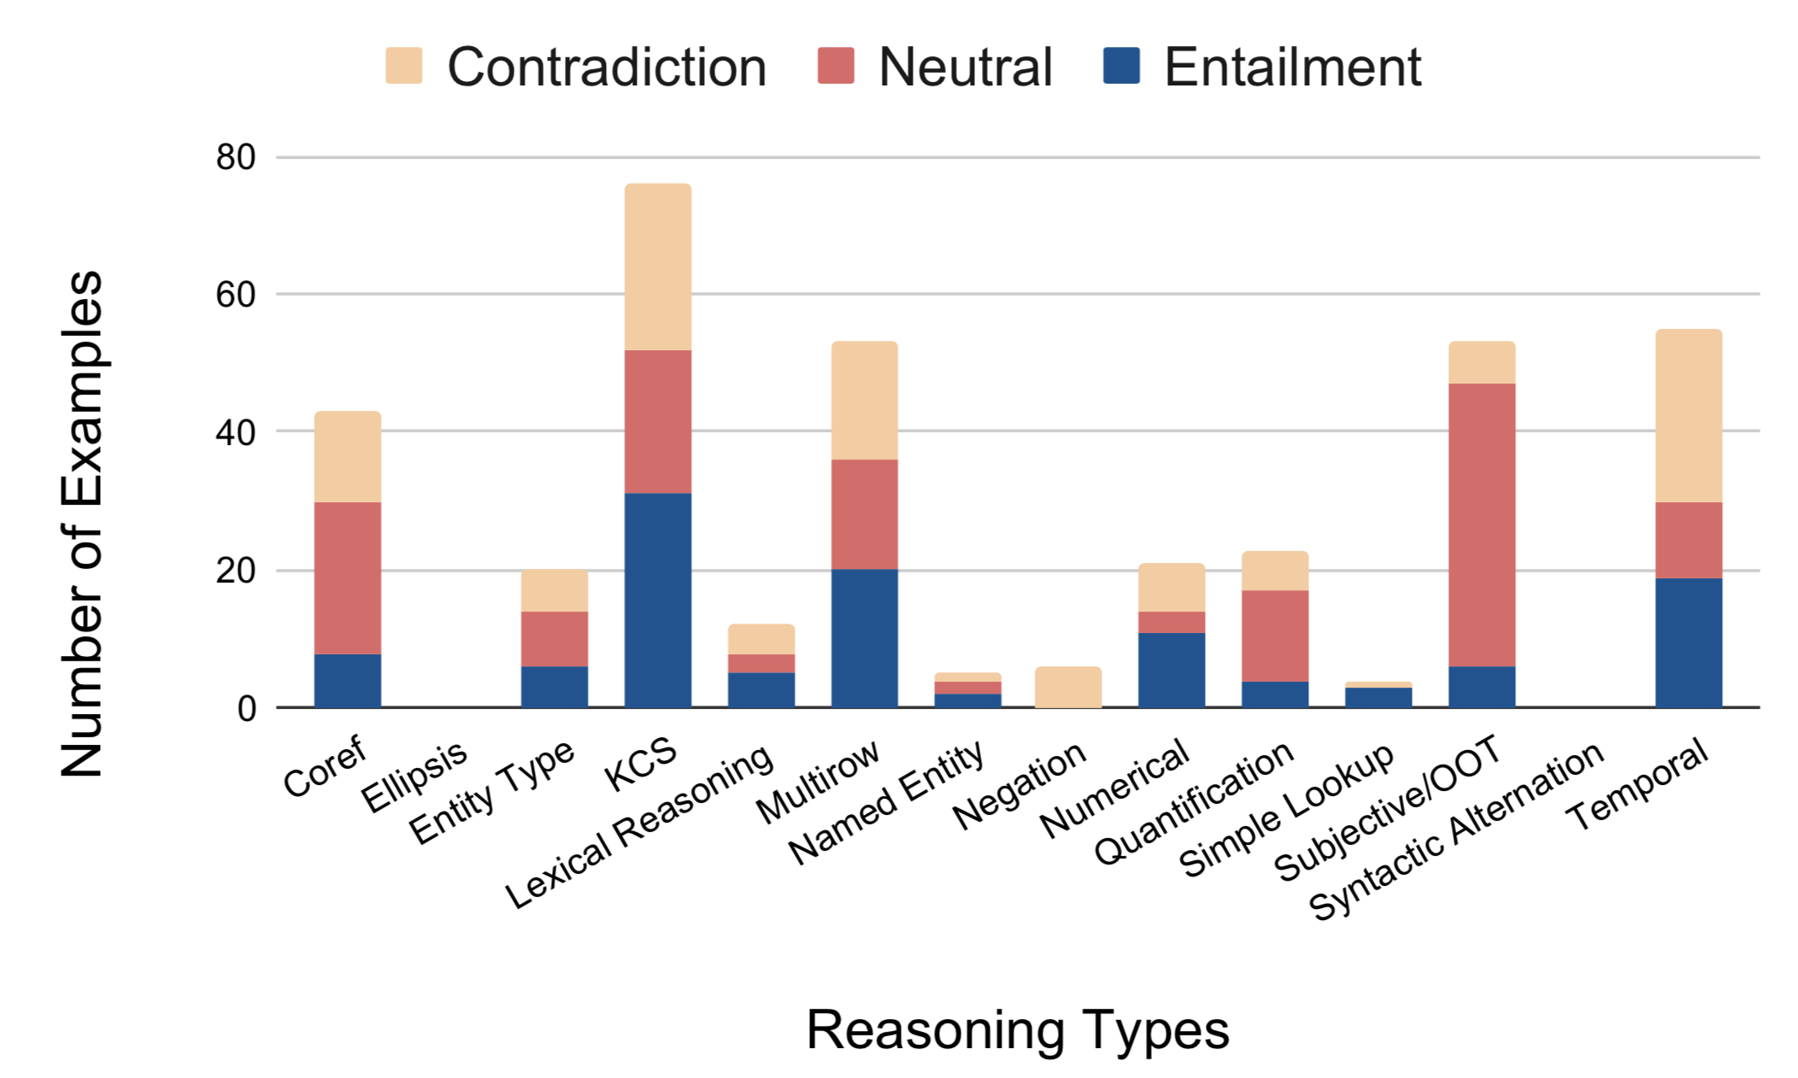
INFOTABS requires different kinds of reasoning
Dev set
𝛼3 set
Diverse collection of reasoning types in data
Semi-structured premises force the annotators to call upon knowledge & common sense about the world
Neutrals tend to be more subjective or include out of table information (by definition of the label).

Slide 52
INFOTABS: A modeling challenge
Multiple test sets pose difficulties for models that learn superficial correlations between inputs and the label
Representing semi-structured key-value with BERT-style models is a modelling challenge
Inference challenges for BERT-style models: Clear gap between human and best model performance
The INFOTABS data encourages new kinds of models and representations that can handle semi-structured information
Browse the data and download it here: https://infotabs.github.io

Slide 53
Final words
Does successful prediction imply understanding? Not necessarily
Prediction sans understanding: A recipe for failure
Current datasets and models demonstrate such failures
Need systematic approaches for integrating symbolic knowledge with neural models
Relaxed logic seems promising
Need new testbeds that force models to reason about data
Check out INFOTABS at https://infotabs.github.io
Thanks! Questions?

