Slide 1
Fads, Fallacies & Fantasies in the Name of Machine Learning
Vivek Srikumar

Slide 2
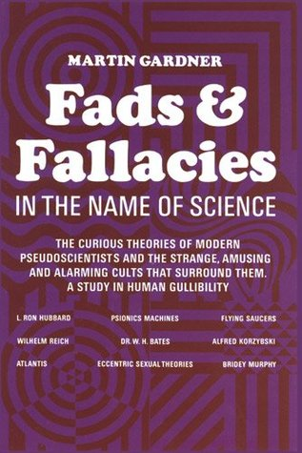
Fads & Fallacies
Title of this talk: A reference to Martin Gardner’s famous book from the 1950s
One of the first writings about scientific skepticism
“The curious theories of modern pseudoscientists and the strange, amusing and alarming cults that surround them.
A study in human gullibility”

Slide 3
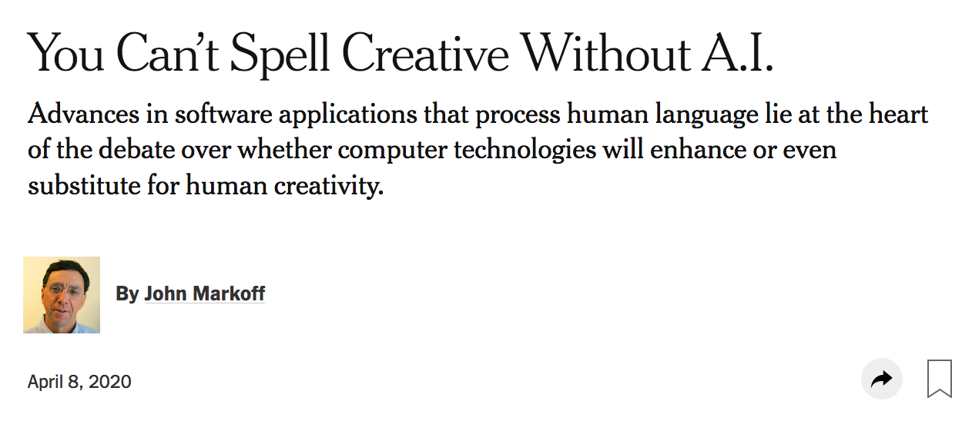
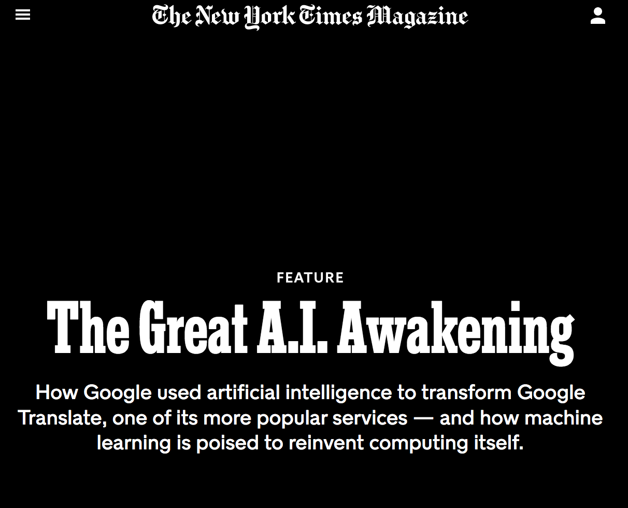
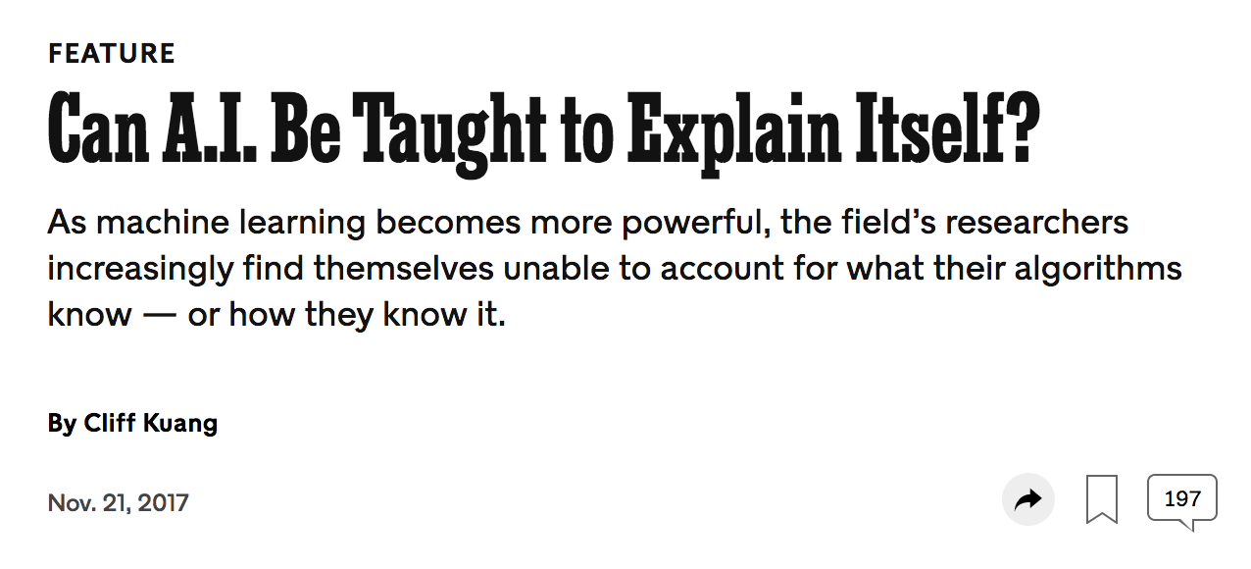
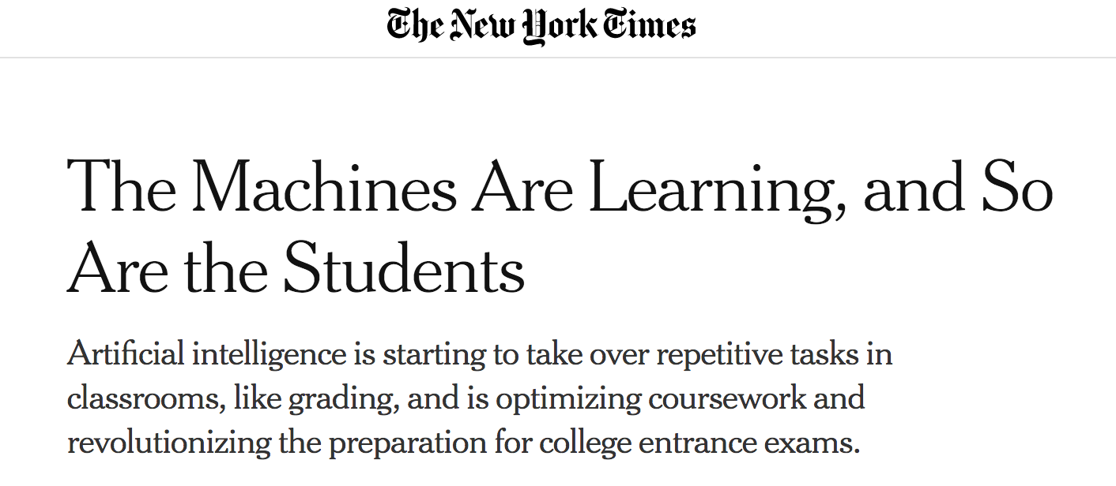
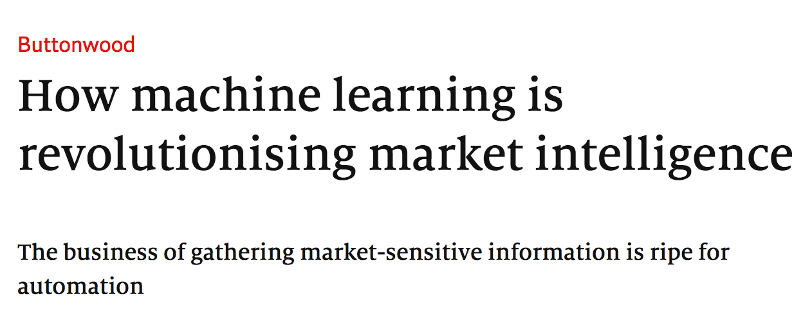
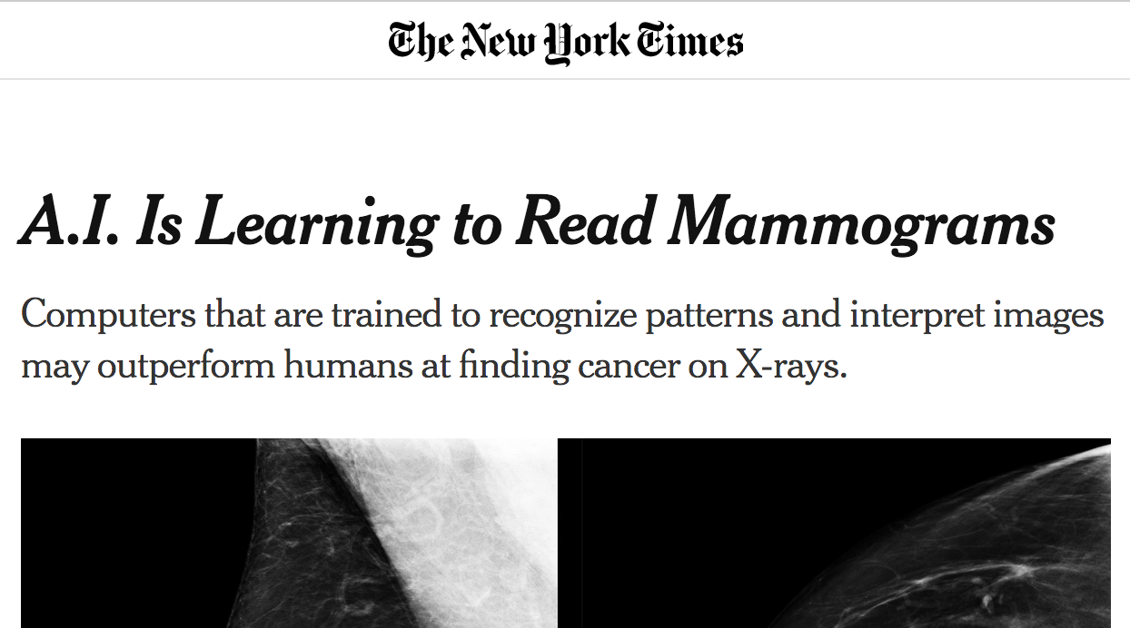
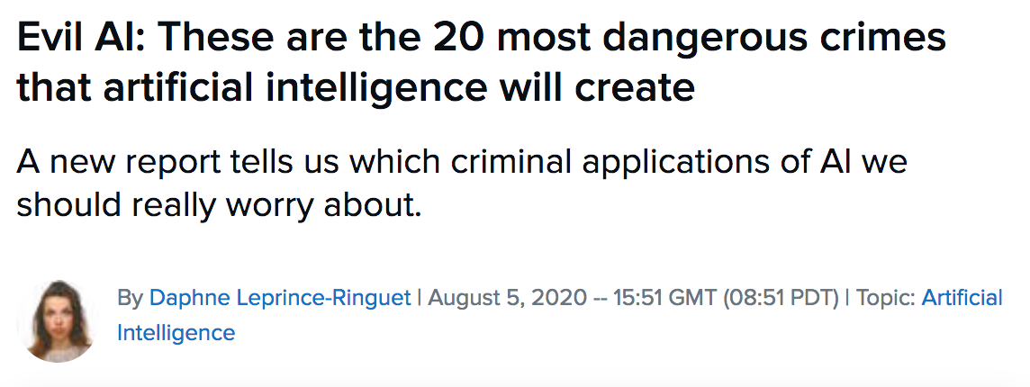
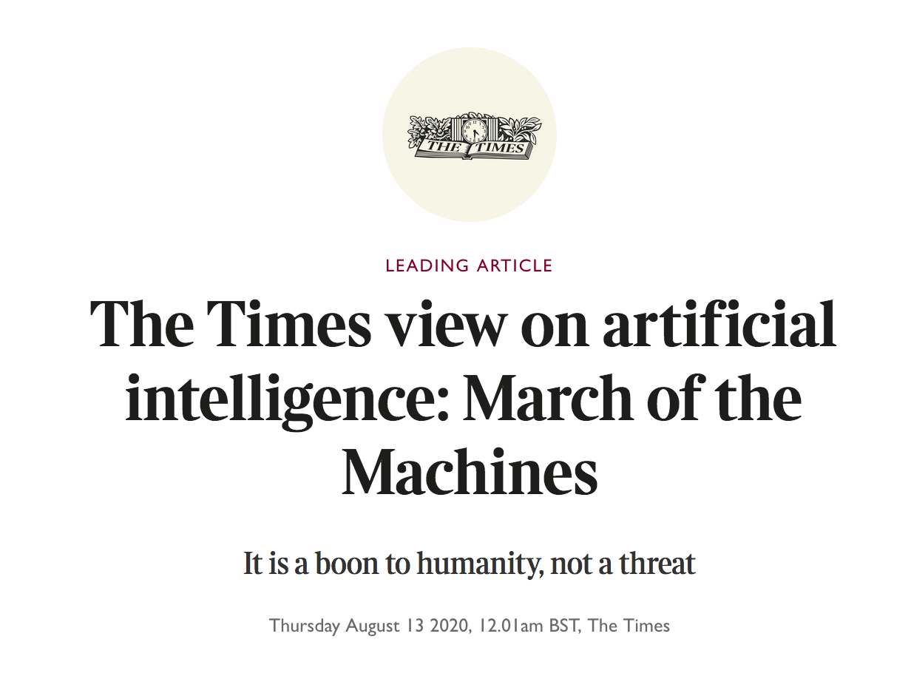
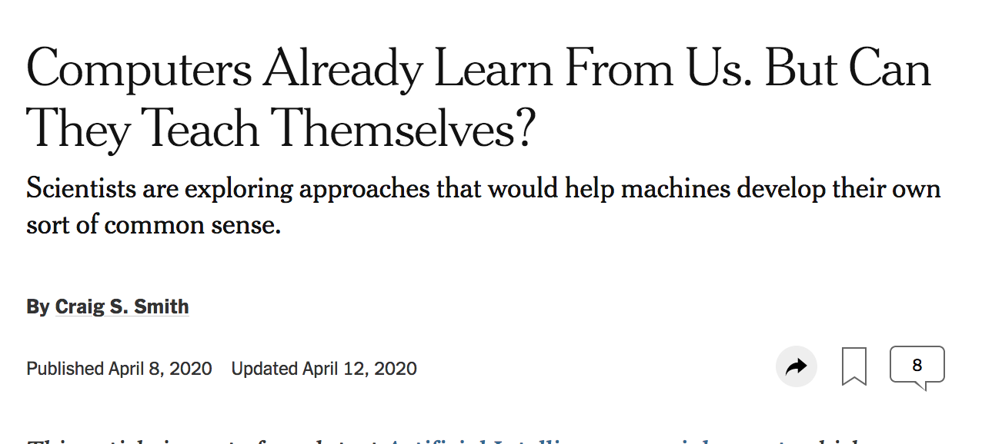
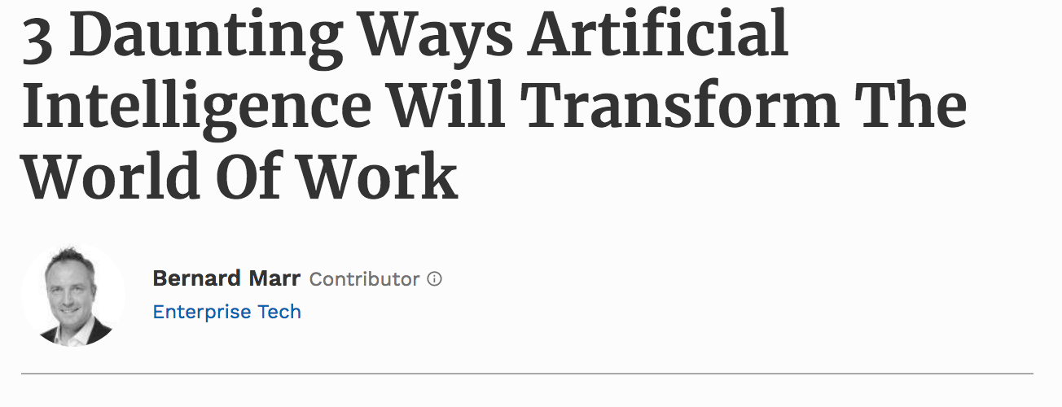
This talk:
A skeptical look at recent AI/ML advances
The goal:
To provoke questions and discussion as we get into a new academic year
There is some hyperbole to aid this goal

Slide 4
The plan for this talk
Does successful prediction imply understanding?
The Small Data Problem
Industrial strength BLOCKS Worlds + Metric Hacking: An Illusion of Progress
The Bandwagon

Slide 5
Does successful prediction imply understanding?

Slide 6
Date: May 28, 585 BCE
Time: Late afternoon
Location: Ancient Greece
Photo Credit: flickr.com/nasahqphoto

Slide 7
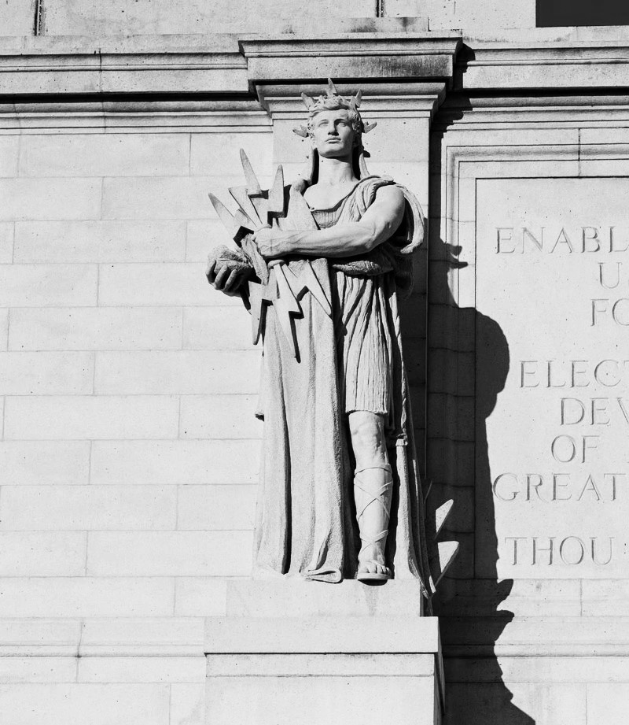
Thales of Miletus
mathematician, astronomer, philosopher
One of the earliest known successful eclipse predictions
  Possibly learned how to do so from the Babylonian astronomers
Did Thales (and Babylonians) understand how eclipses work?
Answer: Most likely not

Slide 8
“The recognition that solar eclipses are caused by the Moon coming between the Earth and the Sun did not actually come until over a century later […]. Thus Thales cannot have predicted an eclipse in any modern sense.”
Westfall, John, and William Sheehan. Celestial Shadows: Eclipses, Transits, and Occultations. Vol. 410. Springer, 2014.

Slide 9
Prediction sans understanding
  Thales & co “data mined” celestial observations to find cycles in lunar and solar eclipses…
  …they had no clue about the positions of the earth, the moon and the sun!
but
Finding patterns in data can lead to seemingly accurate predictions…
…accuracy in prediction does not signal understanding
but
Spurious patterns $→$A recipe for pathological failures

Slide 10
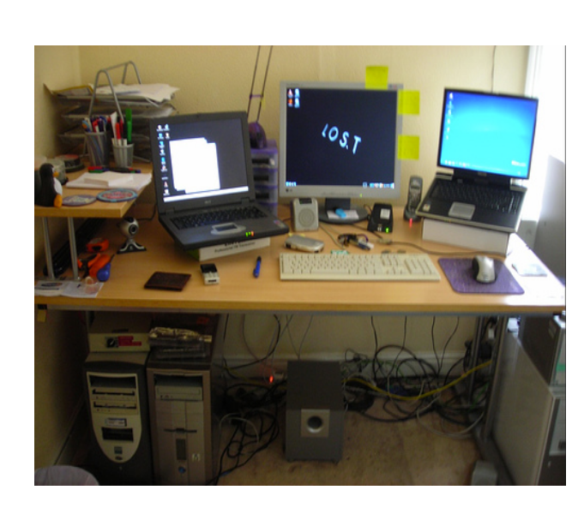
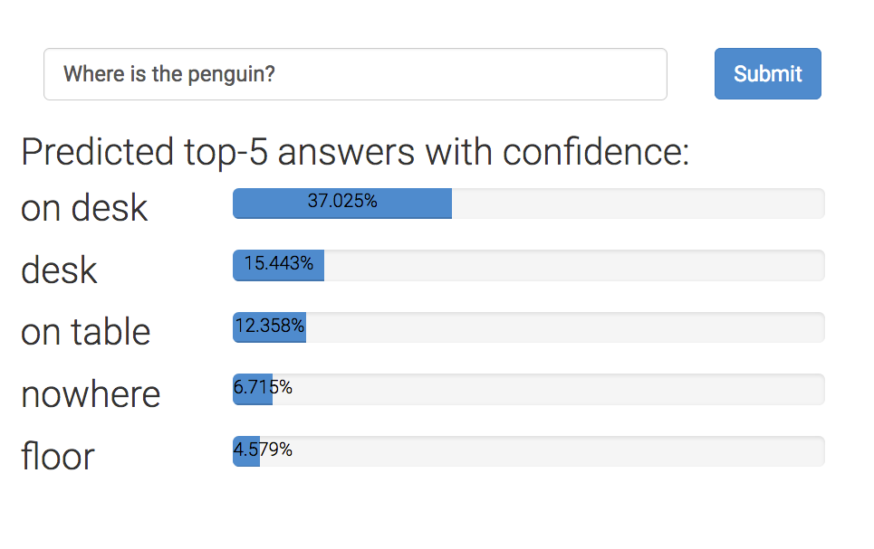
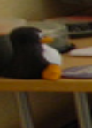
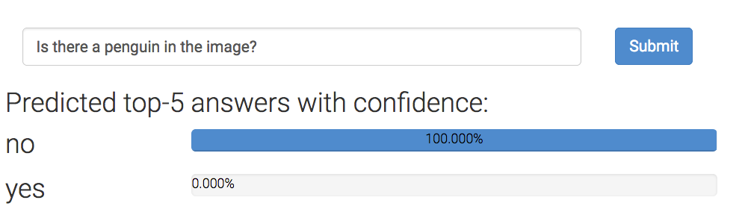
Example: Visual question answering
Where is the penguin?
But can they really ‘read’ images?
Is there a penguin in the image?
From https://visualqa.org, uses Pythia v0. 1: the winning entry to the VQA challenge 2018 [Jiang, Y et al 2018].

Slide 11
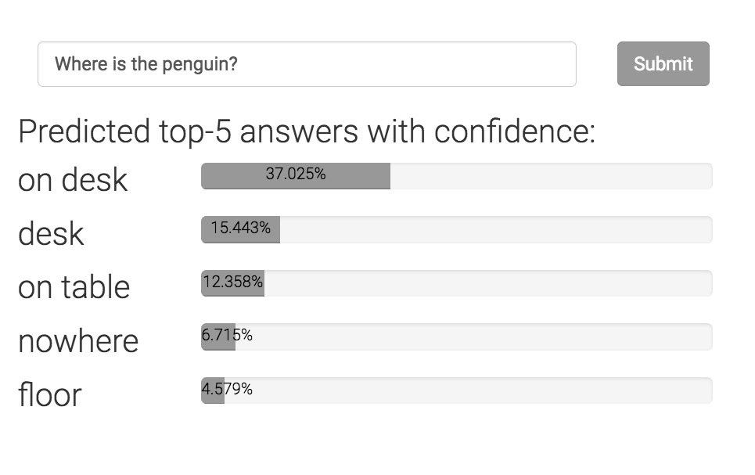
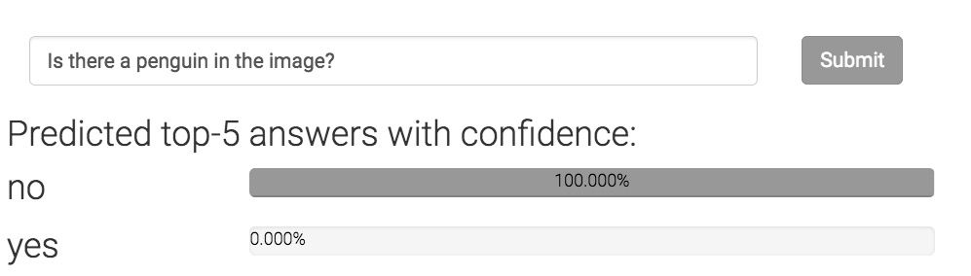
Can neural networks ‘read’ images?
Where is the penguin?
Only one of these answers can be correct.
Today’s state-of-the-art is devoid of any such “theory”
Is there a penguin in the image?

Slide 12
Challenge #1
Modeling strategies that depend on or expose a theory
  (or at least assume the existence of a theory)
  Otherwise, we are just guessing equations involving high dimensional spaces, without understanding what they mean
  Thales versus a modern view of eclipse science
    Precise predictions by curve fitting versus a philosophy of the underlying phenomena

Slide 13
The small data problem

Slide 14
Machine learning = Data-driven computing
Massive labeled data
+
Massive amounts of compute
=
Massive models
Dataset | Task | Number of labeled examples
ImageNet | Object recognition | >1 million
SNLI | Natural language inference | 570K
SQuAD | Reading comprehension | ~150K
And many, many more large datasets
Labeled data is seen as precious
  Annotation is expensive
  Pay people to annotate, or make them do it for other reasons (e.g. ReCAPTCHA)

Slide 15
Machine learning = Data-driven computing
💰-driven
Data-driven
💰
Massive labeled data
+
Massive amounts of compute
=
Massive models
💰
Is that all there is?

Slide 16
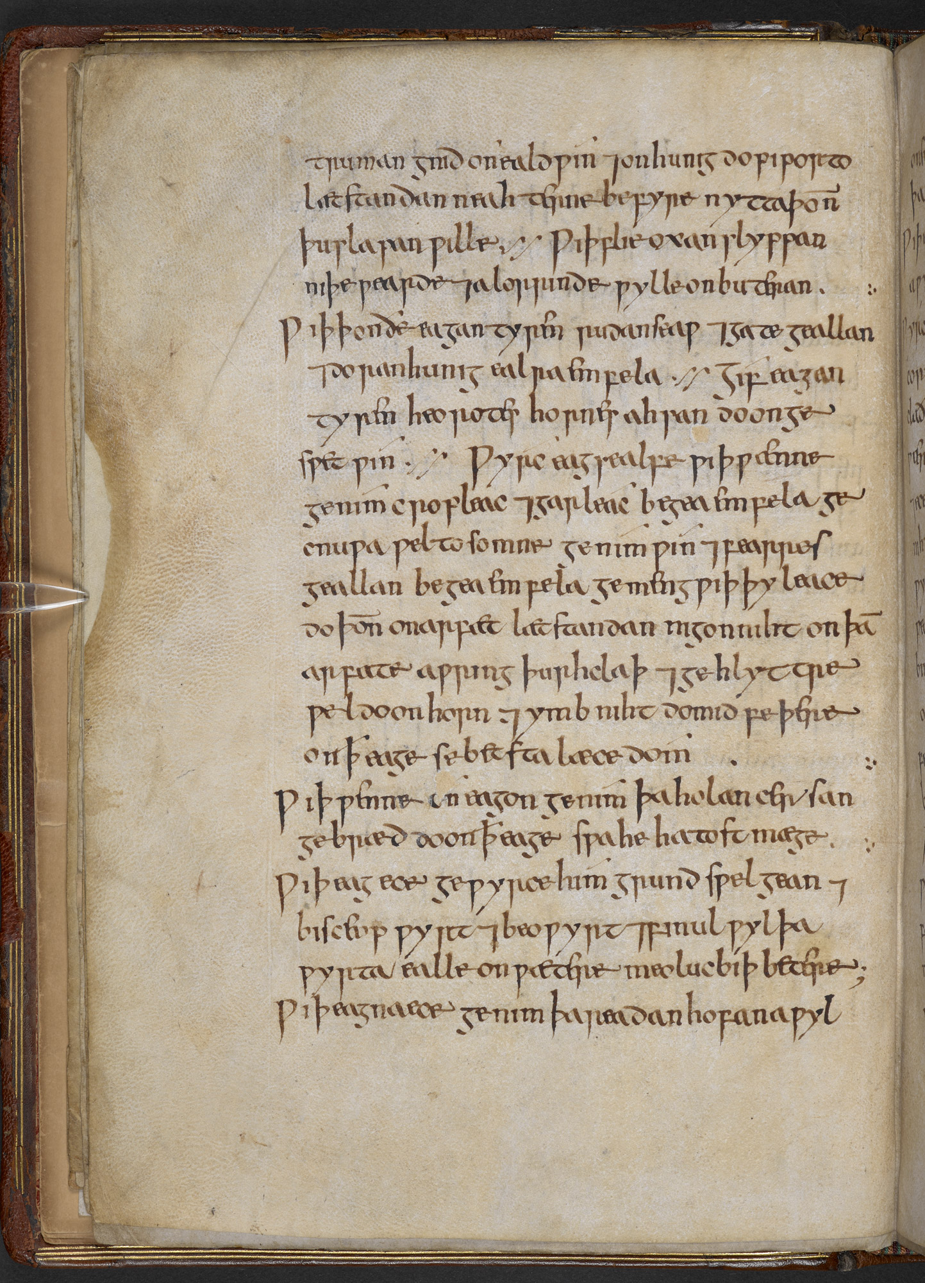
An interlude: Bald’s Leechbook
A large collection of medical remedies in Old English
Remedies against problems like
  Injuries
  Infections
  Elves
  Night goblins
  Devils
What could this possibly teach us?
Digitized by the British Library, Royal MS 12 D XVII

Slide 17
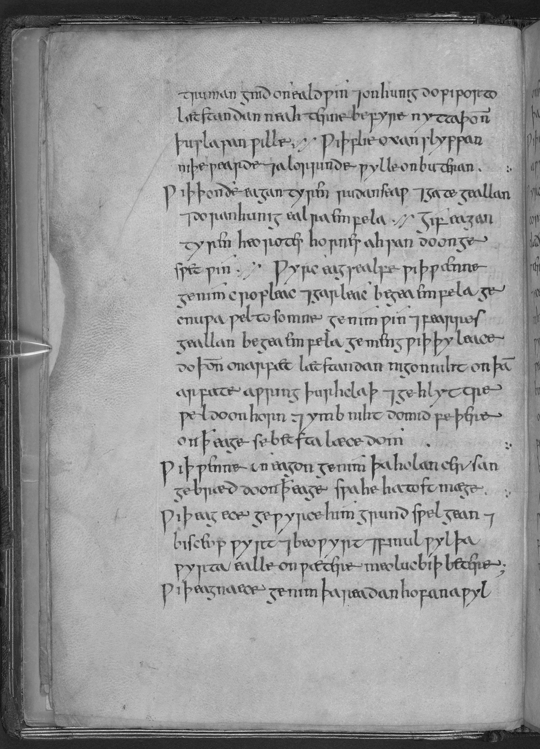
Bald’s Leechbook
Bald’s eyesalve kills an antibiotic-resistant ‘superbug’ S. aureus (also known as MRSA)!
“Make an eyesalve against a wen: take equal amounts of [an Allium species] and garlic, pound well together, take equal amounts of wine and oxgall, mix with the alliums, put this in a brass vessel, let [the mixture] stand for nine nights in the brass vessel, wring through a cloth and clarify well, put in a horn and at night apply to the eye with a feather; the best medicine.”
Are there other such recipes in this book?
…in other Old English books?
…in other ancient books in other languages?
Are there novel principles of medicine and drug development that we could learn?
Can we build statistical models that can scour old books to help drug discovery?
Freya Harrison and Erin Connelly. 2018. Could Medieval Medicine Help the Fight Against Antimicrobial Resistance. Making the Medieval Relevant:113–134.
Translation by Christina Lee.

Slide 18
Bald’s Leechbook
Can we build statistical models that can scour old books to help drug discovery?
Medieval/ancient languages and scripts
Unknown or ambiguous words, even for familiar ingredients
Lots of placebo or simply strange recipes and conditions
  (e.g., protection from elves!)
But clearly there is something useful here

Slide 19
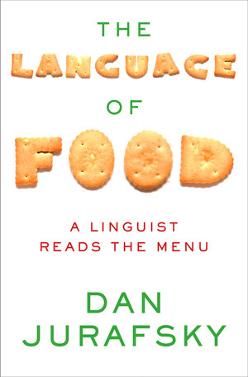
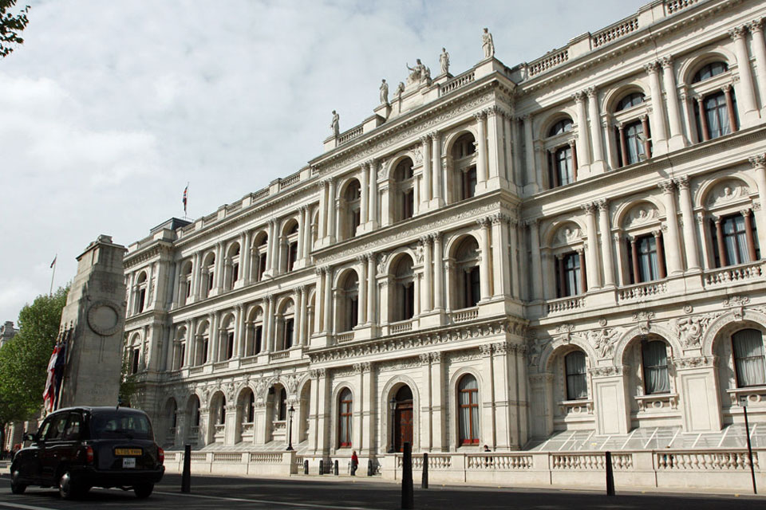
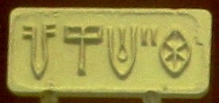
There are many other such questions
All these have a “small data problem”
What do these Indus valley symbols mean?
Do the records stored here contain evidence of colonial brutality?
Can we read old recipes to trace the spread of the cuisine, culture and language?

Slide 20
“Small data” domains and problems
Problems where:
  We don’t even have examples to label
    … because they are hard to find (e.g. archaeology),
    … because they are protected (e.g. psychotherapy)
  Even if we found the data to label, each example needs expertise
No unsupervised or semi-supervised learning
No crowd sourced annotation

Slide 21
Challenge #2
Addressing small data problems
  How do we incorporate the strong inductive bias needed?
  Can we transfer solutions, or theories across problems?

Slide 22
Industrial strength BLOCKS Worlds + Metric Hacking:
An Illusion of Progress

Slide 23
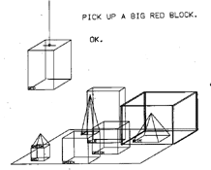
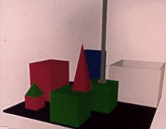
BLOCKS world
Winograd (1971)
An environment involving blocks for where a user could instruct a computer to perform actions
Person: PICK UP A BIG RED BLOCK.
Computer: OK. (does it)
Person: GRASP THE PYRAMID.
Computer: I DON'T UNDERSTAND WHICH PYRAMID YOU MEAN.
Person: FIND A BLOCK WHICH IS TALLER THAN THE ONE YOU ARE HOLDING AND PUT IT INTO THE BOX.
(and so on)
Original BLOCKS world display
A subsequent rendering from Utah
https://hci.stanford.edu/winograd/shrdlu/

Slide 24
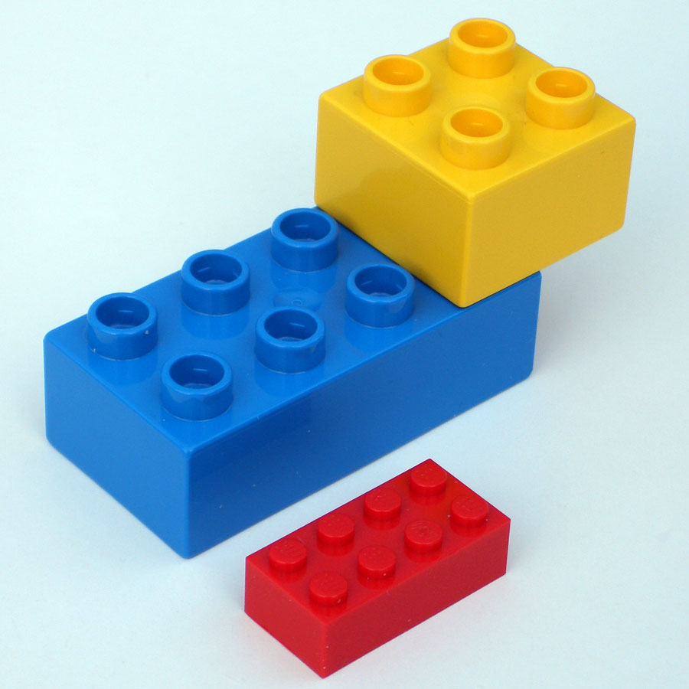
Toy problems
Neat abstractions, no real-world clutter and noise
Rich history in AI
Help understand and develop algorithms
But surely we have moved on from toy problems now, right?
Alas, no

Slide 25
Artificially generated data
An increasingly popular thing lately
Intuition
  Need large datasets to train models
    Annotation is expensive
  Can we list out the phenomena we want to handle, and programmatically create datasets? Maybe via simulation?
    Annotation is free!
Basically today’s version of the BLOCKS world
Tenuous connection to the real world sadly

Slide 26
An example artificial dataset
bAbI (Weston et al 2015) for reading comprehension
  20 focused sub-tasks, each with 1000 training and test examples
  150 word vocabulary
    Most 2-3 year olds know between 200-1000 words
    An average adult knows ~30k words
  Claimed as being “towards AI-complete question answering”
    (Though the paper admits that this is a toy dataset and not meant to be a replacement of the real thing)
An interesting exercise, but does not come close the actual complexity of what question answering may be
Weston, Jason, Antoine Bordes, Sumit Chopra, Alexander M. Rush, Bart van Merriënboer, Armand Joulin, and Tomas Mikolov. "Towards AI-complete question answering: A set of prerequisite toy tasks." arXiv preprint arXiv:1502.05698 (2015).

Slide 27
Artificial datasets vs “real” datasets
Artificial datasets have a tenuous connection to reality
Are natural datasets any better? Yes and No
  Yes: They can offer a focused, and somewhat realistic collection of cognitive phenomena to model
  No: Doing well on a dataset is not “solving” vision/language/speech/etc

Slide 28
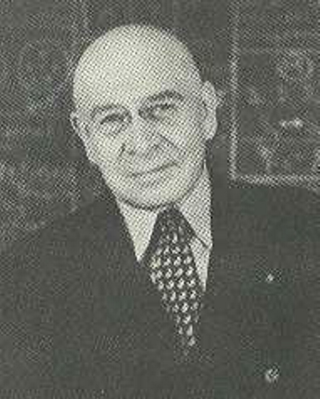
The map is not the territory
Alfred Korzybski, Science and Sanity
A dataset is an abstraction of a phenomenon we want to model
  Necessarily finite
  Necessarily gives up on edge cases
  Necessarily makes hard boundaries between soft concepts
A dataset is not the task

Slide 29
Task- and dataset-driven myopia
Computer vision is not the same as
  Recognizing 20k objects with ImageNet
  Recognizing digits with MNIST
  Generating faces
  Visual question answering using any fixed dataset
Natural language processing is not the same as
  Sentiment analysis on SST dataset
  Natural language inference on any fixed dataset
  Reading comprehension on any fixed dataset
  Generating a sequence of words using the largest model
Human vision does all this, but much more
without actually training on these datasets!
Human language processing does all this, but much more
Important caveat: Of course these tasks are present intellectual challenges. But they are not all there is.

Slide 30
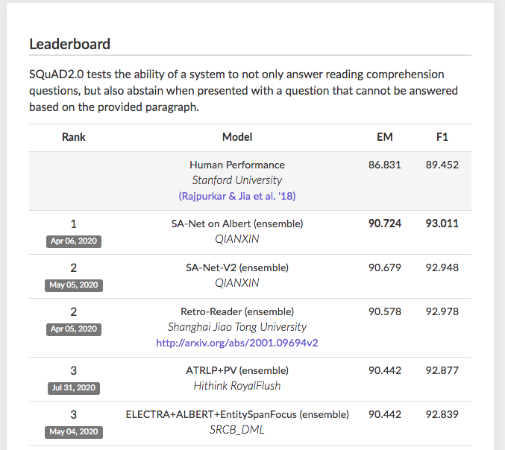
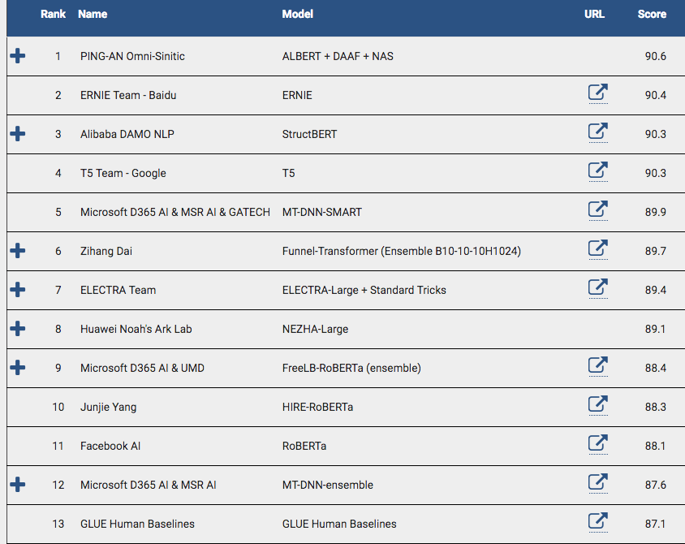
A related trend: Leaderboarding
Has the metric become the goal?
What does it mean to do better than human?!
SQuAD
GLUE

Slide 31
Some things to think about
Even the biggest fixed dataset out there…
  …only accesses a tiny slice of the cognitive phenomena we are capable of
    Object recognition in static images, but nothing else?
    Sentiment recognition that works well only on movie reviews?
  …only uses a small fragment of vocabulary that we are capable of learning
Chasing state-of-the-art on a leaderboard can become a counterproductive end goal
  Model failures are as important as model successes to drive progress
  What does “better than human” even mean if humans represent the ground truth?

Slide 32
Challenges #3, #4
We need datasets to evaluate (and maybe even train). But…
…how do we avoid dataset myopia?
Standardized evaluation is important. But…
…how can we avoid a leaderboard-fueled SOTA-chasing culture?

Slide 33
The Bandwagon

Slide 34
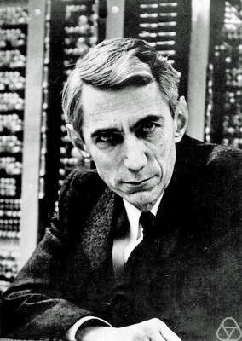
Claude Shannon and Information Theory
Formalized information theory in his landmark 1948 paper
Widely applicable, almost immediately
In fact, so successful that it entered into a hype cycle

Slide 35
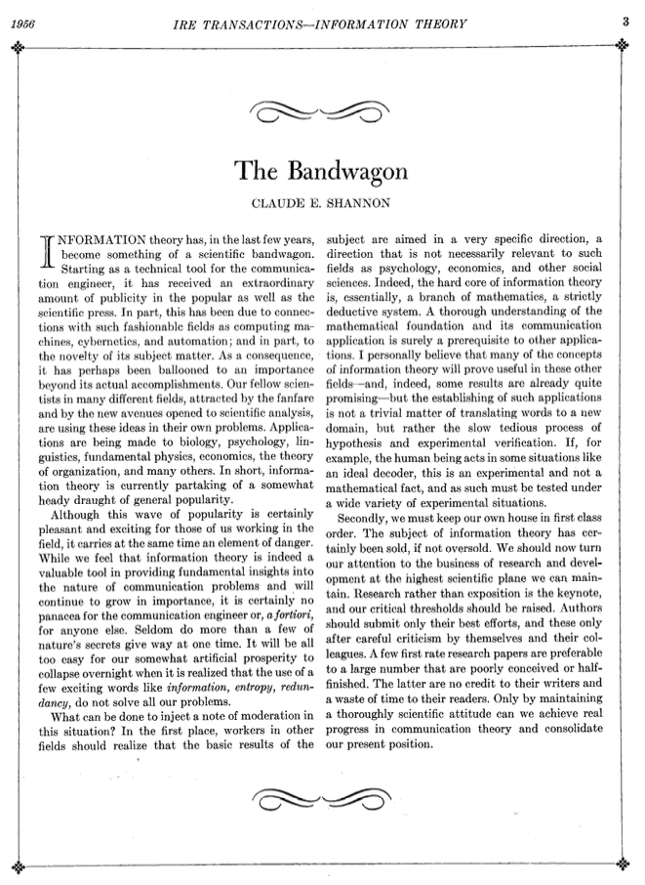
The Bandwagon
A short 1956 opinion piece warning about the dangers of jumping on the bandwagon
Focused on information theory, but it is more broadly relevant
  Worth reading and mentally replacing “information theory” with “machine learning”
Shannon, Claude E. "The Bandwagon." IRE Transactions on Information Theory 2, no. 1 (1956): 3.

Slide 36
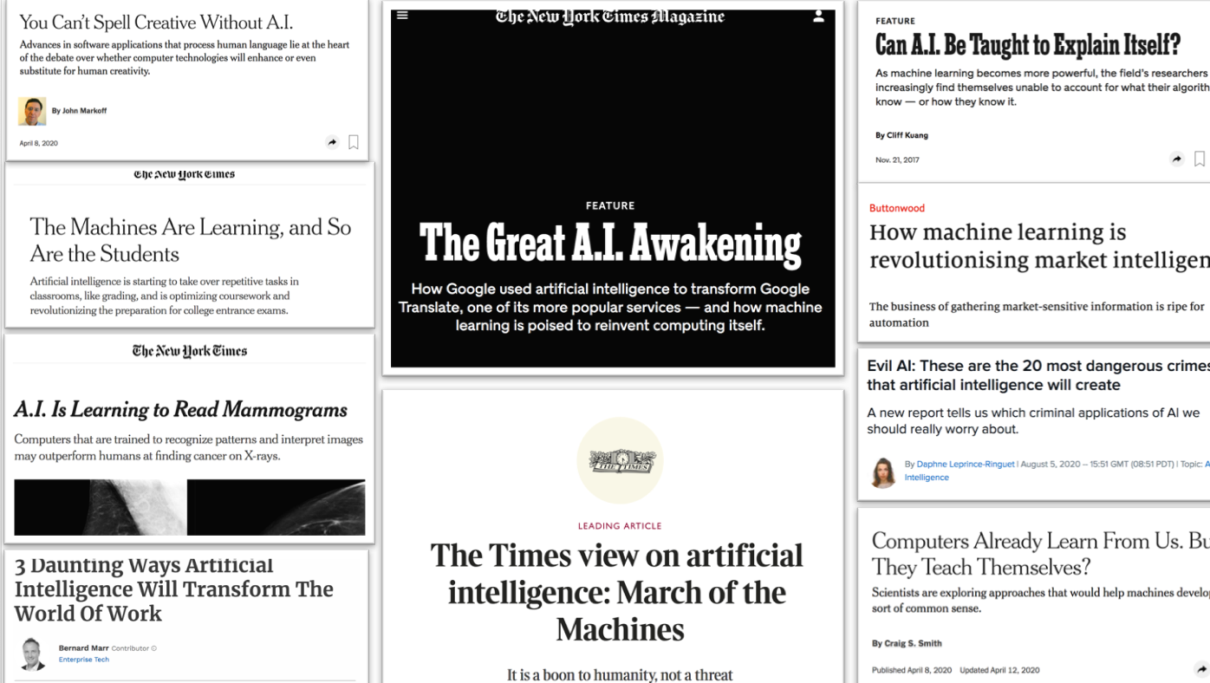
The symptoms of the bandwagon
A technical tool for a niche group of engineers or scientists
Receives an extraordinary amount of publicity in the popular as well as scientific press
  Connections with fashionable fields
  Also because of the novelty of its subject matter
Balloons to an importance beyond its actual accomplishments
Fellow scientists in many different fields are using the ideas in their own problems
All these are lightly edited quotes from Shannon, 1956

Slide 37
A warning
The wave of popularity carries an element of danger
The subject (i.e, information theory/machine learning) is important, but not a panacea
  Seldom do more than a few of nature's secrets give way at one time.
The artificial prosperity may collapse overnight…
  …when people realize that the new exciting words don’t solve all problems
All these are lightly edited quotes from Shannon, 1956

Slide 38
Injecting moderation: Avoid overstating relevance
Establishing applications in new fields is not a trivial matter of translating words to a new domain
  Slow, tedious process of hypothesis and experimental verification
If certain prediction appear to be true in practice, they must be tested under a wide variety of experimental conditions
All these are lightly edited quotes from Shannon, 1956

Slide 39
Injecting moderation: Keeping our house clean
The subject has certainly been sold, if not oversold
Authors should submit only their best efforts
  A few first rate research papers are preferable to a large number that are poorly conceived or half-finished
Only maintaining a thoroughly scientific attitude can achieve real progress
All these are lightly edited quotes from Shannon, 1956

Slide 40
Fads & Fallacies
Title of this talk: A reference to Martin Gardner’s famous book from the 1950s
One of the first writings about scientific skepticism
“The curious theories of modern pseudoscientists and the strange, amusing and alarming cults that surround them.
A study in human gullibility”
60+ year old stuff that we may be able to laugh about now
What will people from 2080 find about us to laugh about?

Slide 41
Final words
Develop modeling strategies that depend on or expose a theory
Address small data problems
Go beyond neat toy problems
Don’t be fooled by metrics and question them
Beware the bandwagon
Thanks! Questions?

