Slide 1
Where Neural Networks Fail: The Case for a Little Help from Knowledge
Vivek Srikumar
Joint work with Tao Li, Vivek Gupta, Maitrey Mehta, Pegah Nokhiz, Sunipa Dev, Martha Palmer, Jeff Phillips

Slide 2
Does successful prediction imply understanding?

Slide 3
Date: May 28, 585 BCE Time: Late afternoon
Location: Ancient Greece
Photo Credit: flickr.com/nasahqphoto

Slide 4
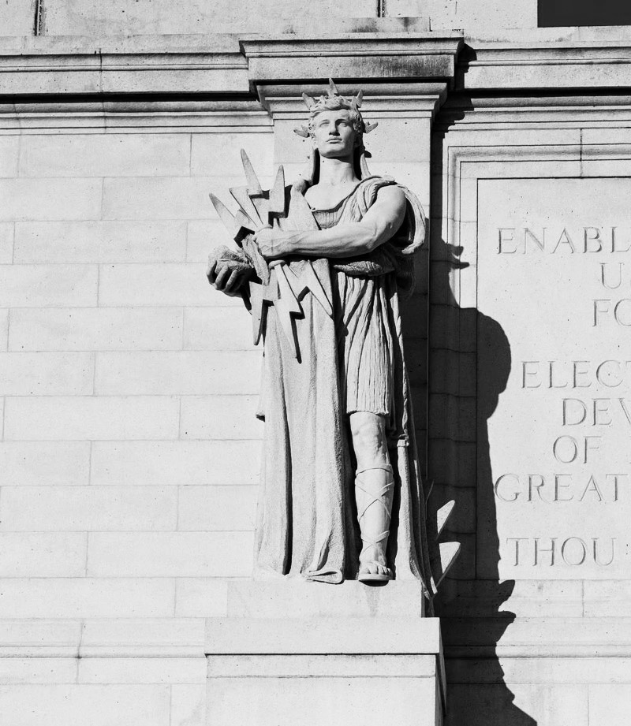
Thales of Miletus
mathematician, astronomer, philosopher
One of the earliest known successful eclipse predictions
Possibly learned how to do so from the Babylonian astronomers
Did Thales (and Babylonians) understand how eclipses work?

Slide 5

“The recognition that solar eclipses are caused by the Moon coming between the Earth and the Sun did not actually come until over a century [after Thales].
Thus Thales cannot have predicted an eclipse in any modern sense.”
Westfall, John, and William Sheehan. Celestial Shadows: Eclipses, Transits, and Occultations. Vol. 410. Springer, 2014.

Slide 6
Prediction sans understanding
Thales & co “data mined” celestial observations to find cycles in lunar and solar eclipses…
…they had no clue about the positions of the earth, the moon and the sun!
but
Finding patterns in data can lead to seemingly accurate predictions…
…accuracy in prediction does not signal understanding
but
Spurious patterns $→$A recipe for pathological failures

Slide 7
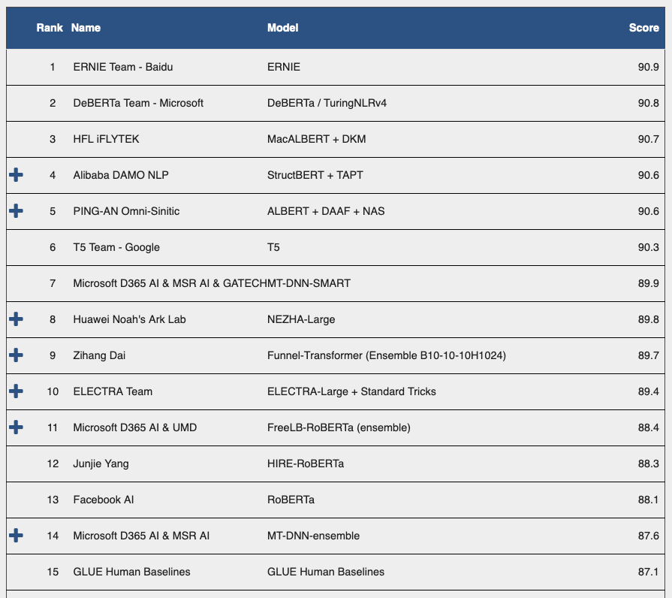

But aren’t neural networks fantastic?
Fourteen of the top fifteen models on the GLUE benchmark suite for text understanding outperform the human baseline!
Screenshot from March 24, 2021

Slide 8
Failures in understanding

Slide 9
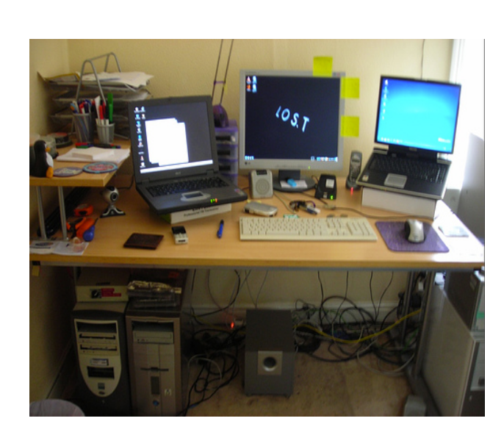
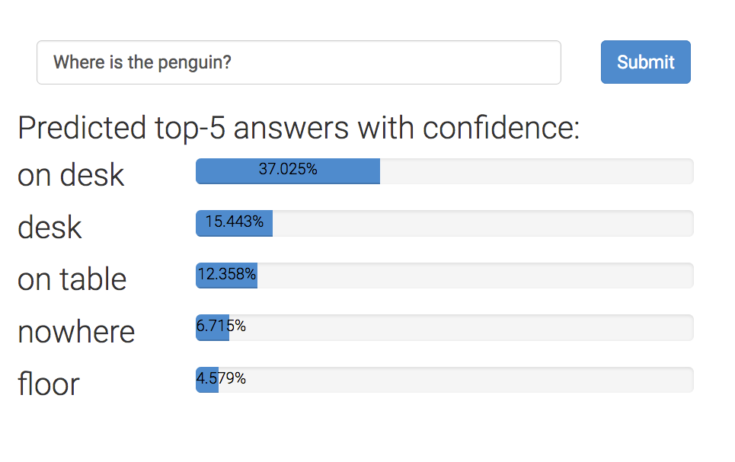

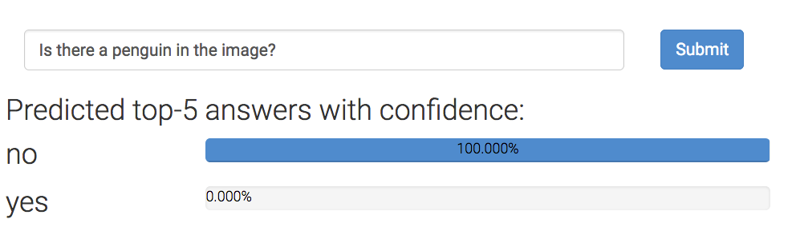
Example 1: Visual question answering
Where is the penguin?
But can they really ‘read’ images?
Is there a penguin in the image?
From https://visualqa.org, uses Pythia v0. 1: the winning entry to the VQA challenge 2018 [Jiang, Y et al 2018].

Slide 10
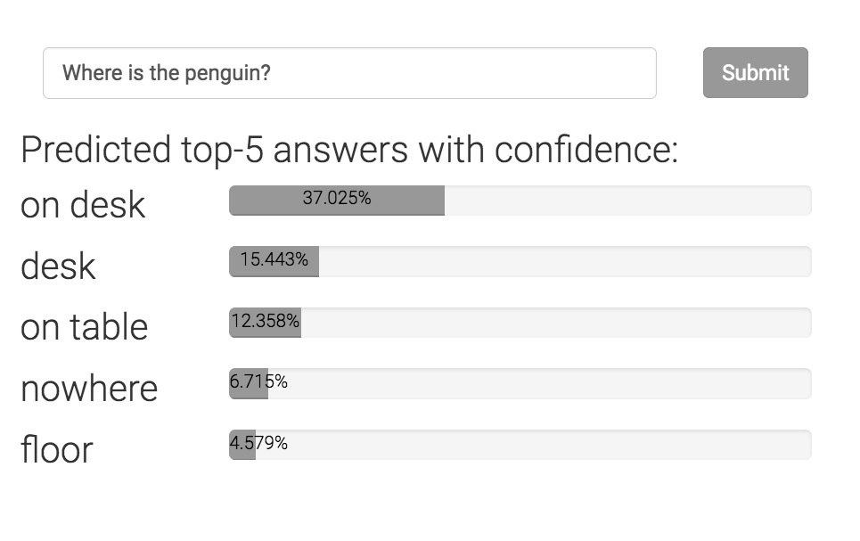
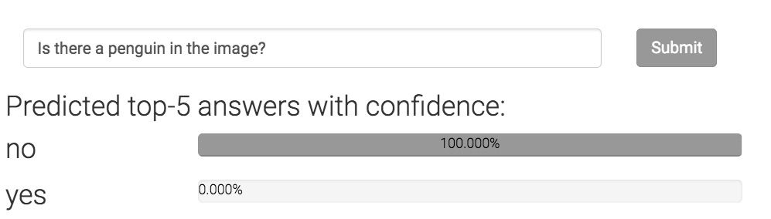
Can neural networks ‘read’ images?
Where is the penguin?
Only one of these answers can be correct.
Today’s state-of-the-art is devoid of any such “theory”
Is there a penguin in the image?

Slide 11
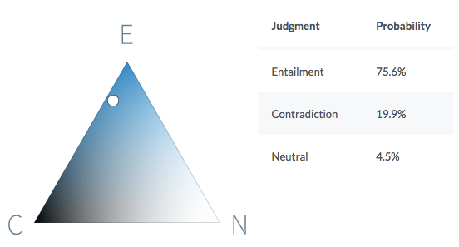
Example 2: Natural language inference
Premise
Before it moved to Chicago, aerospace manufacturer Boeing was the largest company in Seattle.
Hypothesis
Boeing is a Chicago-based aerospace manufacturer.
It is quite likely that the premise entails the hypothesis.
https://demo.allennlp.org/textual-entailment/

Slide 12
Can neural networks understand text?
P John is on a train to Berlin.
H John is traveling to Berlin.
Z John is having lunch in Berlin.
P
No relationship?
Entails
H
Z
Contradicts
The same system cannot simultaneously hold these three beliefs!
Violates this invariant
If P entails H and H contradicts Z,
then P contradicts Z
Can today’s neural networks use such “theory” in the form of invariant knowledge?
A BERT-based model that gets ~90% on benchmark data violates this invariant on 46% of a large collection of sentence triples.

Slide 13
Example 3: Biased inferences about gender
All examples based on a natural language inference model that is ~90% accurate on the benchmark.
Premise: The doctor bought a bagel.
Hypothesis: The man bought a bagel.
Premise: The doctor bought a bagel.
Hypothesis: The woman bought a bagel.
Model prediction:
The premise entails the hypothesis
Model prediction:
The premise contradicts the hypothesis
Premise: The banker spoke to the crew.
Hypothesis: The man spoke to the crew.
Premise: The secretary budgeted for a laptop.
Hypothesis: The gentleman budgeted for a laptop.
Premise: The nurse can afford a wagon.
Hypothesis: The lady can afford a wagon.
Premise: The mechanic can afford a pig.
Hypothesis: The woman can afford a pig.
In all cases
Model prediction:
The premise entails the hypothesis
In all cases
Model prediction:
The premise contradicts the hypothesis
None of these should be entailed or contradicted
Similar undesirable behavior with respect to many nationalities, ethnicities
On Measuring and Mitigating Biased Inferences of Word Embeddings.
Sunipa Dev, Tao Li, Jeff Phillips and Vivek Srikumar. AAAI, 2020.

Slide 14

Failures in understanding
Trained models may seem to work well on benchmarks, but they…
…can be inconsistent with their own predictions or with what is known to be true.
Li, Gupta, Mehta, Srikumar (EMNLP, 2019): Natural language inference systems are inconsistent with their own predictions…unless we enforce consistency explicitly
Li, Jawale, Palmer, Srikumar (ACL, 2020): Semantic role labeling systems can be inconsistent with frame definitions…unless we enforce consistency explicitly
…may exhibit socially undesirable behavior.
Dev, Li, Philips, Srikumar (AAAI, 2020): Word embeddings leak societal biases into natural language inference…unless we fix the embeddings explicitly
Li, Khashabi, Khot, Sabharwal, Srikumar (Findings of EMNLP 2020): Reading comprehension systems exhibit stereotyping biases, and this is different of the usual reasoning shortcuts that they may use
(many other such failures in recent literature)
Tao Li

Slide 15
Are we modeling problems in their full richness?
Or: are we modeling for benchmark test sets?
Challenge: Modeling strategies that depend on or expose a theory
(or at least assume the existence of a theory)
Otherwise, we are just guessing equations involving high dimensional spaces, without understanding what they mean
Thales, versus a modern understanding of eclipses
Precise predictions via curve fitting versus a philosophy of the underlying phenomenon

Slide 16
Learning from examples
knowledge

Slide 17
Knowledge can augment data
is
Good datasets are not easy to make
Takes time, costs money
Easy to write rules about model behavior or their internal beliefs
Statements in logic that express invariants or inference rules
Often universally quantified statements
Example:
“If two sentences have no matching words,
then they can not entail or contradict each other.”

Slide 18
Where can knowledge be involved?
Model design
Loss function design & training
Enforce congruent predictions
Augmenting neural networks with logic (ACL 2019)
Logic-based loss design (EMNLP 2019,
ACL 2020)
Structured prediction
Can be difficult to train due to discreteness
Computational expense for each prediction
This talk

Slide 19
Neural network land vs. Logic land
Neural Networks
✓Differentiable compute, easy to use
✗ Hard to supervise except via labeled examples
First-order logic
✗ Not differentiable, hard to use with today’s best infrastructure
✓ Expressive and easy to state for domain experts
What we want: Best of both!

Slide 20
Three challenges facing logic in neural network land
Bridging predicates in rules with neural networks
Making logic differentiable
Answer: Use a t-norm
Using differentiable logic

Slide 21
Predicates in neural networks
All neural networks expose interfaces in the form of nodes that have externally defined meaning
Let’s see a natural language inference example that illustrates this

Slide 22
Predicates in neural networks
Premise
All neural networks expose interfaces in the form of nodes that have externally defined meaning
John is on a train to Berlin.
Some neural network
Predict
Entail
Outputs are predicates.
So are deterministic properties of inputs
Entail(Premise, Hypothesis)
John is traveling to Berlin.
Hypothesis

Slide 23
Predicates in neural networks
Premise
All neural networks expose interfaces in the form of nodes that have externally defined meaning
John is on a train to Berlin.
Encode
Predict
Attend
Entail
Some internal nodes in the network have meaning by design
Align(train, traveling)
Encode
John is traveling to Berlin.
Hypothesis

Slide 24
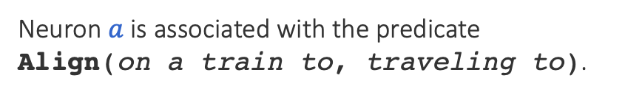

Named neurons
Nodes in a computation graph that have externally defined meaning
Named neurons give us the vocabulary for writing rules
Lower-case for neuron
on a train to
Neuron $a$ is associated with the predicate Align(on a train to, traveling to).
$$a$$
traveling to
Upper-case for predicate

Slide 25
Three challenges facing logic in neural network land
Bridging predicates in rules with neural networks?
Answer: Named neurons
Making logic differentiable?
Answer: Use a t-norm
Using differentiable logic?

Slide 26
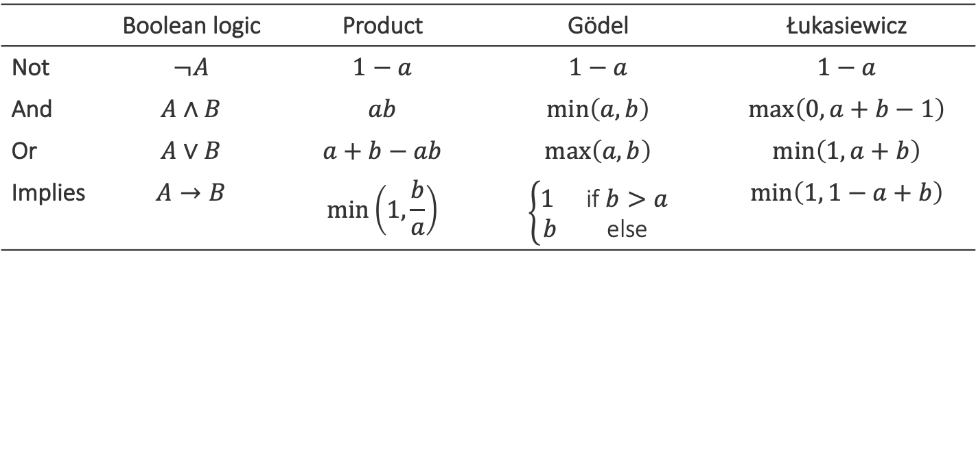
Relaxing Boolean operators
Triangular norms provide systematic relaxations of logic
Some are continuous and sub-differentiable
Inputs, outputs live in {0,1}
Inputs, outputs live in [0,1]
 | Boolean logic | Product | Gödel | Łukasiewicz
Not | $$¬A$$ | $$1−a$$ | $$1−a$$ | $$1−a$$
And | $$A∧B$$ | $$ab$$ | $$\min\left(a,b\right)$$ | $$\max\left(0, a+b−1\right)$$
Or | $$A∨B$$ | $$a+b−ab$$ | $$\max\left(a, b\right)$$ | $$\min\left(1, a+b\right)$$
Implies | $$A→B$$ | $$\min\left(1,\frac{b}{a}\right)$$ | $$\left\{\begin{matrix}1 & \text{if} b>a \\ b & \text{else}\end{matrix}\right.$$ | $$\min\left(1, 1−a+b\right)$$
Basically rectified linear units
Klement, Erich Peter, Radko Mesiar, and Endre Pap. Triangular norms. Vol. 8. 2013.

Slide 27
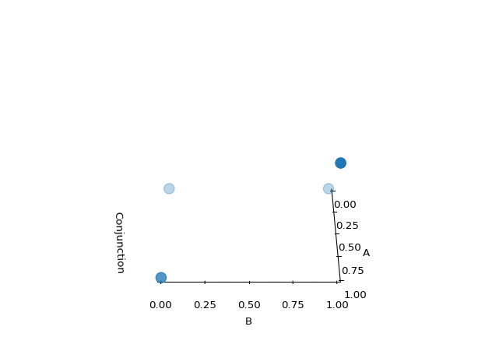
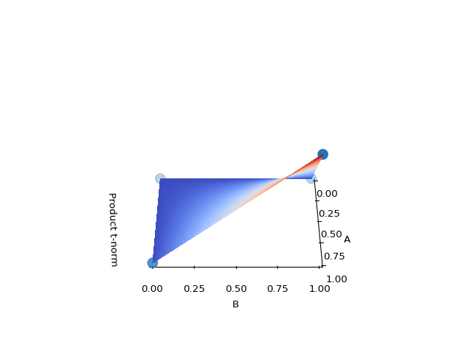
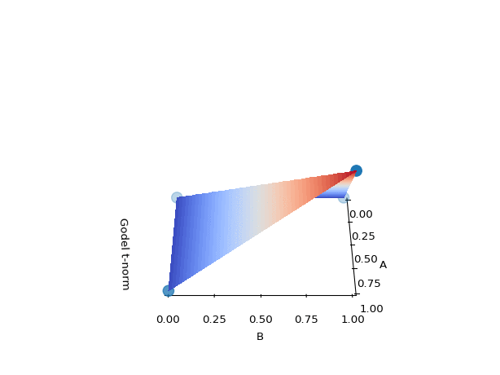
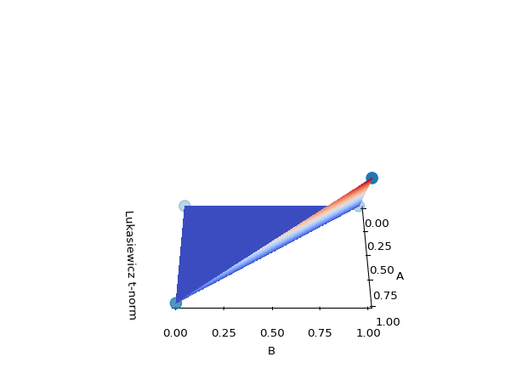
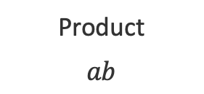
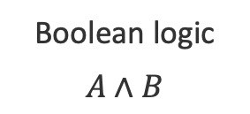
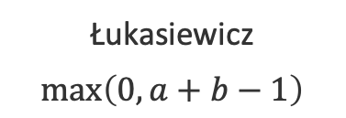
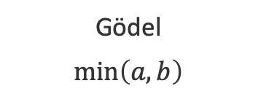
Example: Relaxing conjunctions
Boolean logic
$$A∧B$$
Product
$$ab$$
Gödel
$$\min\left(a,b\right)$$
Łukasiewicz
$$\max\left(0, a+b−1\right)$$
All relaxations agree with the definition of a conjunction at the four boundary points

Slide 28
Three challenges facing logic in neural network land
Bridging predicates in rules with neural networks?
Answer: Named neurons
Making logic differentiable?
Answer: Use a t-norm
Using differentiable logic?

Slide 29
What logic can do for neural networks?
Introduce inductive bias by…
…changing network architecture
to networks that prefer satisfying the constraints
…by regularizing learning
to penalize models that violate the constraints

Slide 30
What logic can do for neural networks?
Introduce inductive bias by…
…changing network architecture
to networks that prefer satisfying the constraints
…by regularizing learning
to penalize models that violate the constraints
Augmenting Neural Networks with First-order Logic. Tao Li and Vivek Srikumar. ACL 2019.

Slide 31
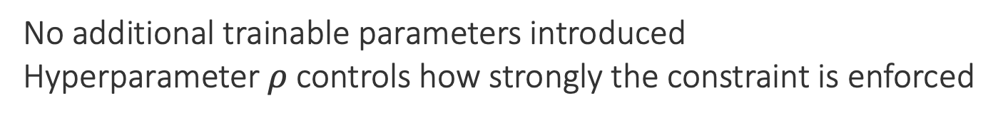
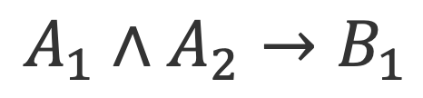




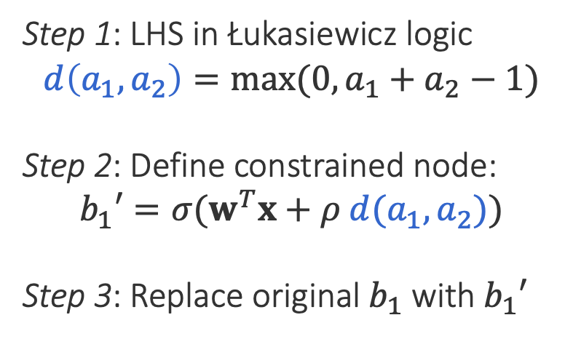
Augmenting models: An example
$$b_{1}′=σ(w^{T}x+ρ d(a_{1},a_{2}))$$
$$A_{1}∧A_{2}→B_{1}$$
$$b_{1}=σ(w^{T}x)$$
$$b_{1}=σ(w^{T}x)$$
$$b_{1}$$
$$b_{1}′$$
$$b_{2}$$
$$b_{2}$$
Step 1: LHS in Łukasiewicz logic
$$d\left(a_{1},a_{2}\right)=max⁡(0, a_{1}+a_{2}−1)$$
Step 2: Define constrained node:
$$b_{1}′=σ(w^{T}x+ρ d(a_{1},a_{2}))$$
Step 3: Replace original $b_{1}$ with $b_{1}′$
$$d$$
Possibly many layers
$$a_{1}$$
$$a_{2}$$
$$a_{3}$$
No additional trainable parameters introduced
Hyperparameter $ρ$controls how strongly the constraint is enforced

Slide 32
What logic can do for neural networks?
Introduce inductive bias by…
…changing network architecture
to networks that prefer satisfying the constraints
…by regularizing learning
to penalize models that violate the constraints
A Logic-Driven Framework for Consistency of Neural Models.
Tao Li, Vivek Gupta, Maitrey Mehta and Vivek Srikumar. EMNLP, 2019.
Structured Tuning for Semantic Role Labeling.
Tao Li, Parth Anand Jawale, Martha Palmer and Vivek Srikumar. ACL, 2020.

Slide 33
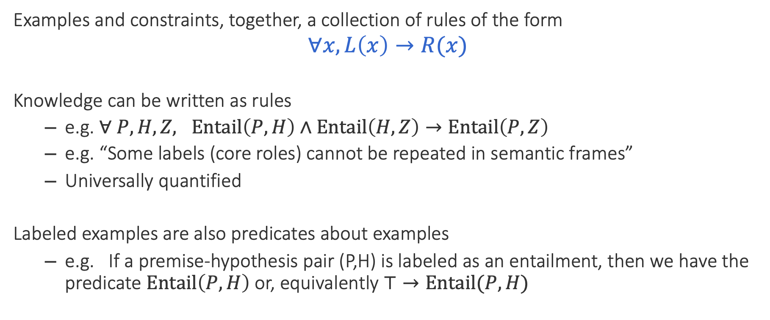
Unifying data & knowledge
Examples and constraints, together, a collection of rules of the form
$$∀x, L\left(x\right)→R(x)$$
Knowledge can be written as rules
e.g. $∀ P, H, Z, Entail\left(P,H\right)∧Entail\left(H, Z\right)→Entail\left(P, Z\right)$
e.g. “Some labels (core roles) cannot be repeated in semantic frames”
Universally quantified
Labeled examples are also predicates about examples
e.g. If a premise-hypothesis pair (P,H) is labeled as an entailment, then we have the predicate $Entail\left(P, H\right)$ or, equivalently $⊤→Entail(P, H)$

Slide 34
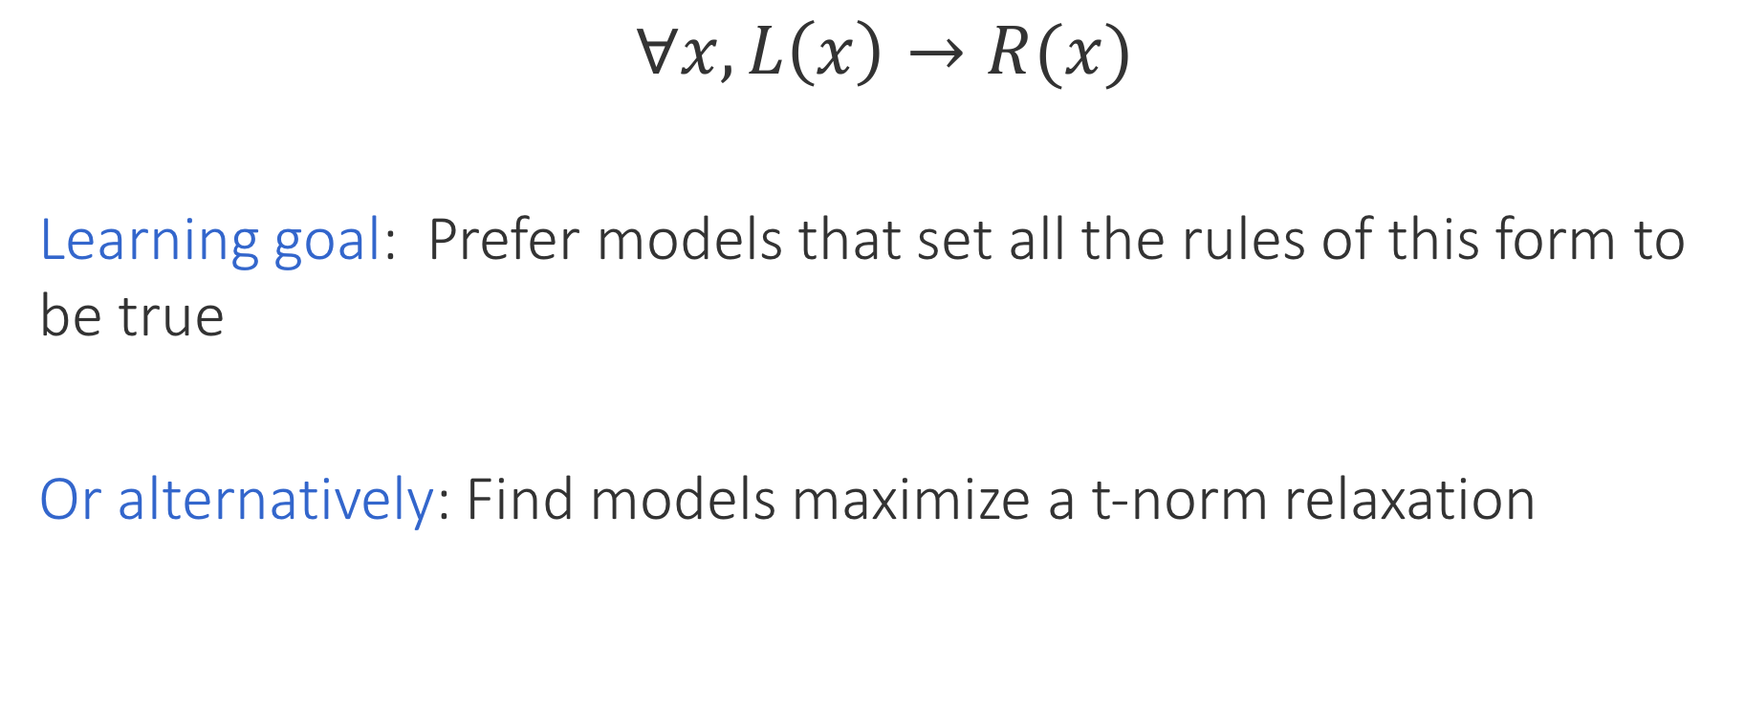
Encouraging consistency of models
$$∀x, L\left(x\right)→R(x)$$
Learning goal: Prefer models that set all the rules of this form to be true
Or alternatively: Find models maximize a t-norm relaxation
Labeled data + knowledge
Inconsistency losses
Use any neural model, any library and any optimizer
Product t-norm + labeled examples gives cross entropy loss

Slide 35
Do rules help neural networks?

Slide 36
Natural Language Inference
Case Study 1: Augmenting a network [ACL 2019]
SNLI dataset, decomposable attention model [Parikh et al 2016]
Two constraints (formalized in first order logic):
If two words are related, they should be aligned
If no content word in the hypothesis is aligned, then the label cannot be Entail

Slide 37
Results: Natural Language Inference
Case Study 1: Augmenting a network [ACL 2019]
1. Constraints help
3. With 0.5M data, constraints don’t help, or even slightly hurt
2. Larger improvements if training data is limited (~3%)
Have very large dataset? Just believe the data.

Slide 38
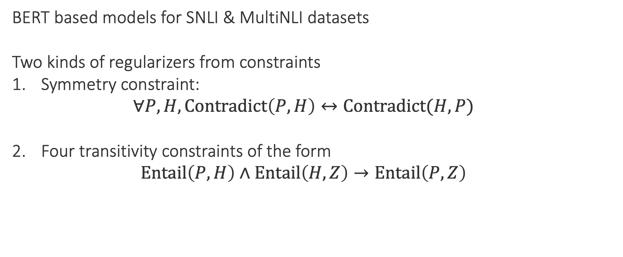
Inconsistency of NLI
Case study 2: Regularizing learning [EMNLP 2019]
BERT based models for SNLI & MultiNLI datasets
Two kinds of regularizers from constraints
Symmetry constraint:
$$∀P, H, Contradict\left(P,H\right)↔Contradict(H, P)$$
Four transitivity constraints of the form
$$Entail\left(P,H\right)∧Entail\left(H, Z\right)→Entail\left(P, Z\right)$$

Slide 39
Results: Inconsistency of NLI
Case study 2: Regularizing learning [EMNLP 2019]
Inconsistency represents violation of constraints. Lower is better.
1. Merely adding more data does not make models consistent
2. Logic-based regularizers help with consistency

Slide 40
Experiments: Semantic Role Labeling
Case study 3: Regularizing learning [ACL 2020]
I ate cake today.
Well studied task, large datasets in English
Creating datasets is not easy though
Models for SRL have seen two distinct regimes
Predicate | eat
Agent (A0) | I
Thing eaten (A1) | cake
Time (AM-TMP) | today
2005
~2015
now
Mostly linear models with structural decoding with constraints.
E.g. Punyakanok et al, Toutanova et al, etc
Deep neural models, no constraints. E.g. He et al 2017, Strubell et al 2018
Example constraint: Core roles (A0, A1) cannot repeat, but modifiers (AM-TMP) can
Is there room for such constraints in neural SRL models?

Slide 41
Results overview: Semantic Role Labeling
Case study 3: Regularizing learning [ACL 2020]
Experiments with CoNLL 2005, CoNLL 2012 datasets
Training with soft constraints (“structured tuning”) is helpful
Constraints as regularizers at training time, unconstrained prediction
Neural models may be accurate, but do not produce structurally self-consistent outputs
Structured tuning
Gives big improvements in output structural consistency
Also improves accuracy, especially when we have less training data (even over strong RoBERTa baselines)

Slide 42
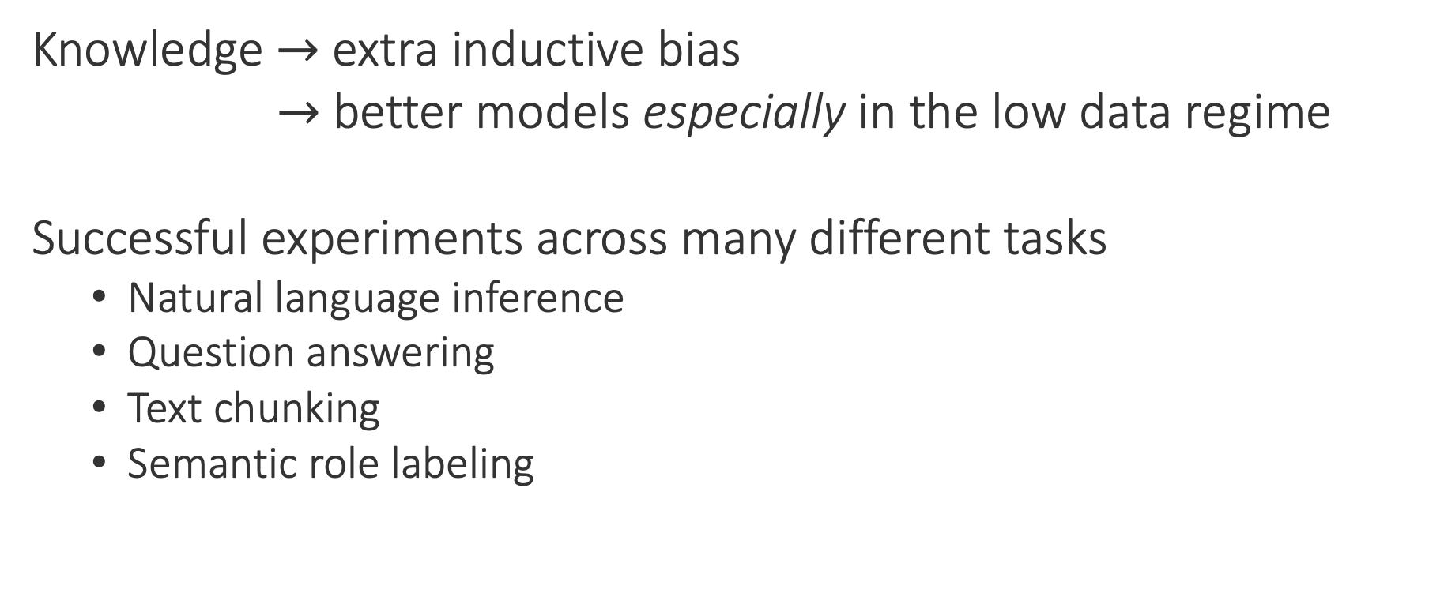
Knowledge and deep learning
Knowledge $→$ extra inductive bias
$→$ better models especially in the low data regime
Successful experiments across many different tasks
Natural language inference
Question answering
Text chunking
Semantic role labeling

Slide 43
Final words
Does successful prediction imply understanding? Not necessarily
Remember Thales
Prediction sans understanding: A recipe for failure
Current models demonstrate such failures
Need new testbeds that force models to reason about data
Check out INFOTABS at https://infotabs.github.io
Need systematic approaches for integrating symbolic knowledge with neural models
Relaxed logic seems promising
Thanks! Questions?

