Slide 1
Training Neural Networks with a Little Help from Knowledge
Vivek Srikumar
Joint work with Tao Li, Vivek Gupta, Maitrey Mehta, Martha Palmer, Ashim Gupta and Mattia Medina-Grespan

Slide 2
Does successful prediction imply understanding?
Today’s neural networks are fantastic prediction machines

Slide 3
Date: May 28, 585 BCE
Time: Late afternoon
Location: Ancient Greece
Photo Credit: flickr.com/nasahqphoto

Slide 4
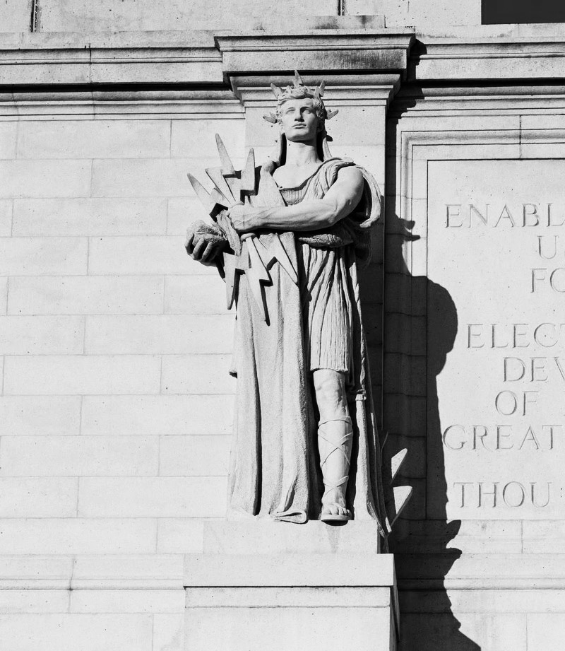
Thales of Miletus
mathematician, astronomer, philosopher
One of the earliest known successful eclipse predictions
  Possibly learned how to do so from the Babylonian astronomers
Did Thales (and Babylonians) understand how eclipses work?
  No. That came about a century after Thales

Slide 5
Prediction sans understanding
  Thales & co “data mined” celestial observations to find cycles in lunar and solar eclipses…
  …they had no clue about the positions of the earth, the moon and the sun!
but
Finding patterns in data can lead to seemingly accurate predictions…
…accuracy in prediction does not imply understanding
but
Spurious patterns $→$A recipe for pathological failures

Slide 6
Failures in understanding

Slide 7
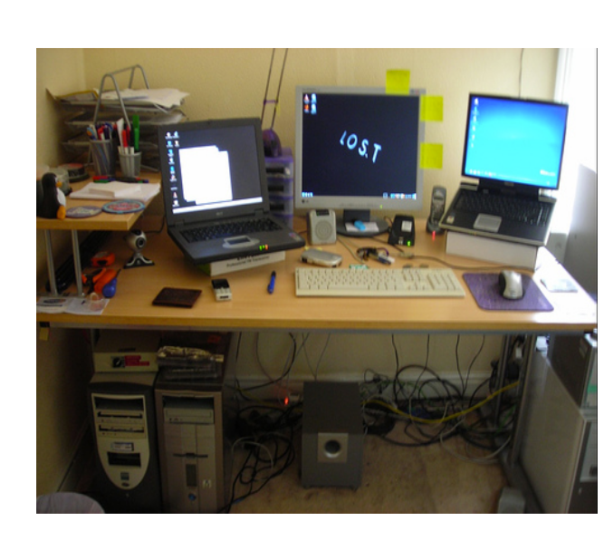
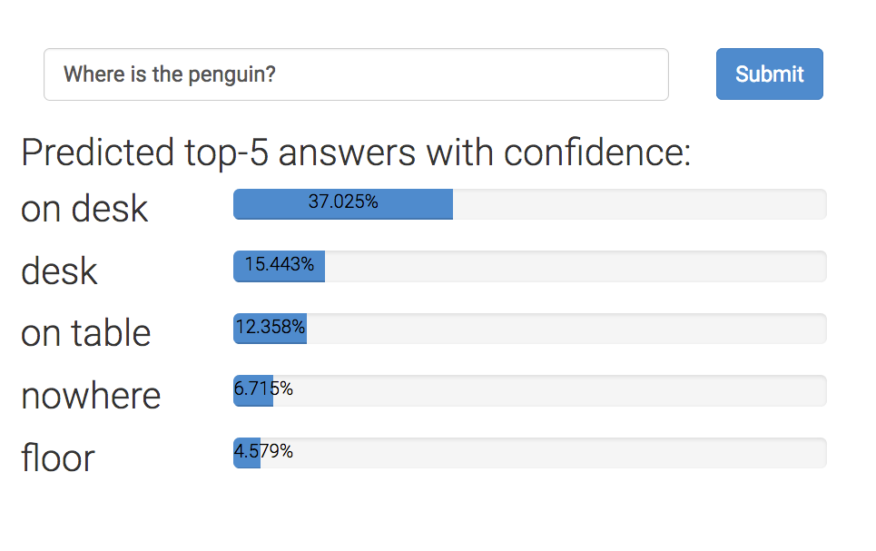

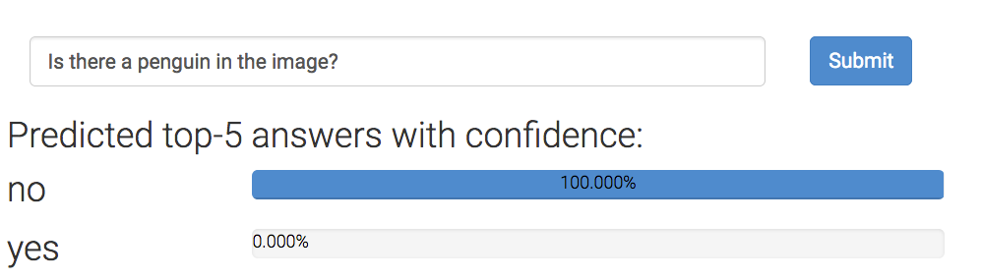
Example 1: Visual question answering
Failures in understanding
Where is the penguin?
~64.7% probability that the penguin is on the table
But can they really ‘read’ images?
Is there a penguin in the image?
From https://visualqa.org, uses Pythia v0. 1: the winning entry to the VQA challenge 2018 [Jiang, Y et al 2018].

Slide 8
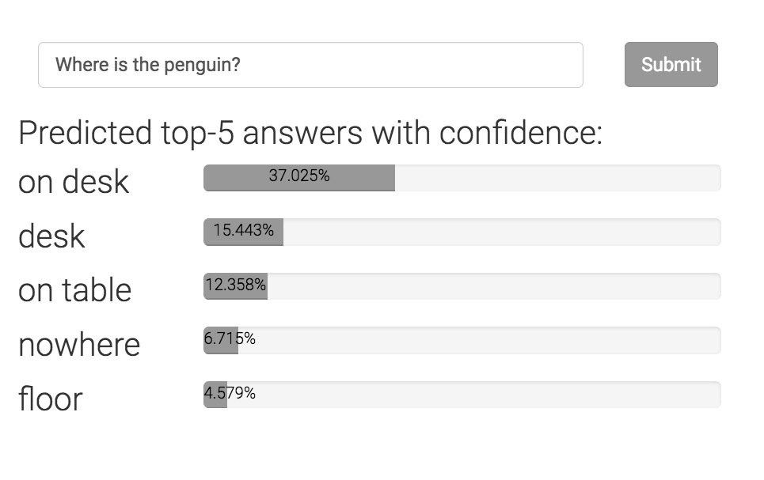
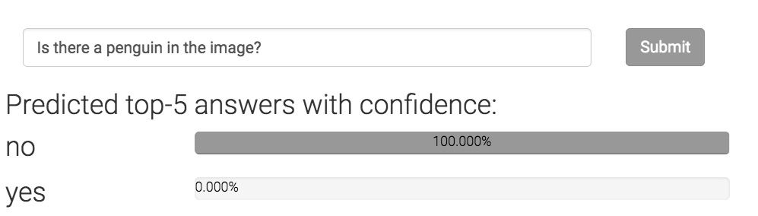
Can neural networks ‘read’ images?
Failures in understanding
Where is the penguin?
Only one of these answers can be correct.
Today’s state-of-the-art is devoid of any such “theory”
Is there a penguin in the image?

Slide 9
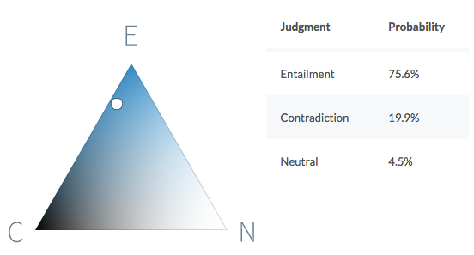
Example 2: Natural language inference
Failures in understanding
Premise
Before it moved to Chicago, aerospace manufacturer Boeing was the largest company in Seattle.
Hypothesis
Boeing is a Chicago-based aerospace manufacturer.
It is quite likely that the premise entails the hypothesis.
https://demo.allennlp.org/textual-entailment/

Slide 10
Can neural networks understand text?
Failures in understanding
P John is on a train to Berlin.
H John is traveling to Berlin.
Z John is having lunch in Berlin.
P
No relationship?
Entails
H
Z
Contradicts
The same system cannot simultaneously hold these three beliefs!
Violates this invariant
If P entails H and H contradicts Z,
then P contradicts Z
Can today’s neural networks use such “theory” in the form of invariant knowledge?
A BERT-based model that gets ~90% on benchmark data violates this invariant on 46% of a large collection of sentence triples.

Slide 11
Are we modeling problems in their full richness?
Failures in understanding
Or: are we modeling for benchmark test sets?
Challenge: Modeling strategies that depend on or expose a theory
  Otherwise, we are just guessing equations involving high dimensional spaces, without understanding what they mean
  Thales, versus a modern understanding of eclipses
      Precise predictions via curve fitting versus a philosophy of the underlying phenomenon

Slide 12
Learning from examples
knowledge

Slide 13
Knowledge can augment data
is
Good datasets are not easy to make
  Takes time, costs money
Easier to write rules about model behavior or their internal beliefs
  Statements in logic that express invariants or inference rules
  Often universally quantified statements
  Example:
  “If two sentences have no matching words,
  then they can not entail or contradict each other.”

Slide 14
Where can knowledge be involved?
Model design
Loss function design & training
Enforce congruent predictions
Augmenting neural networks with logic (ACL 2019)
Logic-based loss design (EMNLP 2019,
ACL 2020, IJCAI 2021)
Structured learning & prediction
  Can be difficult to train due to discretenes and computational expense of inference
This talk

Slide 15
Neural network land vs. Logic land
Neural Networks
✓Differentiable compute, easy to use
✗ Hard to supervise except via labeled examples
First-order logic
✗ Not differentiable, hard to use with today’s best infrastructure
✓ Expressive and easy to state for domain experts
What we want: Best of both!

Slide 16
Three challenges facing logic in neural network land
Bridging predicates in rules with neural networks
Making logic differentiable
    Answer: Use a t-norm
Using differentiable logic

Slide 17
Predicates in neural networks
All neural networks expose interfaces in the form of nodes that have externally defined meaning
Let’s see a natural language inference example that illustrates this

Slide 18
Predicates in neural networks
Premise
All neural networks expose interfaces in the form of nodes that have externally defined meaning
John is on a train to Berlin.
Some neural network
Predict
Entail
Outputs are predicates.
So are deterministic properties of inputs
Entail(Premise, Hypothesis)
John is traveling to Berlin.
Hypothesis
IsName(John)

Slide 19
Predicates in neural networks
Premise
All neural networks expose interfaces in the form of nodes that have externally defined meaning
John is on a train to Berlin.
Encode
Predict
Attention
Entail
Some internal nodes in the network have meaning by design
Align(train, traveling)
Encode
John is traveling to Berlin.
Hypothesis

Slide 20
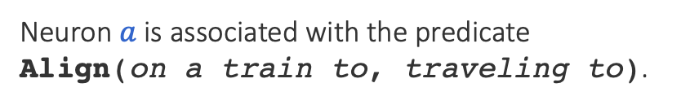

Named neurons
Nodes in a computation graph that have externally defined meaning
Named neurons give us the vocabulary for writing rules
Lower-case for neuron
on a train to
Neuron $a$ is associated with the predicate Align(on a train to, traveling to).
$$a$$
traveling to
Upper-case for predicate

Slide 21
Three challenges facing logic in neural network land
Bridging predicates in rules with neural networks?
    Answer: Named neurons
Making logic differentiable?
    Answer: Use a t-norm
Using differentiable logic?

Slide 22
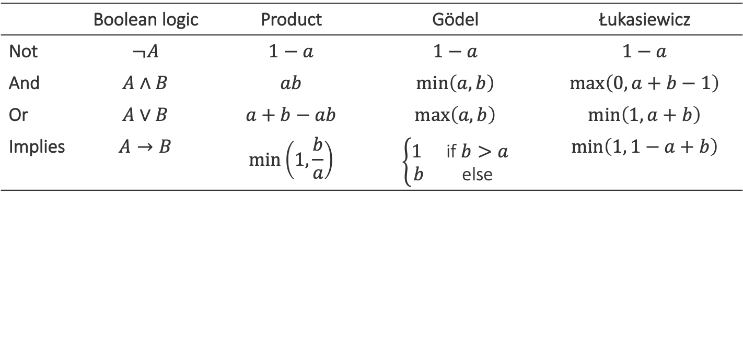
Relaxing Boolean operators
Triangular norms provide systematic relaxations of logic
Some are continuous and sub-differentiable
Inputs, outputs live in {0,1}
Inputs, outputs live in [0,1]
 | Boolean logic | Product | Gödel | Łukasiewicz
Not | $$¬A$$ | $$1−a$$ | $$1−a$$ | $$1−a$$
And | $$A∧B$$ | $$ab$$ | $$\min\left(a,b\right)$$ | $$\max\left(0, a+b−1\right)$$
Or | $$A∨B$$ | $$a+b−ab$$ | $$\max\left(a, b\right)$$ | $$\min\left(1, a+b\right)$$
Implies | $$A→B$$ | $$\min\left(1,\frac{b}{a}\right)$$ | $$\left\{\begin{matrix}1 & \text{if} b>a \\ b & \text{else}\end{matrix}\right.$$ | $$\min\left(1, 1−a+b\right)$$
Basically rectified linear units
Klement, Erich Peter, Radko Mesiar, and Endre Pap. Triangular norms. Vol. 8. 2013.

Slide 23
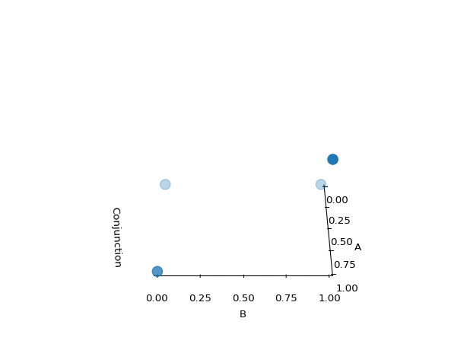
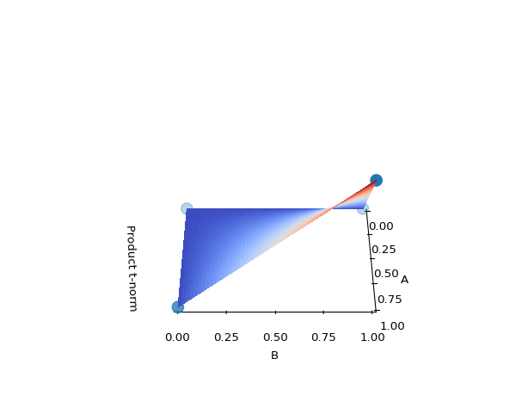
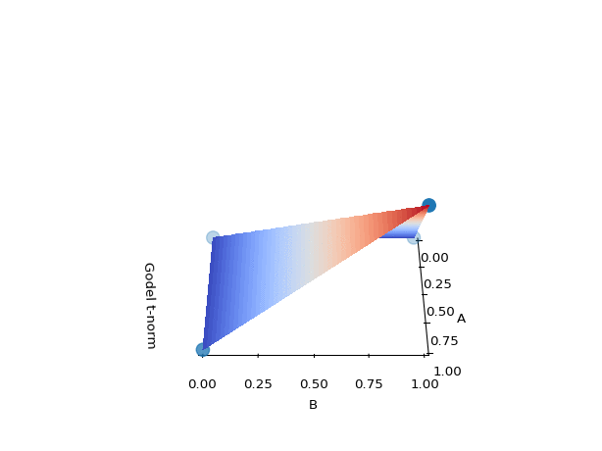
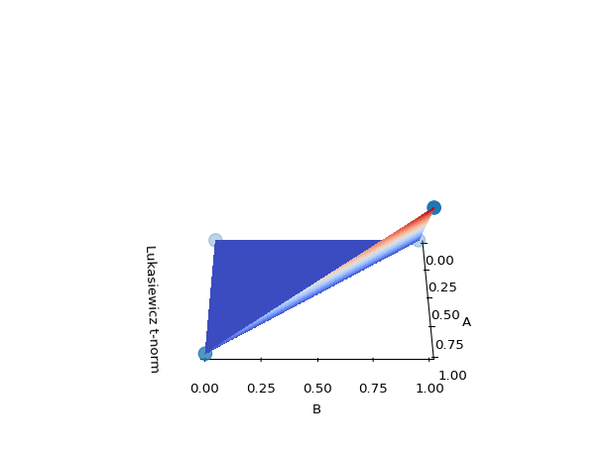
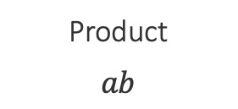
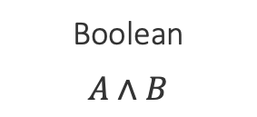
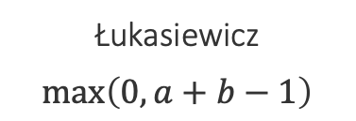
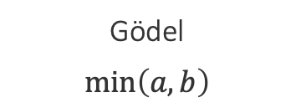
Example: Relaxing conjunctions
Boolean
$$A∧B$$
Product
$$ab$$
Gödel
$$\min\left(a,b\right)$$
Łukasiewicz
$$\max\left(0, a+b−1\right)$$
All relaxations agree with the definition of a conjunction at the four boundary points

Slide 24
Three challenges facing logic in neural network land
Bridging predicates in rules with neural networks?
    Answer: Named neurons
Making logic differentiable?
    Answer: Use a t-norm
Using differentiable logic?

Slide 25
What logic can do for neural networks?
Introduce inductive bias by…
…changing network architecture
  to networks that prefer satisfying the constraints
…by regularizing learning
  to penalize models that violate the constraints

Slide 26
What logic can do for neural networks?
Introduce inductive bias by…
…changing network architecture
  to networks that prefer satisfying the constraints
…by regularizing learning
  to penalize models that violate the constraints
Augmenting Neural Networks with First-order Logic. Li and Srikumar. ACL 2019.

Slide 27
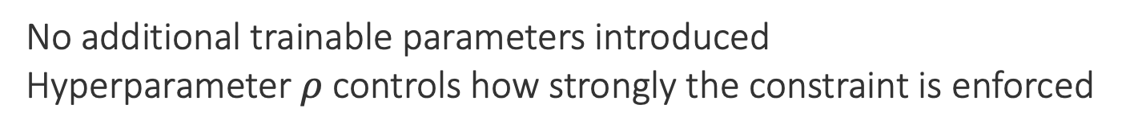
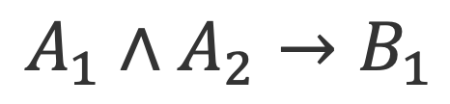



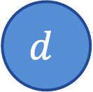
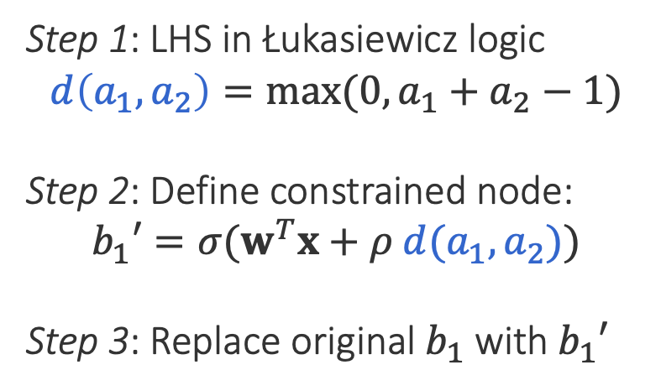
Augmenting models: An example
$$b_{1}′=σ(w^{T}x+ρ d(a_{1},a_{2}))$$
$$A_{1}∧A_{2}→B_{1}$$
$$b_{1}=σ(w^{T}x)$$
$$b_{1}=σ(w^{T}x)$$
$$b_{1}$$
$$b_{1}′$$
$$b_{2}$$
$$b_{2}$$
Step 1: LHS in Łukasiewicz logic
$$d\left(a_{1},a_{2}\right)=max⁡(0, a_{1}+a_{2}−1)$$
Step 2: Define constrained node:
$$b_{1}′=σ(w^{T}x+ρ d(a_{1},a_{2}))$$
Step 3: Replace original $b_{1}$ with $b_{1}′$
$$d$$
Possibly many layers
$$a_{1}$$
$$a_{2}$$
$$a_{3}$$
No additional trainable parameters introduced
Hyperparameter $ρ$controls how strongly the constraint is enforced

Slide 28
What logic can do for neural networks?
Introduce inductive bias by…
…changing network architecture
  to networks that prefer satisfying the constraints
…by regularizing learning
  to penalize models that violate the constraints
A Logic-Driven Framework for Consistency of Neural Models. Li, Gupta, Mehta and Srikumar. EMNLP, 2019.
Structured Tuning for Semantic Role Labeling. Li, Jawale, Palmer and Srikumar. ACL, 2020.
Evaluating Relaxations of Logic for Neural Networks: A Comprehensive Study. Medina-Grespan, Gupta, Srikumar. IJCAI 2021.

Slide 29
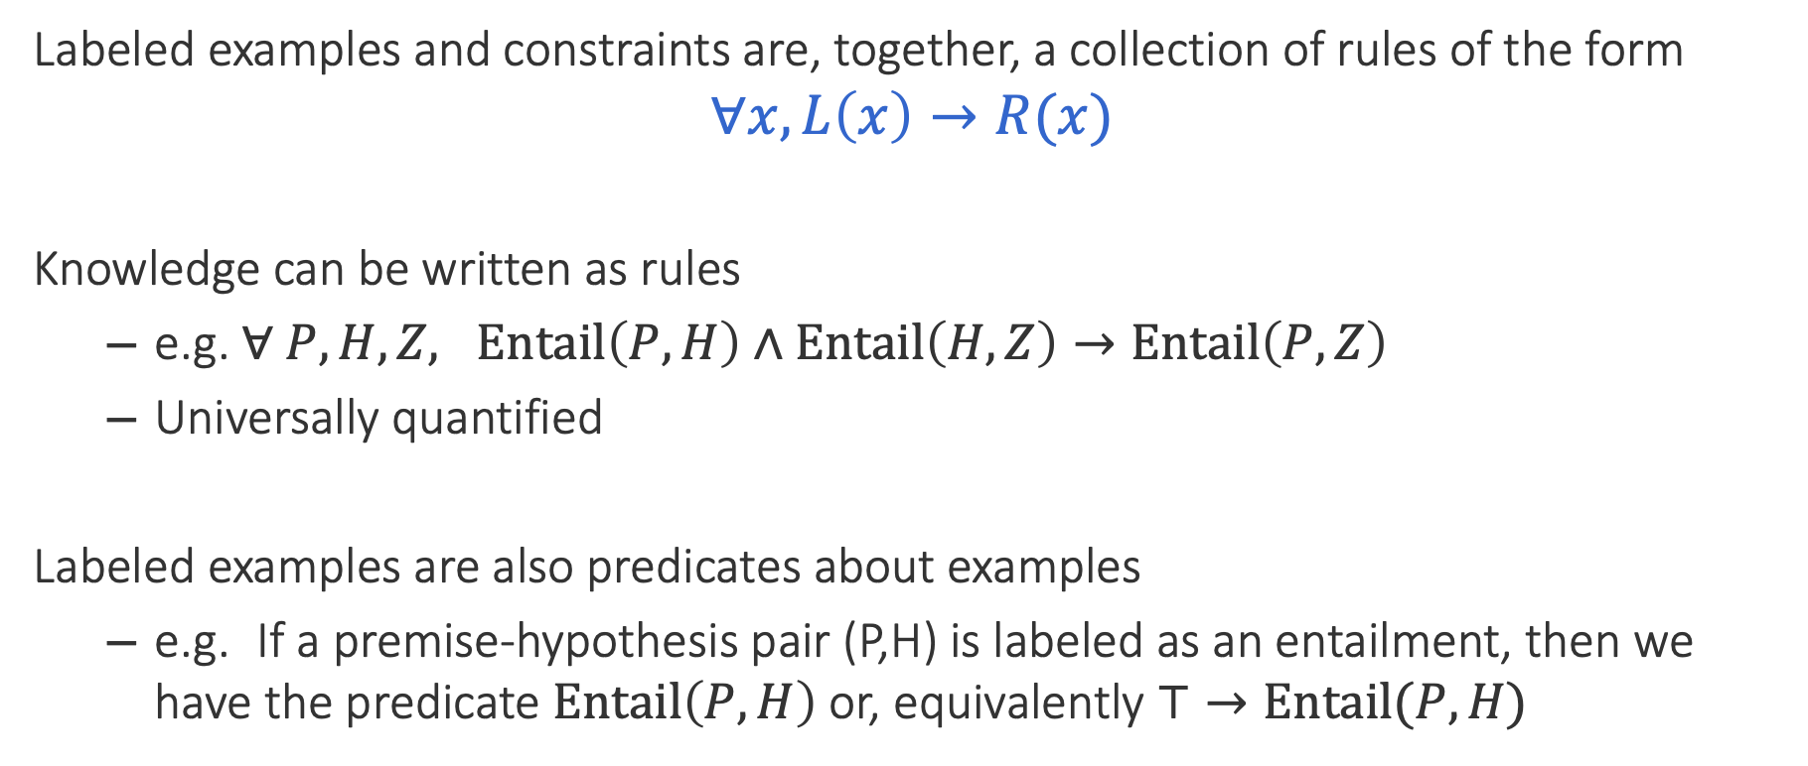
Unifying data & knowledge
Labeled examples and constraints are, together, a collection of rules of the form
$$∀x, L\left(x\right)→R(x)$$
Knowledge can be written as rules
  e.g. $∀ P, H, Z, Entail\left(P,H\right)∧Entail\left(H, Z\right)→Entail\left(P, Z\right)$
  Universally quantified
Labeled examples are also predicates about examples
  e.g. If a premise-hypothesis pair (P,H) is labeled as an entailment, then we have the predicate $Entail\left(P, H\right)$ or, equivalently $⊤→Entail(P, H)$

Slide 30
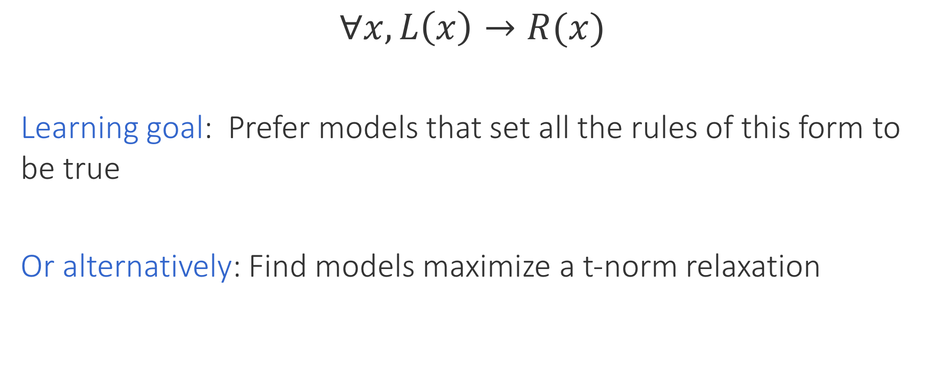
Encouraging consistency of models
$$∀x, L\left(x\right)→R(x)$$
Learning goal: Prefer models that set all the rules of this form to be true
Or alternatively: Find models maximize a t-norm relaxation
Labeled data + knowledge
Inconsistency losses
Use any neural model, any library and any optimizer
Product t-norm + labeled examples gives cross entropy loss

Slide 31
Do rules help neural networks?

Slide 32
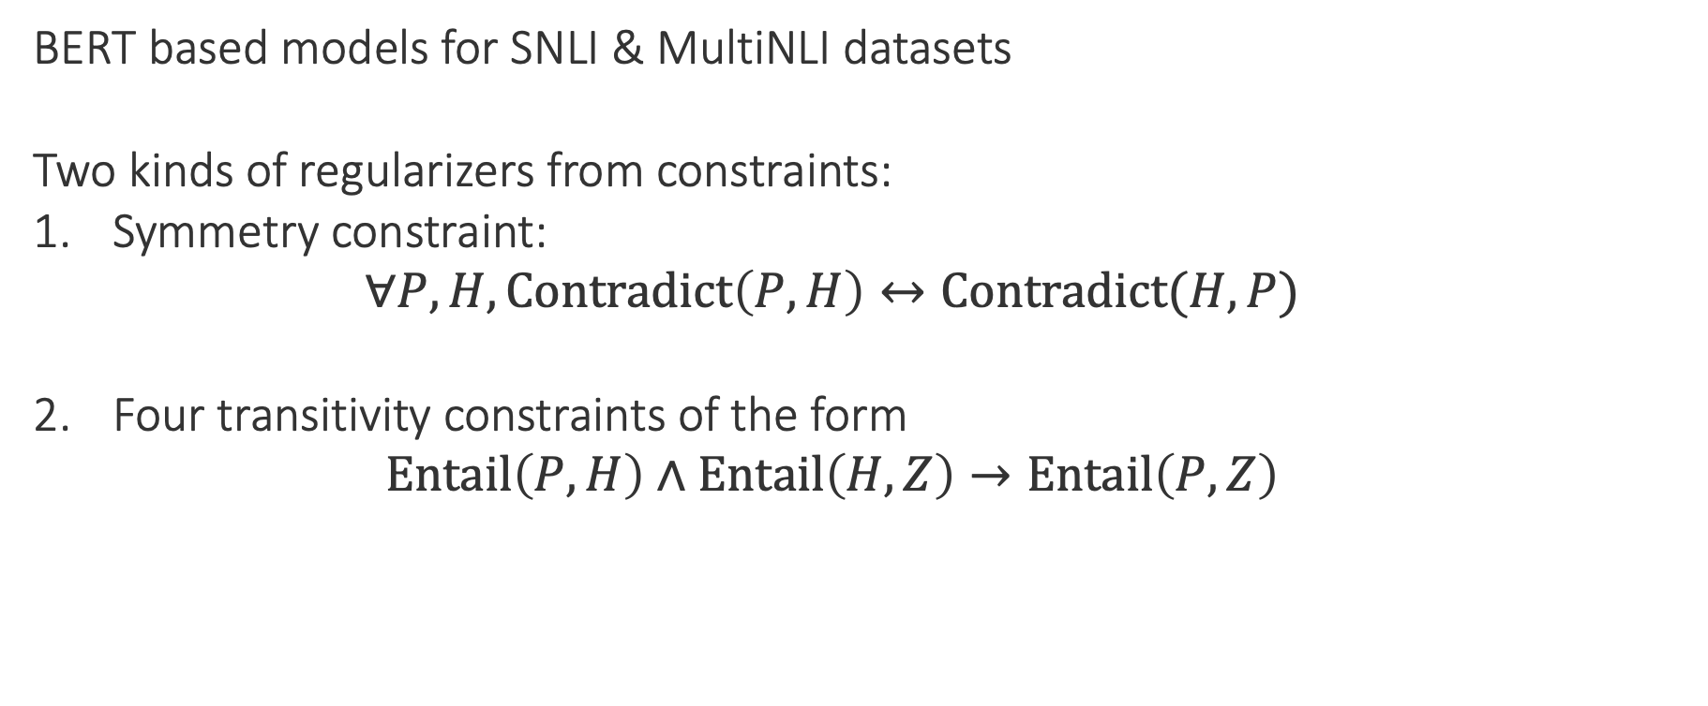
Inconsistency of natural language inference
Example case study: Regularizing learning
P
No relationship?
BERT based models for SNLI & MultiNLI datasets
Two kinds of regularizers from constraints:
Symmetry constraint:
  $$∀P, H, Contradict\left(P,H\right)↔Contradict(H, P)$$
Four transitivity constraints of the form
  $$Entail\left(P,H\right)∧Entail\left(H, Z\right)→Entail\left(P, Z\right)$$
Entails
H
Z
Contradicts

Slide 33
Results: Inconsistency of natural language inference
Example case study: Regularizing learning
Inconsistency represents violation of constraints. Lower is better.
1. Merely adding more data does not make models consistent
2. Logic-based regularizers help with consistency

Slide 34
Knowledge helps deep learning
Successful experiments across many different tasks
  Natural language inference
  Question answering
  Text chunking
  Semantic role labeling
  Joint digit recognition and numerical operations over them
  Information extraction
General flavor of results
  When we have less data, knowledge gives better statistical models
  We can “inject” invariances into learned systems…
    …which don’t otherwise seem to be learned, even with lots of data

Slide 35
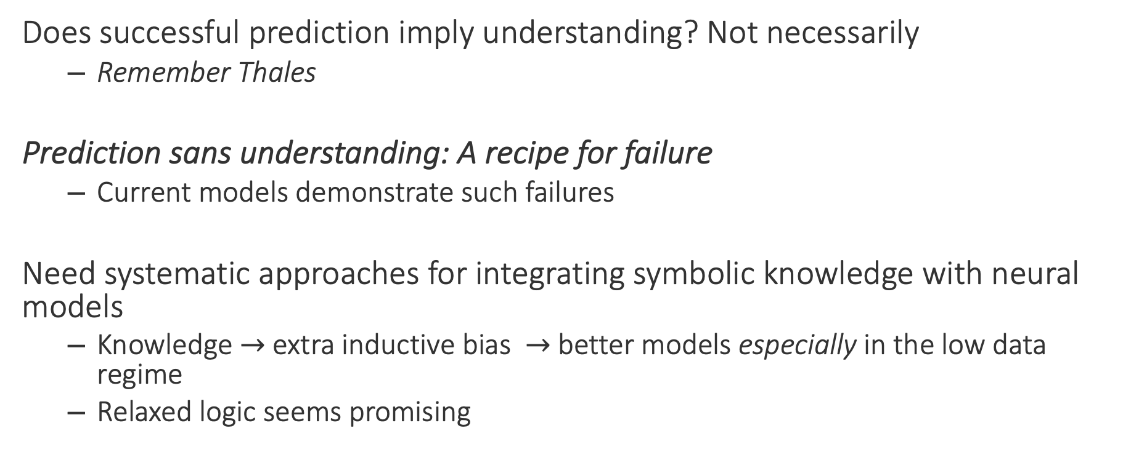
Final words
Does successful prediction imply understanding? Not necessarily
  Remember Thales
Prediction sans understanding: A recipe for failure
  Current models demonstrate such failures
Need systematic approaches for integrating symbolic knowledge with neural models
  Knowledge $→$ extra inductive bias $→$ better models especially in the low data regime
  Relaxed logic seems promising
Thanks! Questions?

