Slide 1
Adventures with Neural Networks and Logic: Semantic Roles & Beyond
Vivek Srikumar
Joint work with Tao Li, Vivek Gupta, Maitrey Mehta, Martha Palmer, Ashim Gupta, Mattia Medina Grespan

Slide 2
Semantic Role Labeling

Slide 3




Semantic Role Labeling (SRL)
Who did what to whom, where, when, why?
The mouse ate the cheese when the farmer left the kitchen.
Arg0
Arg1
ArgM-TMP
Arg1
Arg0
ate
Arg0 | The mouse
Arg1 | the cheese
ArgM-TMP | when the farmer left the kitchen
left
Arg0 | the farmer
Arg1 | the kitchen

Slide 4
Semantic Role Labeling (SRL)
Who did what to whom, where, when, why?
The mouse ate the cheese when the farmer left the kitchen.
These semantic roles are defined by the PropBank data (Palmer et al)
ate
Arg0 | The mouse
Arg1 | the cheese
ArgM-TMP | when the farmer left the kitchen
left
Arg0 | the farmer
Arg1 | the kitchen

Slide 5
What do the labels mean?
The mouse ate the cheese when the farmer left the kitchen.
Agent: entity in motion
Agent: eater, consumer
ate
Arg0 | The mouse
Arg1 | the cheese
ArgM-TMP | when the farmer left the kitchen
left
Arg0 | the farmer
Arg1 | the kitchen
Patient: the meal
Starting point, location vacated
Temporal modifier
PropBank defines what the labels Arg0, Arg0 etc mean for each verb

Slide 6
Semantic Role Labeling: The modeling problem
Input: A sentence
Output: Semantic frames for all verbs
A well studied task, large datasets in English
Penn Treebank data, Ontonotes annotated with PropBank roles
Creating datasets is not easy though

Slide 7
Semantic Role Labeling: The modeling problem
Input: A sentence
Output: Semantic frames for all verbs
The output is structured, and has constraints about the labels. For example
Core arguments (e.g. Arg0, Arg1) cannot repeat…
…but modifiers (e.g. ArgM-TMP) can
Certain arguments (called references, e.g. R-Arg0) can appear only if the corresponding referent argument exists (here, Arg0)
These symbolic constraints come from the task definition. And linguistic assumptions.
We will see other constraints later

Slide 8
A brief history of models for SRL
Models for SRL have seen two distinct regimes
2005
~2015
now
Mostly linear models with structural decoding with constraints.
E.g. Punyakanok et al, Toutanova et al, etc
Deep neural models, no constraints. E.g. He et al 2017, Strubell et al 2018

Slide 9
A common design of neural SRL models
There is usually a CRF layer across these label predictions to introduce sequential dependencies between labels
A BIO classifier over the token and verb (a small neural network)
Arg0
Arg1
ArgM-TMP
B-A0
I-A0
V
B-A1
I-A1
B-AM-TMP
…
I-AM-TMP
Each predicate treated separately. Here we see the predictions for the verb ate.
An encoder network (e.g. BERT) to produce contextual representations
A different commonly seen design involves span-based predictions instead of word-level ones.
The
mouse
ate
the
cheese
when
the
farmer
left
the
kitchen

Slide 10
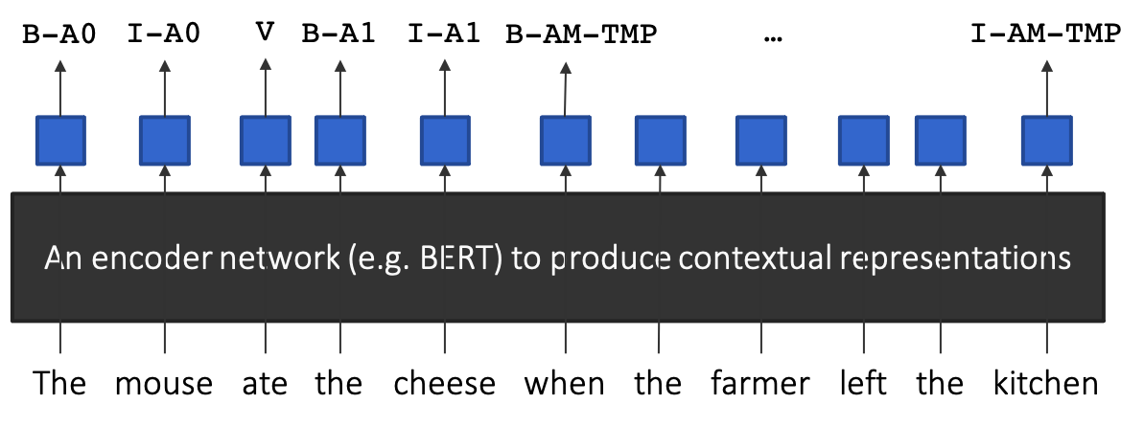
A remarkable class of models!
These models are excellent in terms of predictive accuracy
E.g. with RoBERTa embeddings, on Wall Street Journal data, we can get ~88% F-scores
And ~80% on out of domain (Brown corpus) sentences
Impressively, they do so with no information about the output space
No symbolic constraints prohibiting invalid labels
No structural information about references, etc
No frame information
Is there room for knowledge in the form of symbolic constraints in neural SRL models?
If so, how do we introduce it without sacrificing modeling convenience?
And why do we need symbolic constraints anyway if the models are so successful already?

Slide 11
Does successful prediction imply understanding?

Slide 12
Date: May 28, 585 BCE Time: Late afternoon
Location: Ancient Greece
Photo Credit: flickr.com/nasahqphoto

Slide 13
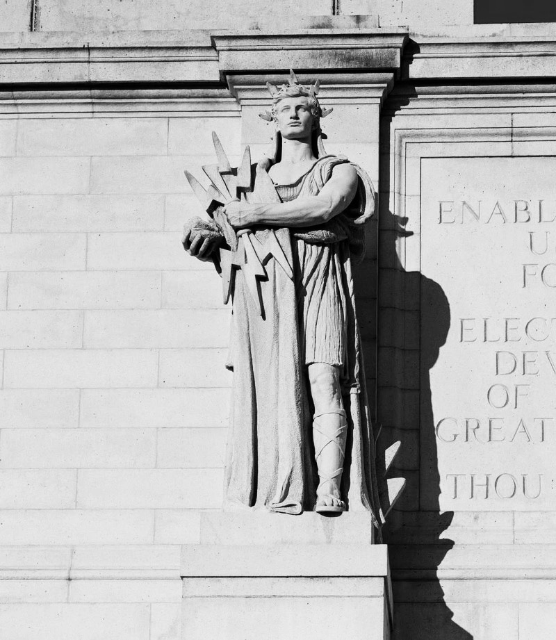
Thales of Miletus
mathematician, astronomer, philosopher
One of the earliest known successful eclipse predictions
Possibly learned how to do so from the Babylonian astronomers
Did Thales (and Babylonians) understand how eclipses work?
No. That came about a century after Thales

Slide 14
Prediction sans understanding
Thales & co “data mined” celestial observations to find cycles in lunar and solar eclipses…
…they had no clue about the positions of the earth, the moon and the sun!
but
Finding patterns in data can lead to seemingly accurate predictions…
…accuracy in prediction does not imply understanding
but
Spurious patterns $→$A recipe for pathological failures

Slide 15
Failures in understanding

Slide 16
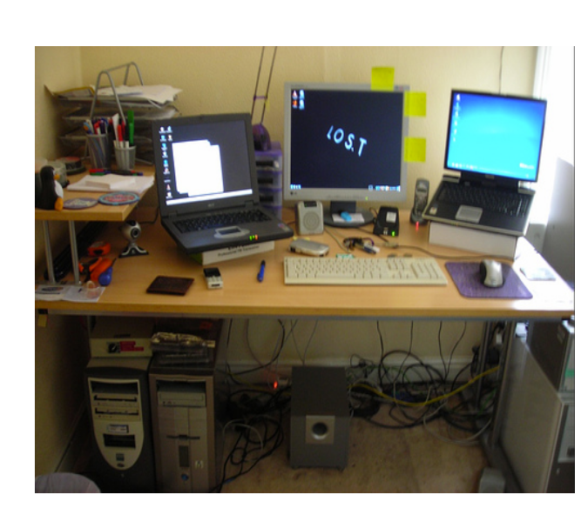
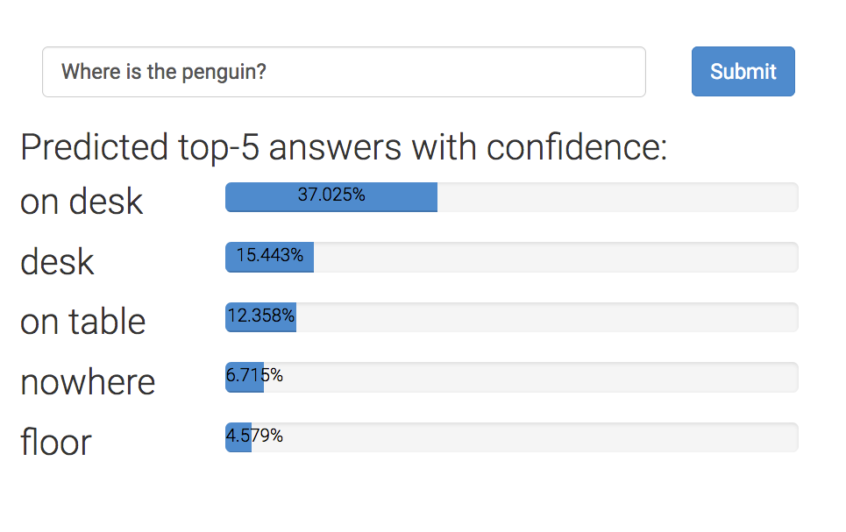

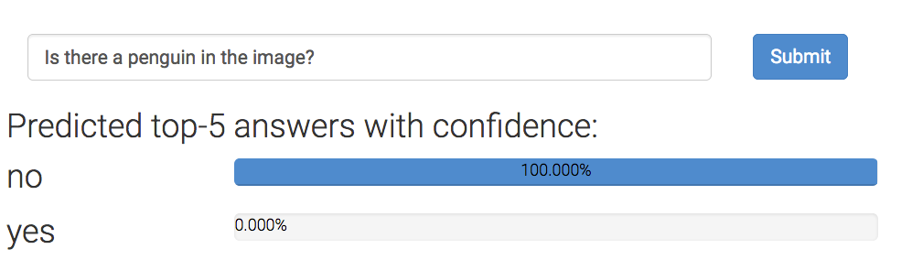
Example 1: Visual question answering
Failures in understanding
Where is the penguin?
~64.7% probability that the penguin is on the table
But can they really ‘read’ images?
Is there a penguin in the image?
From https://visualqa.org, uses Pythia v0. 1: the winning entry to the VQA challenge 2018 [Jiang, Y et al 2018].

Slide 17
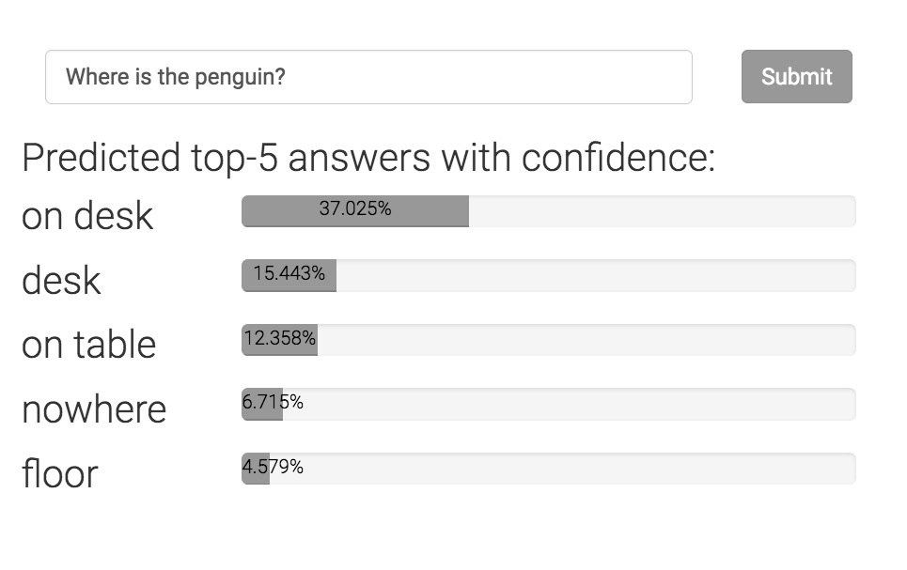
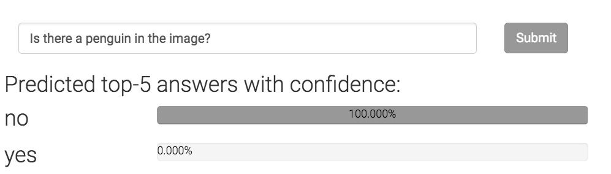
Can neural networks ‘read’ images?
Failures in understanding
Where is the penguin?
Only one of these answers can be correct.
Today’s state-of-the-art is devoid of any such “theory”
Is there a penguin in the image?

Slide 18
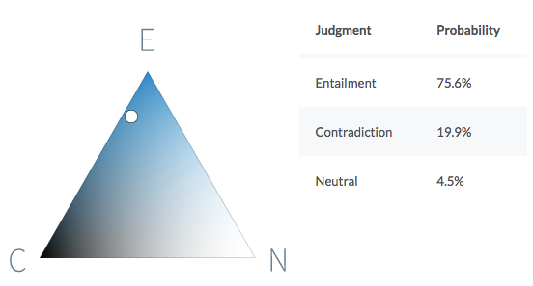
Example 2: Natural language inference
Failures in understanding
Premise
Before it moved to Chicago, aerospace manufacturer Boeing was the largest company in Seattle.
Hypothesis
Boeing is a Chicago-based aerospace manufacturer.
It is quite likely that the premise entails the hypothesis.
https://demo.allennlp.org/textual-entailment/

Slide 19
Can neural networks understand text?
Failures in understanding
P John is on a train to Berlin.
H John is traveling to Berlin.
Z John is having lunch in Berlin.
P
No relationship?
Entails
H
Z
Contradicts
The same system cannot simultaneously hold these three beliefs!
Violates this invariant
If P entails H and H contradicts Z,
then P contradicts Z
Can today’s neural networks use such “theory” in the form of invariant knowledge?
A BERT-based model that gets ~90% on benchmark data violates this invariant on 46% of a large collection of sentence triples.

Slide 20
Are we modeling problems in their full richness?
Failures in understanding
Or: are we modeling for benchmark test sets?
Challenge: Modeling strategies that depend on or expose a theory
Otherwise, we are just guessing equations involving high dimensional spaces, without understanding what they mean
Thales, versus a modern understanding of eclipses
Precise predictions via curve fitting versus a philosophy of the underlying phenomenon

Slide 21
Learning from examples
knowledge

Slide 22
Knowledge can augment data
is
Good datasets are not easy to make
Takes time, costs money
Easy to write rules about model behavior or their internal beliefs
Statements in logic that express invariants or inference rules
Often universally quantified statements
Example:
“Core arguments (e.g. Arg0, Arg1) cannot repeat for a predicate”

Slide 23
Where can knowledge be involved?
Model design
Loss function design & training
Enforce congruent predictions
Augmenting neural networks with logic (ACL 2019)
Logic-based loss design (EMNLP 2019,
ACL 2020, IJCAI 2021)
Structured prediction
Can be difficult to train due to discreteness
Computational expense for each prediction
This talk

Slide 24
Neural network land vs. Logic land
Neural Networks
✓Differentiable compute, easy to use
✗ Hard to supervise except via labeled examples
First-order logic
✗ Not differentiable, hard to use with today’s best infrastructure
✓ Expressive and easy to state for domain experts
What we want: Best of both!

Slide 25
Three challenges facing logic in neural network land
Bridging predicates in rules with neural networks
Making logic differentiable
Answer: Use a t-norm
Using differentiable logic

Slide 26
Predicates in neural networks
All neural networks expose interfaces in the form of nodes that have externally defined meaning
Let’s use an SRL example to illustrate this principle

Slide 27
Predicates in neural networks
All neural networks expose interfaces in the form of nodes that have externally defined meaning
B-A0
I-A0
V
B-A1
I-A1
B-AM-TMP
…
I-AM-TMP
Outputs are predicates.
B-A0(ate, The)
I-A0(ate, mouse)
…
I-AM-TMP(ate, kitchen)
So are deterministic properties of inputs
An encoder network (e.g. BERT) to produce contextual representations
The
mouse
ate
the
cheese
when
the
farmer
left
the
kitchen

Slide 28
Predicates in neural networks
Premise
All neural networks expose interfaces in the form of nodes that have externally defined meaning
John is on a train to Berlin.
Encode
Predict
Attend
Entail
Some internal nodes in the network have meaning by design
Align(train, traveling)
Encode
John is traveling to Berlin.
Hypothesis

Slide 29
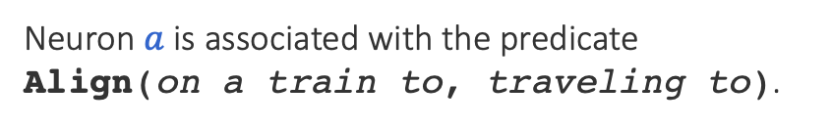

Named neurons
Nodes in a computation graph that have externally defined meaning
Named neurons give us the vocabulary for writing rules
Lower-case for neuron
on a train to
Neuron $a$ is associated with the predicate Align(on a train to, traveling to).
$$a$$
traveling to
Upper-case for predicate

Slide 30
Three challenges facing logic in neural network land
Bridging predicates in rules with neural networks?
Answer: Named neurons
Making logic differentiable?
Answer: Use a t-norm
Using differentiable logic?

Slide 31
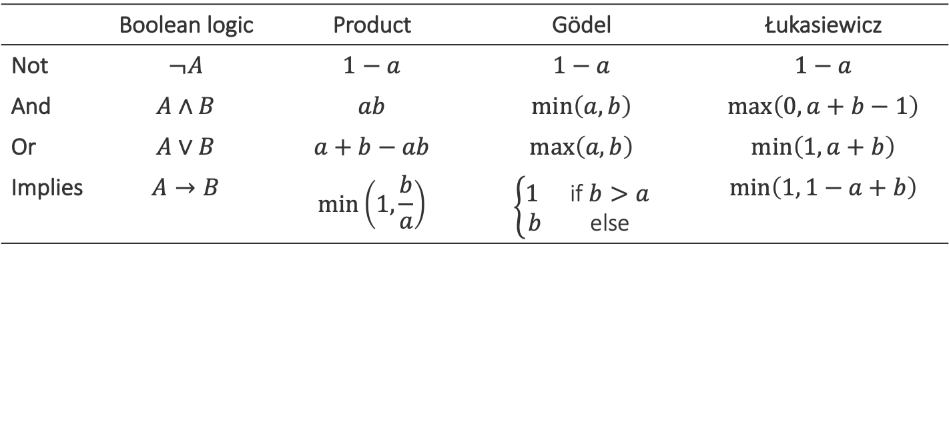
Relaxing Boolean operators
Triangular norms provide systematic relaxations of logic
Some are continuous and sub-differentiable
Inputs, outputs live in {0,1}
Inputs, outputs live in [0,1]
 | Boolean logic | Product | Gödel | Łukasiewicz
Not | $$¬A$$ | $$1−a$$ | $$1−a$$ | $$1−a$$
And | $$A∧B$$ | $$ab$$ | $$\min\left(a,b\right)$$ | $$\max\left(0, a+b−1\right)$$
Or | $$A∨B$$ | $$a+b−ab$$ | $$\max\left(a, b\right)$$ | $$\min\left(1, a+b\right)$$
Implies | $$A→B$$ | $$\min\left(1,\frac{b}{a}\right)$$ | $$\left\{\begin{matrix}1 & \text{if} b>a \\ b & \text{else}\end{matrix}\right.$$ | $$\min\left(1, 1−a+b\right)$$
Basically rectified linear units
Klement, Erich Peter, Radko Mesiar, and Endre Pap. Triangular norms. Vol. 8. 2013.

Slide 32
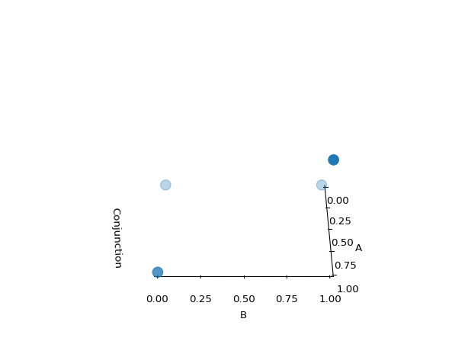
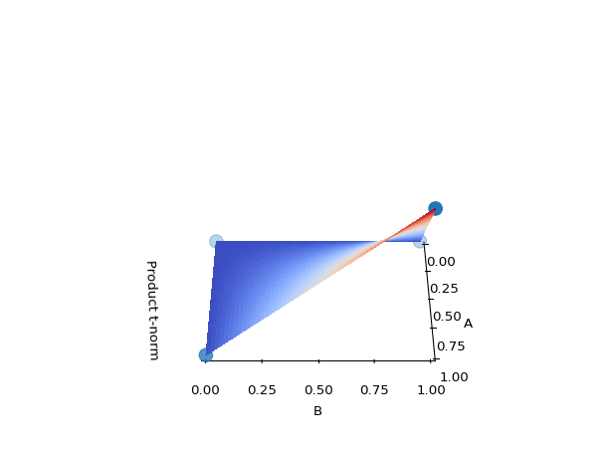
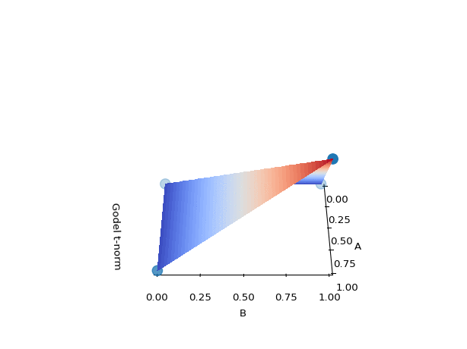
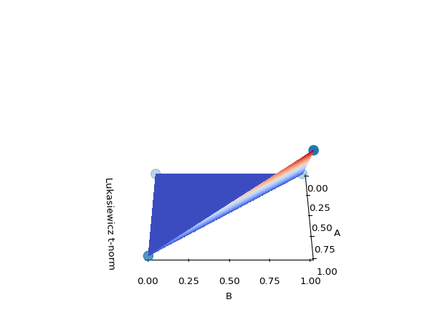
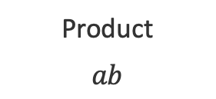
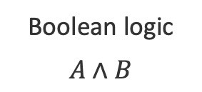
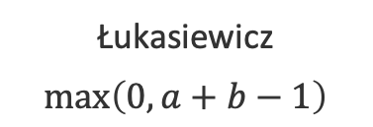
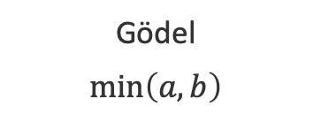
Example: Relaxing conjunctions
Boolean logic
$$A∧B$$
Product
$$ab$$
Gödel
$$\min\left(a,b\right)$$
Łukasiewicz
$$\max\left(0, a+b−1\right)$$
All relaxations agree with the definition of a conjunction at the four boundary points

Slide 33
Three challenges facing logic in neural network land
Bridging predicates in rules with neural networks?
Answer: Named neurons
Making logic differentiable?
Answer: Use a t-norm
Using differentiable logic?

Slide 34
What logic can do for neural networks?
Introduce inductive bias by…
…changing network architecture
to networks that prefer satisfying the constraints
…by regularizing learning
to penalize models that violate the constraints

Slide 35
What logic can do for neural networks?
Introduce inductive bias by…
…changing network architecture
to networks that prefer satisfying the constraints
…by regularizing learning
to penalize models that violate the constraints
Augmenting Neural Networks with First-order Logic. Li and Srikumar. ACL 2019.

Slide 36
What logic can do for neural networks?
Introduce inductive bias by…
…changing network architecture
to networks that prefer satisfying the constraints
…by regularizing learning
to penalize models that violate the constraints
A Logic-Driven Framework for Consistency of Neural Models. Li, Gupta, Mehta and Srikumar. EMNLP, 2019.
Structured Tuning for Semantic Role Labeling. Li, Jawale, Palmer and Srikumar. ACL, 2020.
Evaluating Relaxations of Logic for Neural Networks: A Comprehensive Study. Medina-Grespan, Gupta, Srikumar. IJCAI 2021.

Slide 37
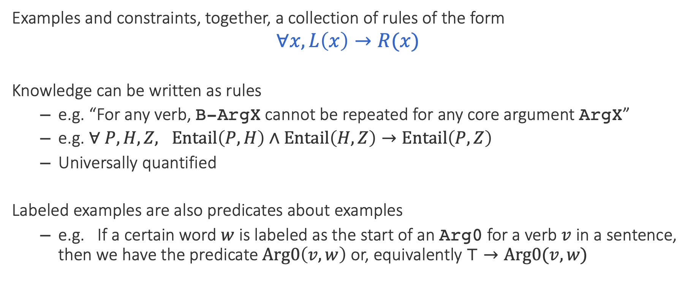
Unifying data & knowledge
Examples and constraints, together, a collection of rules of the form
$$∀x, L\left(x\right)→R(x)$$
Knowledge can be written as rules
e.g. “For any verb, B-ArgX cannot be repeated for any core argument ArgX”
e.g. $∀ P, H, Z, Entail\left(P,H\right)∧Entail\left(H, Z\right)→Entail\left(P, Z\right)$
Universally quantified
Labeled examples are also predicates about examples
e.g. If a certain word $w$ is labeled as the start of an Arg0 for a verb $v$ in a sentence, then we have the predicate $Arg0\left(v, w\right)$ or, equivalently $⊤→Arg0(v, w)$

Slide 38
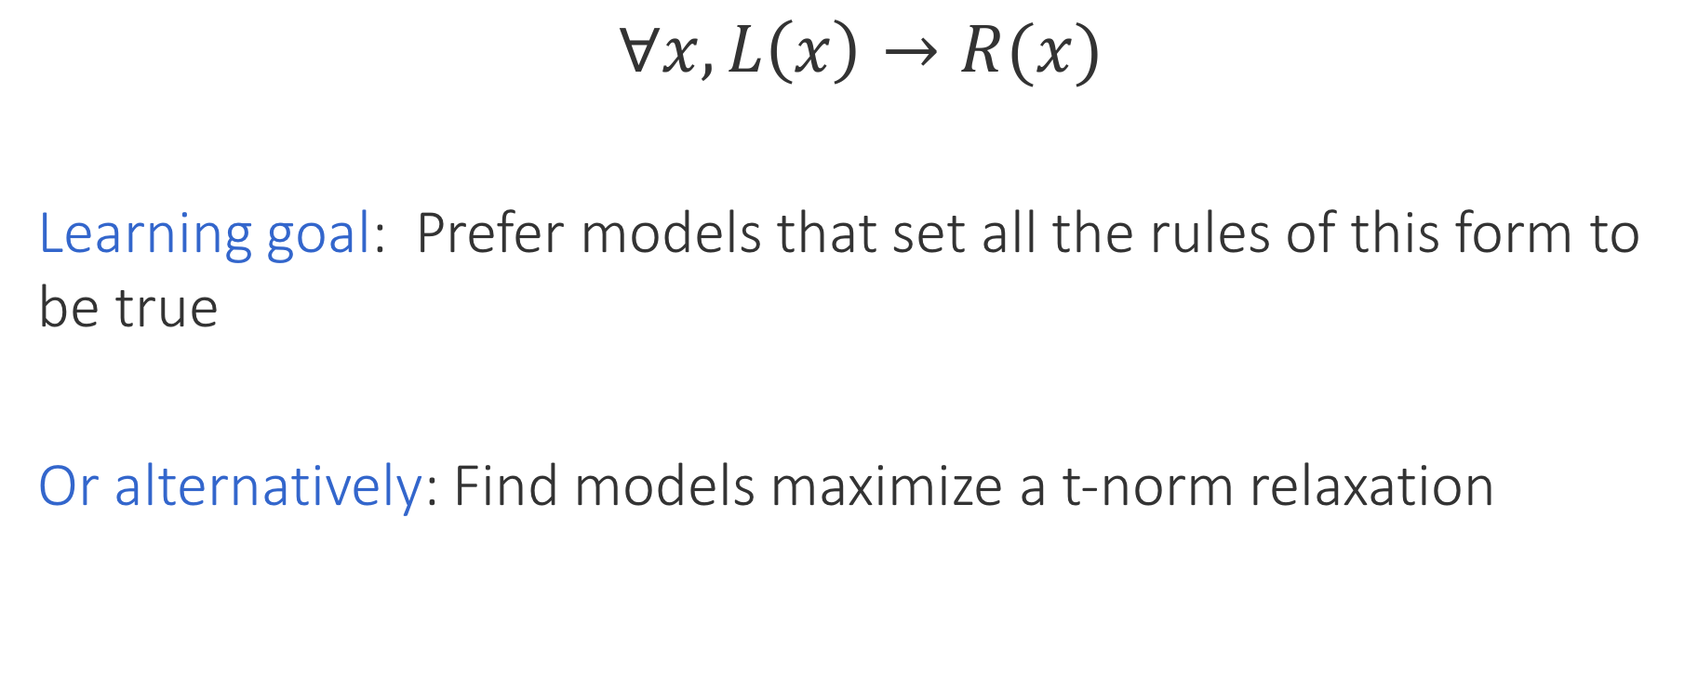
Encouraging consistency of models
$$∀x, L\left(x\right)→R(x)$$
Learning goal: Prefer models that set all the rules of this form to be true
Or alternatively: Find models maximize a t-norm relaxation
Labeled data + knowledge
Structured Tuning with Inconsistency losses
Use any neural model, any library and any optimizer
Product t-norm + labeled examples gives cross entropy loss

Slide 39

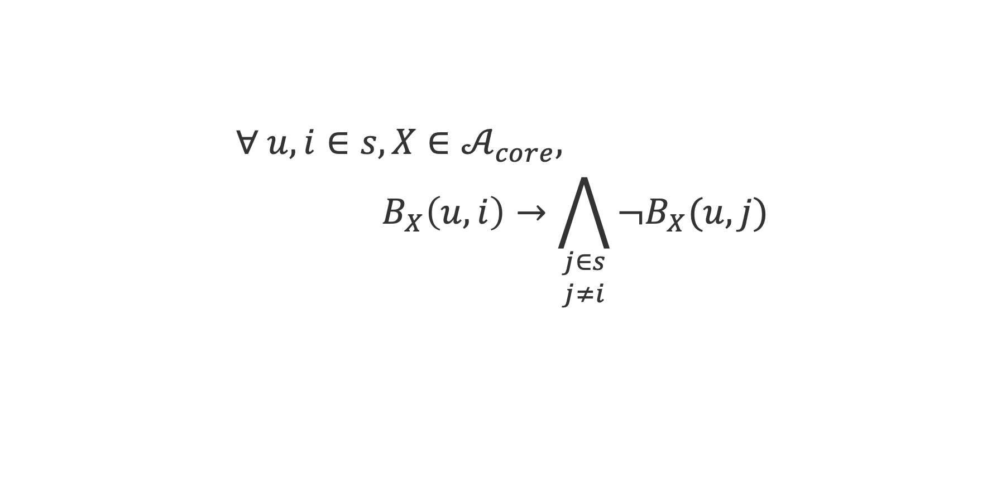

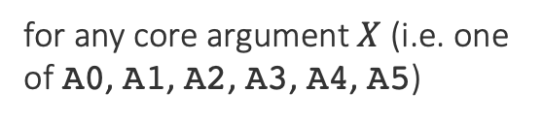
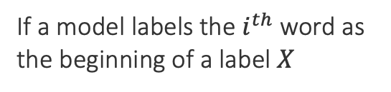
Constraints in SRL: Unique Core Roles
$$∀ u, i∈s, X∈𝒜_{core}, \\ { B}_{X}\left(u, i\right)→\bigwedge_{\begin{aligned}j∈s \\ j≠i\end{aligned}}{¬B_{X}(u, j)}$$
for any core argument $X$ (i.e. one of A0, A1, A2, A3, A4, A5)
For any verb $u$, and a word $i$
The model cannot predict that it is the beginning of the same label
If a model labels the $i^{th}$ word as the beginning of a label $X$
Then, for any other word $j$

Slide 40
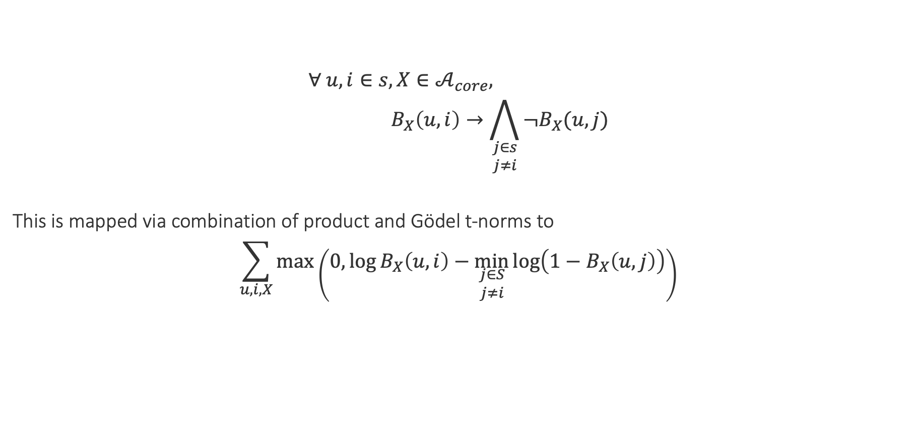
Constraints in SRL: Unique Core Roles
$$∀ u, i∈s, X∈𝒜_{core}, \\ { B}_{X}\left(u, i\right)→\bigwedge_{\begin{aligned}j∈s \\ j≠i\end{aligned}}{¬B_{X}(u, j)}$$
This is mapped via combination of product and Gödel t-norms to
$$\sum_{u, i, X}{\max\left(0,\log{B_{X}\left(u,i\right)}−\min_{\begin{aligned}j∈S \\ j≠i\end{aligned}}{\log\left(1−B_{X}\left(u, j\right)\right)}\right)}$$
Model probabilities for this label
Whenever the model assigns high probabilities to invalid outputs, the loss will be high.
(Conversion details in the paper)

Slide 41
Other constraints (informally)
Both compiled to losses
The exclusively overlapping role constraint:
In any sentence, an argument for a predicate can either be contained in, or fully outside, the argument for any predicate
The frame core role constraint
A verb can have only those core arguments that are defined in PropBank
✓
✓
✗

Slide 42
Do rules help neural networks?

Slide 43

Scenario 1: The low data regime
Example case study 1: SRL
Train with 3% data with and without constraints
Constraints greatly improve precision in the low data regime over the strong RoBERTa baseline
Constraint violations reduced, especially for unique core roles and the frame constraints
CoNLL 05: 1.1k examples
CoNLL 12: 2.7k examples
CoNLL 05: 70.48 $→$ 72.6
CoNLL 12: 74.79 $→$ 76.31
F-scores also improve (see paper for details)

Slide 44
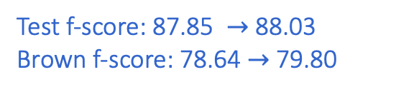
Scenario 2: More training data
Example case study 1: SRL
Train with the full CoNLL 05 data
Surprisingly still better in terms of precision, recall and f-scores, though the margin is lower
Strong out of domain performance on Brown corpus data
Constraint violations reduced for unique core roles and the frame constraints
The unconstrained model doesn’t seem to violate the exclusive overlap constraint!
CoNLL 05: 35k examples, 91k propositions
Test f-score: 87.85 $→$ 88.03
Brown f-score: 78.64 $→$ 79.80

Slide 45

Scenario 3: Even more training data
Example case study 1: SRL
Train with the full CoNLL 12 data
Constrained and unconstrained models are comparable
If you have a lot of data, it is okay to believe the data
CoNLL 05: 90k examples, 253k propositions
Test f-score: 86.4$7→$ 86.61

Slide 46
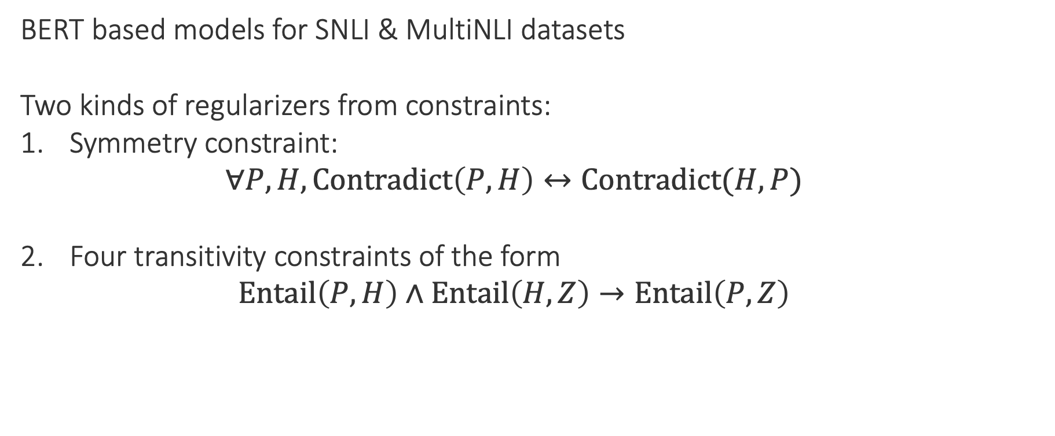
Inconsistency of natural language inference
Example case study 2: NLI
P
No relationship?
BERT based models for SNLI & MultiNLI datasets
Two kinds of regularizers from constraints:
Symmetry constraint:
$$∀P, H, Contradict\left(P,H\right)↔Contradict(H, P)$$
Four transitivity constraints of the form
$$Entail\left(P,H\right)∧Entail\left(H, Z\right)→Entail\left(P, Z\right)$$
Entails
H
Z
Contradicts

Slide 47
Results: Inconsistency of NLI
Example case study 2: NLI
Inconsistency represents violation of constraints. Lower is better.
1. Merely adding more data does not make models consistent
2. Regularizers help with consistency

Slide 48
Knowledge helps deep learning
Successful experiments across many different tasks
Natural language inference
Question answering
Text chunking
Semantic role labeling
Joint digit recognition and numerical operations over them
Information extraction
General flavor of results
When we have less data, knowledge gives better statistical models
We can “inject” invariances into learned systems…
…which are sometimes not learned, even with lots of data

Slide 49
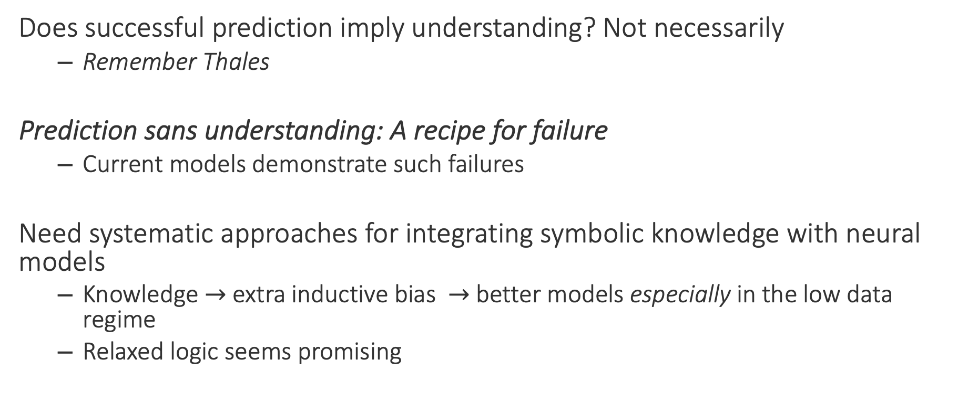
Final words
Does successful prediction imply understanding? Not necessarily
Remember Thales
Prediction sans understanding: A recipe for failure
Current models demonstrate such failures
Need systematic approaches for integrating symbolic knowledge with neural models
Knowledge $→$ extra inductive bias $→$ better models especially in the low data regime
Relaxed logic seems promising
Thanks! Questions?

