Slide 1

Dissecting NLP models and Mending them with Logic
Vivek Srikumar
Joint work with numerous collaborators

Slide 2
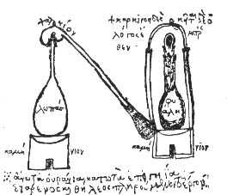
The Alchemy of BERTology
Convert input text into some output (could be labels or other text)
, ,…

Slide 3
Distribution over outputs
( , )
BERT
The name “BERT” is a stand-in for the entire BERT family of models: BERT, RoBERTa, etc.
Also, of course, NLP is not BERT, but…
( , )
Pre-trained
Fine-tuned
( , )
( , )
( , )
A labeled dataset
Input text
Labeled data
Pre-trained BERT
Fine-tuned BERT
Evaluate

Slide 4
Evaluation: Does a model mimic people well?
Typically:
Label accuracy, F-score, etc
BLEU, ROUGE, etc with respect to reference text
Other bespoke metrics to capture fidelity to human annotators
Manual evaluation
BERT
Can we do more?
Model evaluation should help us understand them better.
Looks at these two aspects and whether they are correct for each other

Slide 5
Example: Evaluation beyond accuracy
P John is on a train to Berlin.
H John is traveling to Berlin.
Z John is having lunch in Berlin.
P
No relationship?
Entails
H
Z
Contradicts
The same system cannot simultaneously hold these three beliefs!
Violates this invariant
If P entails H and H contradicts Z,
then P contradicts Z
Can today’s neural networks use such “theory” in the form of invariant knowledge?
A BERT-based model that gets ~90% on benchmark data violates this invariant on 46% of a large collection of sentence triples.

Slide 6
prediction
prediction
prediction
prediction
prediction
prediction
prediction
BERT
BERT
BERT
BERT
BERT
BERT
BERT
Standard evaluation: How good is the prediction for an example input?
How does a model react to controlled input changes?
Is a model self-consistent in its predictions over related examples?
What’s happening inside the black box?
New kinds of evaluation $→$ new ways to build models

Slide 7
This talk
Dissecting NLP models
Mending them
Tasks imply contracts
Declarative rules to guide model behavior
Peering into models with geometry

Slide 8
This talk
Dissecting NLP models
Mending them
Tasks imply contracts
Declarative rules to guide model behavior
Peering into models with geometry

Slide 9
An illusion of success?
Are we making progress in NLP?
Are we selectively exploring datasets where current models succeed?
Do our models fool us into thinking that they are better than they actually are?

Slide 10
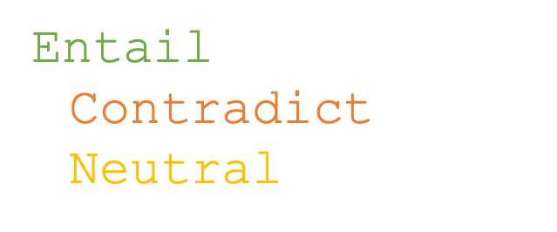
Tasks* define predicates
A different mental model
Example: The natural language inference task defines three predicates called Entail(P,H), Contradict(P,H) and Neutral(P,H)
P John is on a train to Berlin.
H John is traveling to Berlin.
Entail(P, H)
$¬$Contradict(P,H)
$¬$Neutral(P,H)
Labeled datasets show examples of these predicates
Models try to find the best fitting predicates given their arguments
* At least tasks that require labeling examples or parts of them

Slide 11
Task definition versus labeled datasets
Labeled datasets can be biased in their sampling of examples
Not necessarily deliberate or malicious
Such bias can percolate into models
But task specifications implicitly require two contracts from its predicates
Irrespective of what the training data contains, predicates defined for a task should
Generalize to new types of examples
Satisfy task-specific properties

Slide 12
A protocol for empirical evaluations
Generalization to new kinds of examples
Task definition
Training Dataset
Trained Model
Test set 1
Distributionally similar to training set
Test set 2
Differs from training-type data along specific aspect
Characterize model behavior along pre-defined aspects in addition to a standard test set
Multi-faceted evaluation should be built into the data creation process
Let’s look at two examples
Test set 3
Differs from training-type data along specific aspect
.
.
.

Slide 13
Two tasks and new datasets
Task 1: Making inferences about semi-structured data
We are great at understanding tabular data
Task 2: Multilingual fact checking
We are not really good at fact checking
The common theme: Seem to be beyond what existing models are capable of…but only if we evaluate carefully

Slide 14
We are great at understanding tabular data
Task 1: Understanding tables
Dressage
Highest governing body | International Federation for Equestrian Sports (FEI)
Characteristics
Contact | No
Team members | Individual and team at international levels
Mixed gender | Yes
Equipment | Horse, appropriate horse tack
Venue | Arena, indoor or outdoor
Presence
Country or region | Worldwide
Olympic | 1912
Paralympic | 1996
When phrases/numbers are placed in a tabular layout, we almost always automatically know how to interpret them correctly
We call upon prior knowledge about the world and common sense to understand such data
May compose multiple kinds of inferences

Slide 15
Idea: Test for reasoning using such tables
Task 1: Understanding tables
Dressage
Highest governing body | International Federation for Equestrian Sports (FEI)
Characteristics
Contact | No
Team members | Individual and team at international levels
Mixed gender | Yes
Equipment | Horse, appropriate horse tack
Venue | Arena, indoor or outdoor
Presence
Country or region | Worldwide
Olympic | 1912
Paralympic | 1996
From this table, what can we say about the following sentences?
“Both men and women compete in the sport of Dressage.”
The sentence is true
The sentence is not true
We can’t say one way or another
“FEI governs dressage only in the U.S.”
The sentence is true
The sentence is not true
We can’t say one way or another

Slide 16
Idea: Test for reasoning using such tables
Task 1: Understanding tables
Dressage
Highest governing body | International Federation for Equestrian Sports (FEI)
Characteristics
Contact | No
Team members | Individual and team at international levels
Mixed gender | Yes
Equipment | Horse, appropriate horse tack
Venue | Arena, indoor or outdoor
Presence
Country or region | Worldwide
Olympic | 1912
Paralympic | 1996
From this table, what can we say about the following sentences?
“Both men and women compete in the sport of Dressage.”
The sentence is true
The sentence is not true
We can’t say one way or another
“FEI governs dressage only in the U.S.”
The sentence is true
The sentence is not true
We can’t say one way or another

Slide 17
Idea: Test for reasoning using such tables
Task 1: Understanding tables
Dressage
Highest governing body | International Federation for Equestrian Sports (FEI)
Characteristics
Contact | No
Team members | Individual and team at international levels
Mixed gender | Yes
Equipment | Horse, appropriate horse tack
Venue | Arena, indoor or outdoor
Presence
Country or region | Worldwide
Olympic | 1912
Paralympic | 1996
From this table, what can we say about the following sentences?
“Both men and women compete in the sport of Dressage.”
The sentence is true
The sentence is not true
We can’t say one way or another
“FEI governs dressage only in the U.S.”
The sentence is true
The sentence is not true
We can’t say one way or another

Slide 18
INFOTABS: A one slide summary
Task 1: Understanding tables
Goal: To study reasoning about semi-structured, heterogeneous data
A new dataset styled after natural language inference:
Premises are infoboxes
Hypotheses are natural language statements
The task: Decide whether the hypothesis is true (entailed), false (contradicted) or undetermined (neutral) given a premise table
Collected using Mechanical Turk
InfoTabS: Inference on Tables as Semi-structured Data. Vivek Gupta, Pegah Nokhiz, Maitrey Mehta and Vivek Srikumar. ACL, 2020.
Is My Model Using The Right Evidence? Systematic Probes for Examining Evidence-Based Tabular Reasoning. Gupta et al. TACL, 2022.
https://infotabs.github.io

Slide 19
Evaluating on a single test set is not enough
Task 1: Understanding tables
Models may learn “easy” heuristics using artifacts in data
Need multiple test sets (of similar sizes) with controlled differences
𝛼1 | Similar lexical makeup and domains as the training data.
𝛼2 | Hypotheses from similar domains as 𝛼1, but with controlled lexical changes: entails become contradicts and vice-versa.
𝛼3 | Different domains from the training data
[TACL 2022] | Counterfactually modified premises and hypotheses

Slide 20
INFOTABS: A modeling challenge
Task 1: Understanding tables
Surprisingly good RoBERTa performance on the “unchallenging” 𝛼1 test set
Overfits to syntactic and lexical patterns in hypotheses
“Remembers” the pretraining a little too well: Fails on counterfactually modified examples
Inoculating with a little bit of challenge examples does not work
Maybe we need new kinds of models and representations that can handle semi-structured information
This model does not satisfy the task’s implied contract
Browse the data and download it at https://infotabs.github.io

Slide 21
We (i.e. people) are not really good at fact checking
Task 2: Fact checking
…at least not instinctively
Given enough time and resources, we (i.e. fact checkers) can verify claims
Maybe we can train statistical helpers for fact checking that classify claims as being legitimate or not?

Slide 22
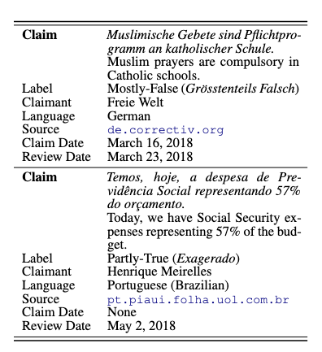
X-Fact: A multilingual dataset of claims
Task 2: Fact checking
31,189 short statements labeled for factual correctness by fact checkers
25 languages, 11 language families
Three test sets
𝛼1 | Same languages and sources as training set
𝛼2 | Same languages as training set, but different sources
𝛼3 | Unseen languages
X-FACT: A New Benchmark Dataset for Multilingual Fact Checking. Ashim Gupta and Vivek Srikumar. ACL 2021

Slide 23

How do models fare on this data?
Task 2: Fact checking
𝛼1 | Same languages and sources as training set
𝛼2 | Unseen news sources
𝛼3 | Unseen languages
Three kinds of models with mBERT
Claim only
Claim + search snippets
Claim + search snippets + metadata
What we found:
All three models do okay on the test set that looks like the training set (𝛼1), and are really bad on the others (𝛼2, 𝛼3)
On 𝛼1, with search snippets, the model performance is better than what a human annotator did with the same snippets!
Augmenting with another 10k English claims doesn’t help
This model does not satisfy the task’s implied contract
Download the data
utahnlp/x-fact

Slide 24

Task specifications $→$ two contracts on predicates
Irrespective of what the training data contains, predicates defined for a task should
Generalize to new types of examples
Satisfy task-specific properties

Slide 25

Model behavior as constraints (1/2)
Expected behavior for NLI: “If a sentence P entails a sentence H, and H entails the sentence Z, then P entails Z”
$$∀ \text{sentences} P, H, Z, \text{Entail}\left(P, H\right)∧\text{Entail}\left(H, Z\right)→\text{Entail}(P, Z)$$
Four such valid transitivity constraints exist
Fine-tuned BERT is inconsistent with the constraints on ~15% of a large collection of such unlabeled triples
A Logic-Driven Framework for Consistency of Neural Models. Li, Gupta, Mehta and Srikumar. EMNLP, 2019.

Slide 26

Model behavior as constraints (2/2)
Task-specific properties
Expected behavior for NLI: “The contradict predicate is symmetric.”
$$∀ \text{sentences} P, H, \text{Contradict}\left(P, H\right)↔\text{Contradict}(H,P)$$
Fine-tuned BERT is inconsistent with the constraint on ~59% of a large collection of such unlabeled triples
A Logic-Driven Framework for Consistency of Neural Models. Li, Gupta, Mehta and Srikumar. EMNLP, 2019.

Slide 27
General recipe for evaluating a model
Task definitions can be accompanied by invariants about its predicates
Formalize the invariants as rules
Collect an corpus (depending on the rules, all we may need is an unlabeled corpus)
Measure inconsistency in addition to standard accuracy

Slide 28
Task specifications $→$ two contracts on predicates
Irrespective of what the training data contains, predicates defined for a task should
Generalize to new types of examples
Satisfy task-specific properties

Slide 29
This talk
Dissecting NLP models
Mending them
Tasks imply contracts
Declarative rules to guide model behavior
Peering into models with geometry

Slide 30
Learning from examples
knowledge

Slide 31
Knowledge can augment data
is
Good datasets are not easy to make. Takes time, costs money
Easy to write rules about model behavior (or their internal “beliefs”)
Statements in logic (often universally quantified) that express invariants or inference rules
Examples of rules
Transitivity: “If a sentence P entails a sentence H, and H entails the sentence Z, then P entails Z”
Task knowledge: “For the task of semantic role labeling, for any verb, certain argument labels cannot occur more than once”

Slide 32
Neural network land vs. Logic land
Neural Networks
✓Differentiable compute, easy to use
✗ Hard to supervise except via labeled examples
First-order logic
✗ Not differentiable, hard to use with today’s best infrastructure
✓ Expressive and easy to state for domain experts
What we want: Best of both!

Slide 33
Three challenges facing logic in neural network land
Bridging predicates in rules with neural networks
Making logic differentiable
Using differentiable logic

Slide 34
Predicates in neural networks
All neural networks expose interfaces in the form of nodes that have externally defined meaning

Slide 35
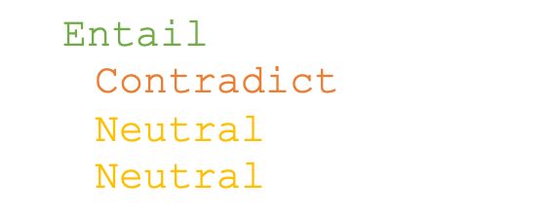
Recall: Labels are predicates
Entail
P John is on a train to Berlin.
H John is traveling to Berlin.
BERT
=
Entail(P, H)
P,H
Labeled datasets are formal specifications
(P1, H1, Entail)
(P2, H2, Contradict)
(P3, H3, Neutral)
(P4, H4, Neutral)
$$\text{Entail}\left(P1, H1\right)∧\text{Contradict}(P2, H2)∧\text{Neutral}(P3, H3)∧\text{Neutral}(P4, H4)$$
=

Slide 36
Named neurons
Nodes in a computation graph that have externally defined meaning
Named neurons can be:
Any output nodes in the network
Inputs to the network
Sometimes, internal nodes that have defined behavior
Named neurons give us the vocabulary for writing rules

Slide 37
Three challenges facing logic in neural network land
Bridging predicates in rules with neural networks?
Answer: Named neurons, nodes in a computation graph that have externally defined meaning
Making logic differentiable?
Using differentiable logic?

Slide 38

Relaxing Boolean operators
Triangular norms provide systematic relaxations of logic
Some are continuous and sub-differentiable
Inputs, outputs live in {0,1}
 | Boolean logic
Not | $$¬A$$
And | $$A∧B$$
Or | $$A∨B$$
Implies | $$A→B$$
Klement, Erich Peter, Radko Mesiar, and Endre Pap. Triangular norms. Vol. 8. 2013.

Slide 39
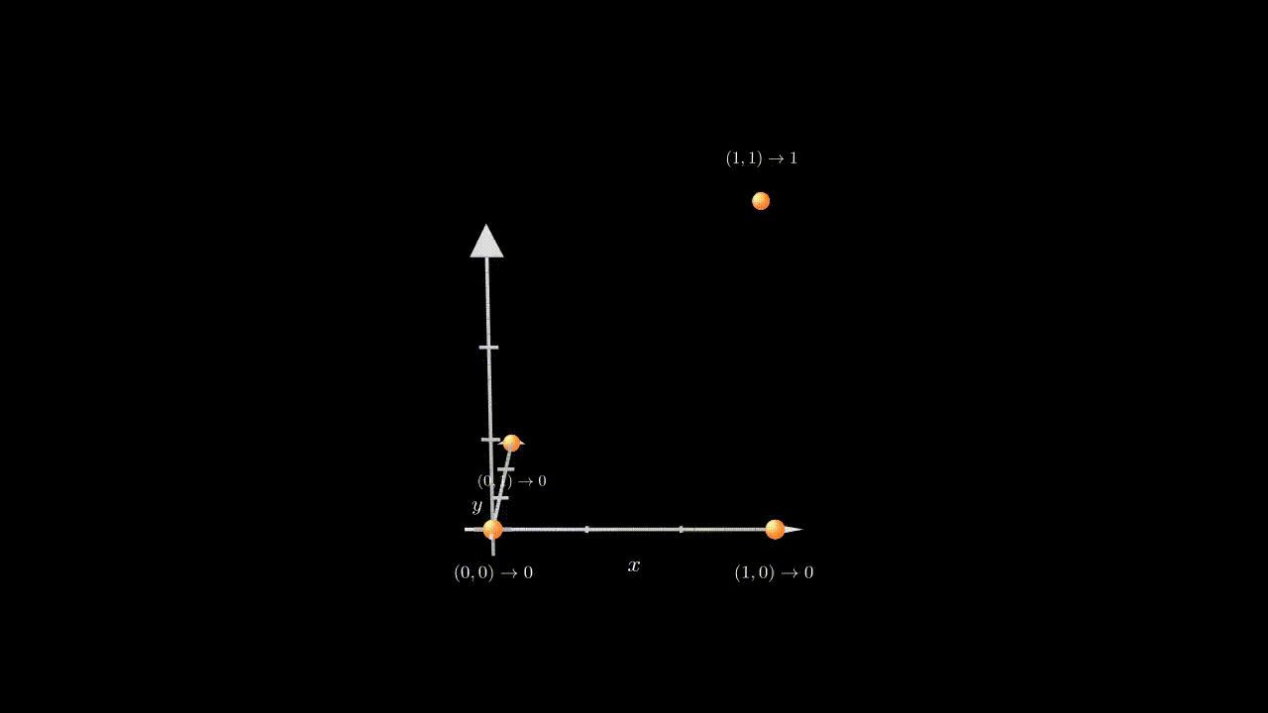
Relaxing the Boolean conjunction

Slide 40
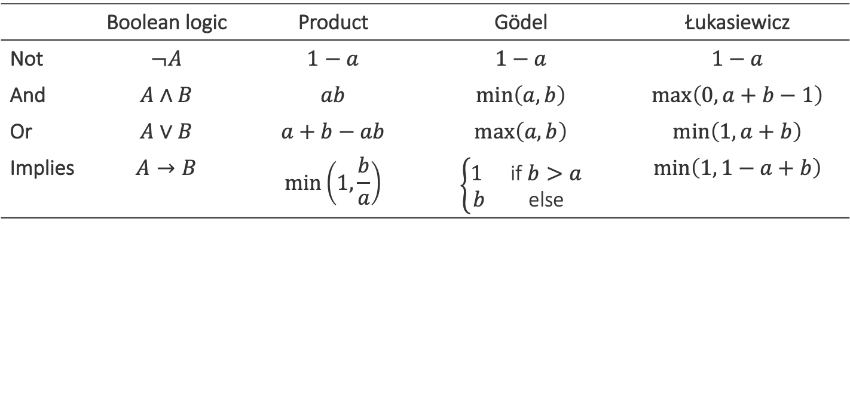
Relaxing Boolean operators
Triangular norms provide systematic relaxations of logic
Some are continuous and sub-differentiable
Inputs, outputs live in {0,1}
Inputs, outputs live in [0,1]
 | Boolean logic | Product | Gödel | Łukasiewicz
Not | $$¬A$$ | $$1−a$$ | $$1−a$$ | $$1−a$$
And | $$A∧B$$ | $$ab$$ | $$\min\left(a,b\right)$$ | $$\max\left(0, a+b−1\right)$$
Or | $$A∨B$$ | $$a+b−ab$$ | $$\max\left(a, b\right)$$ | $$\min\left(1, a+b\right)$$
Implies | $$A→B$$ | $$\min\left(1,\frac{b}{a}\right)$$ | $$\left\{\begin{matrix}1 & \text{if} b>a \\ b & \text{else}\end{matrix}\right.$$ | $$\min\left(1, 1−a+b\right)$$
Klement, Erich Peter, Radko Mesiar, and Endre Pap. Triangular norms. Vol. 8. 2013.

Slide 41
Three challenges facing logic in neural network land
Bridging predicates in rules with neural networks?
Answer: Named neurons
Making logic differentiable?
Answer: Use a t-norm
Using differentiable logic?

Slide 42
What logic can do for neural networks?
Introduce inductive bias by…
…changing network architecture
to networks that prefer satisfying the constraints
…by regularizing learning
to penalize models that violate the constraints

Slide 43
What logic can do for neural networks?
Introduce inductive bias by…
…changing network architecture
to networks that prefer satisfying the constraints
…by regularizing learning
to penalize models that violate the constraints
Augmenting Neural Networks with First-order Logic. Li and Srikumar. ACL 2019.

Slide 44
What logic can do for neural networks?
Introduce inductive bias by…
…changing network architecture
to networks that prefer satisfying the constraints
…by regularizing learning
to penalize models that violate the constraints
A Logic-Driven Framework for Consistency of Neural Models. Li, Gupta, Mehta and Srikumar. EMNLP, 2019.
Structured Tuning for Semantic Role Labeling. Li, Jawale, Palmer and Srikumar. ACL, 2020.
Evaluating Relaxations of Logic for Neural Networks: A Comprehensive Study. Medina-Grespan, Gupta, Srikumar. IJCAI 2021.

Slide 45

Unifying data & knowledge
Labeled data = propositions about examples
Knowledge can be written as rules
e.g. $∀ P, H, Z, Entail\left(P,H\right)∧Entail\left(H, Z\right)→Entail\left(P, Z\right)$
Universally quantified
Labeled examples and constraints are, together, a collection of rules of the form
$$∀x, L\left(x\right)→R(x)$$

Slide 46

Encouraging consistency of models
$$∀x, L\left(x\right)→R(x)$$
Learning goal: Prefer models that set all the rules of this form to be true
Or alternatively: Find models maximize a t-norm relaxation
Labeled data + knowledge
Inconsistency losses
Use any neural model, any library and any optimizer
Product t-norm + labeled examples gives cross entropy loss

Slide 47
Do rules help neural networks?

Slide 48

Inconsistency of natural language inference
Case study: Regularizing learning
BERT based models for SNLI & MultiNLI datasets
Two kinds of regularizers from constraints:
Symmetry constraint:
$$∀P, H, Contradict\left(P,H\right)↔Contradict(H, P)$$
Four transitivity constraints of the form
$$Entail\left(P,H\right)∧Entail\left(H, Z\right)→Entail\left(P, Z\right)$$

Slide 49
Results: Inconsistency of natural language inference
Case study: Regularizing learning
Inconsistency represents violation of constraints. Lower is better.
1. Merely adding more data does not make models consistent
2. Logic-based regularizers help with consistency

Slide 50
Knowledge via soft logic helps neural models
Successful experiments across many different tasks
Natural language inference
Question answering
Text chunking
Semantic role labeling
Joint digit recognition and numerical operations over them
Information extraction
General flavor of results
When we have less data, knowledge gives better statistical models
We can “inject” invariances into learned systems…
…which are sometimes not learned, even with lots of data
Check out pylon: A PyTorch Framework for Learning with Constraints (https://pylon-lib.github.io/)

Slide 51
This talk
Dissecting NLP models
Mending them
Tasks imply contracts
Declarative rules to guide model behavior
Logic ✓
Peering into models with geometry
Geometry

Slide 52
Can we examine how labels carve up a representation?
prediction
BERT

Slide 53
Motivation
With the right representation, no task is complex
With the wrong representation, no task is simple
Training classifiers partitions BERT’s internal representations into regions corresponding to labels
Can we tell what makes a representation good for a task?
We can’t rely on classifier performance for this

Slide 54

Good classifier $⇒$ good representation But bad classifier $⇏$ bad representation
Maybe we got unlucky with our random seed
Maybe we didn’t find the right hyperparameter
Maybe we didn’t find the right architecture
Maybe the learner didn’t converge

Slide 55
The geometry of a classifier
Each classifier for is a hypersurface in a high dimensional feature space
When we probe with a classifier, we pick one of many good classifiers
Claim: A good representation supports more simpler and better classifiers than a bad one

Slide 56

Characterizing representations
Definition: $ε$-Version Space of a representation and a dataset
The set of all classifiers that can that can achieve error less than $ε$ on the given dataset, using the representation
This is an infinite set…
…but we can measure its properties to help us understand the quality of a representation

Slide 57

What can we say without enumerating all models?
Every successful classifier should pass through the shaded region
That is, every element of the $ε$-version space passes through this region
Let us build a piecewise linear approximation of this region by clustering points with the same labels

Slide 58
Convex clusters of labeled points
Every successful classifier should pass through the shaded region
That is, every element of the $ε$-version space passes through this region
Let us build a piecewise linear approximation of this region by clustering points with the same labels

Slide 59

Understanding the $ε$-version space by clustering
Three criteria:
Each cluster only contains points with the same label
There should be no overlaps between convex hulls of different clusters
We want as few clusters as possible

Slide 60
DirectProbe: A heuristic
Initialize each point to be its own cluster
Merge the closest clusters if
They have the same label, and
The convex hull of the merged cluster does not overlap with other labels
Repeat till no clusters can be merged
Merge these two?

Slide 61


$ε$-version space $→$ regions between labels $→\text{DirectProbe}$
To study a representation for a task, the set of interest is the set of all classifiers that give low error on it: $ε$-version space
An infinite set
Every classifier in the $ε$-version space should pass through the region between labels
DirectProbe: A heuristic that groups points so that the clusters don’t enter this region
Yichu Zhou and Vivek Srikumar. "DirectProbe: Studying Representations without Classifiers.”, NAACL 2021

Slide 62
What can the clusters tell us? (1/3)
Experiments on several NLP tasks:
POS tagging
preposition supersense function and role
dependency labels
semantic relations between nominals
text classification
Number of clusters = number of labels: A linear classifier will get perfect accuracy on the data
Surprisingly not the case for RoBERTa with POS tagging!
Yichu Zhou and Vivek Srikumar. "DirectProbe: Studying Representations without Classifiers.”, NAACL 2021

Slide 63
What can the clusters tell us? (2/3)
Conjecture: Larger version space admits more good classifiers, and better generalization.
The minimum distance between clusters of different labels tells us how much room there is for a classifier to be found accidentally
Distances predict that higher layers of BERT, etc are typically better, but not always. Agrees with classifier probes
Labels whose clusters are closer to each other are more confused
Yichu Zhou and Vivek Srikumar. "DirectProbe: Studying Representations without Classifiers.”, NAACL 2021

Slide 64
What can the clusters tell us? (3/3)
Fine tuning pushes labels away from each other, and groups them into fewer clusters
Increases minimum distance between clusters
Fine tuning for one task improves performance for related tasks, but can hurt some other tasks
Cluster distances predict this observation. Fun experiment
Higher layers change more during fine-tuning than lower layers
The relative geometric positions of clusters don’t change much after fine tuning
They are pushed apart, but moved around only if necessary
Yichu Zhou and Vivek Srikumar. "A closer look at how fine-tuning changes BERT.”, ACL 2022

Slide 65
DirectProbe: A summary
Studying the geometry of a representation for a task opens the doors for understanding what tasks can be successful on it
DirectProbe: A heuristic for doing this
Download and play with a python implementation
prediction
BERT
utahnlp/directprobe

Slide 66
Final words
Dissecting NLP models
Mending them
Tasks imply contracts
Declarative rules to guide model behavior
A declarative perspective for understanding and improving models
Evaluating task contracts
Inconsistency losses
Peering into models with geometry
Characterizing learned representations without having to train classifiers
Questions?
DirectProbe

